Slide 1
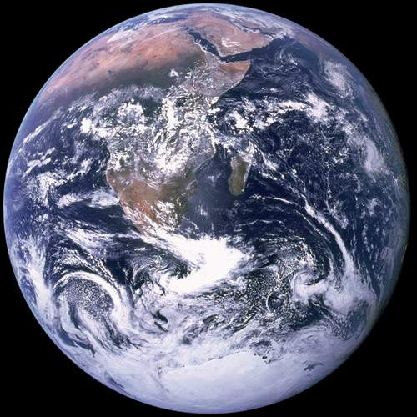
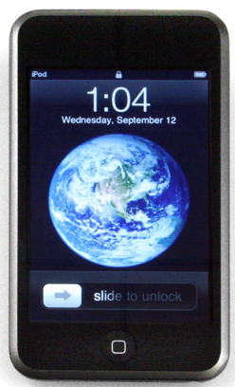
Mobile Learning as a Tool for Enhancing Student Learning
in Geosciences
Sam Matson
Department of Geosciences
Boise State University

Slide 2
Can mobile technology….
– be used to engage students in large lectures?
– be used as an alternative to traditional computers in a lab setting?
– be used for formative and summative assessment in a lab setting?
Setting:
Spring, 2011
– 37 students
– GEOS 102 – Historical Geology
– iPod touch (1 per student)
Fall, 2011
– 250 students
– GEOS 100 – Fundamentals of Geology
– GEOS 101 – Global Environmental Science
– iPad (1 per 4 students in lab)

Slide 3
All else being equal, P-waves traveling through more dense materials should travel _______ P-waves traveling through less dense materials.
Can mobile technology be used to engage students in large lectures?
Example clicker/ResponseWare slide from GEOS 100…
faster than
slower than
the same speed as
V_{p} = velocity of P wave
μ = “rigidity” of material
(shear modulus)
ρ = density of material
k = “incompressibility” of material (bulk modulus)
15

Slide 4
Can mobile technology be used to engage students in large lectures?
ADVANTAGES:
– Students have immediate access to information
– Mobile technology enhances lecture capture (vodcast, podcast, etc.)
– ResponseWare is an affordable alternative to clickers
– RW license: $17 per year; $35 per 4 years
– Clicker: $60+
– ResponseWare is versatile
– Students can send messages with their responses
– Can be used for distance learning
– Available for Blackberry, Android, iPhone/iPod/iPad, laptop
LIMITATIONS:
– Requires robust wireless internet connection
– Extra setup logistics

Slide 5
Can mobile technology be used as an alternative to traditional computers in a lab setting?

Slide 6
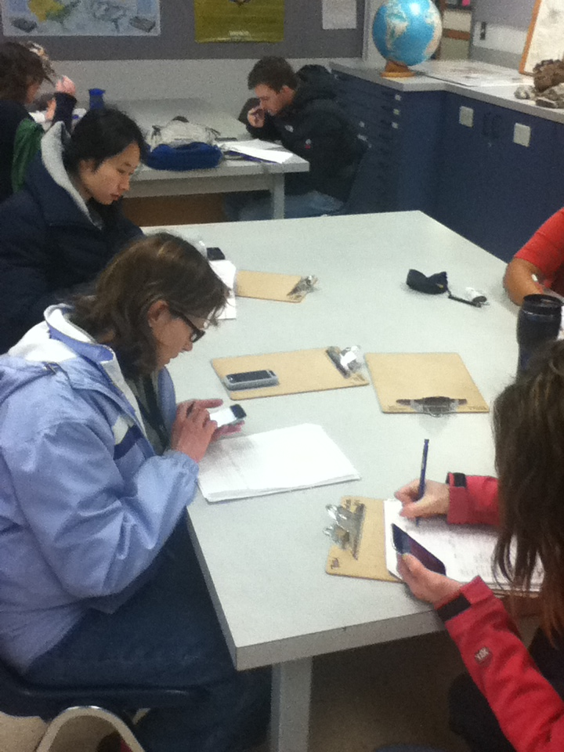
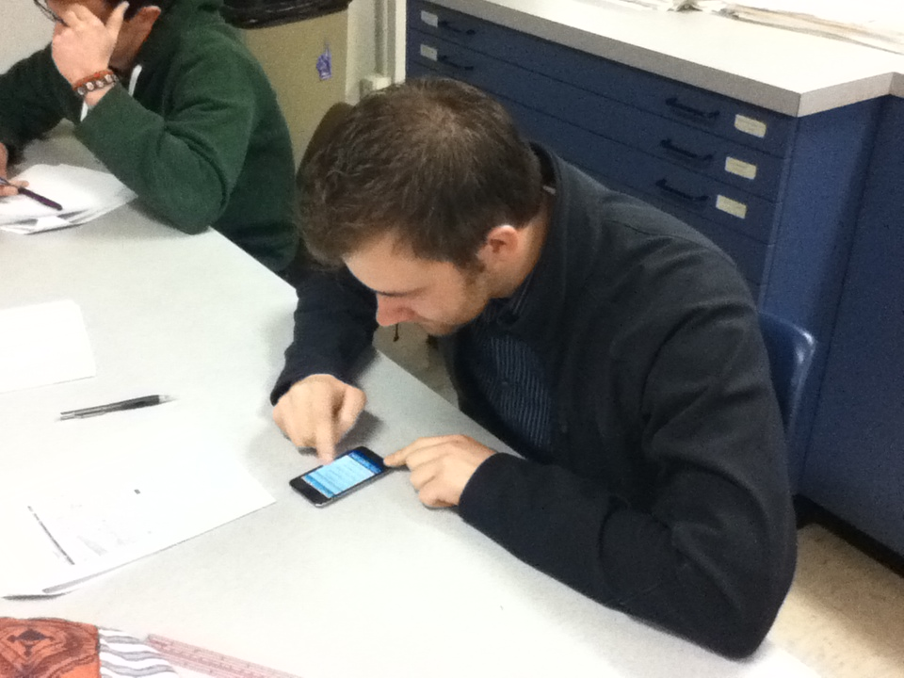
Can mobile technology be used as an alternative to traditional computers in a lab setting?

Slide 7
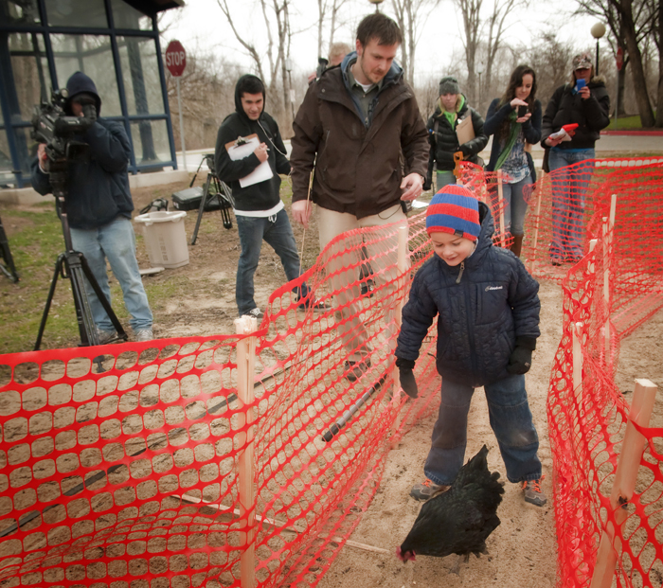
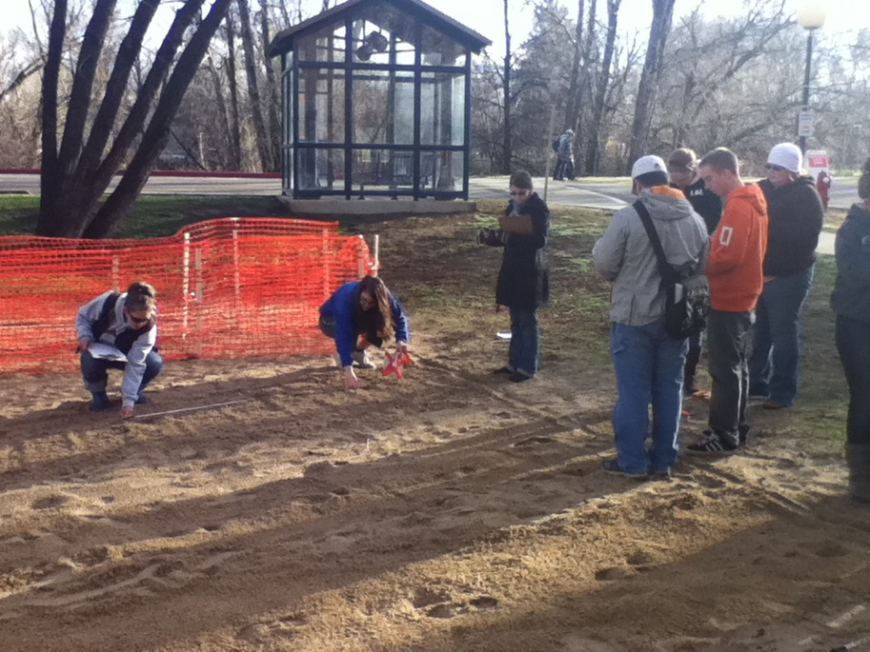
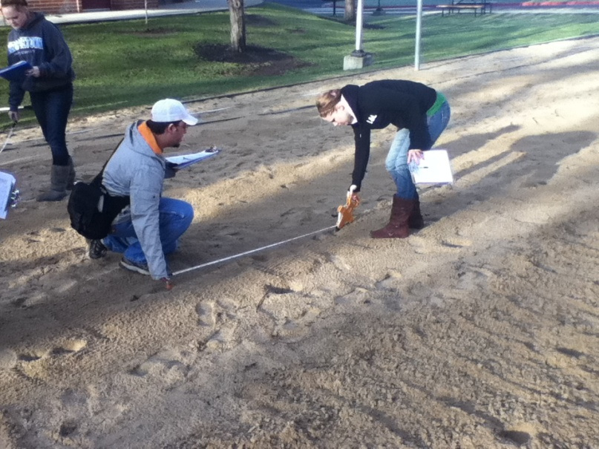
Can mobile technology be used as an alternative to traditional computers in a lab setting?

Slide 8
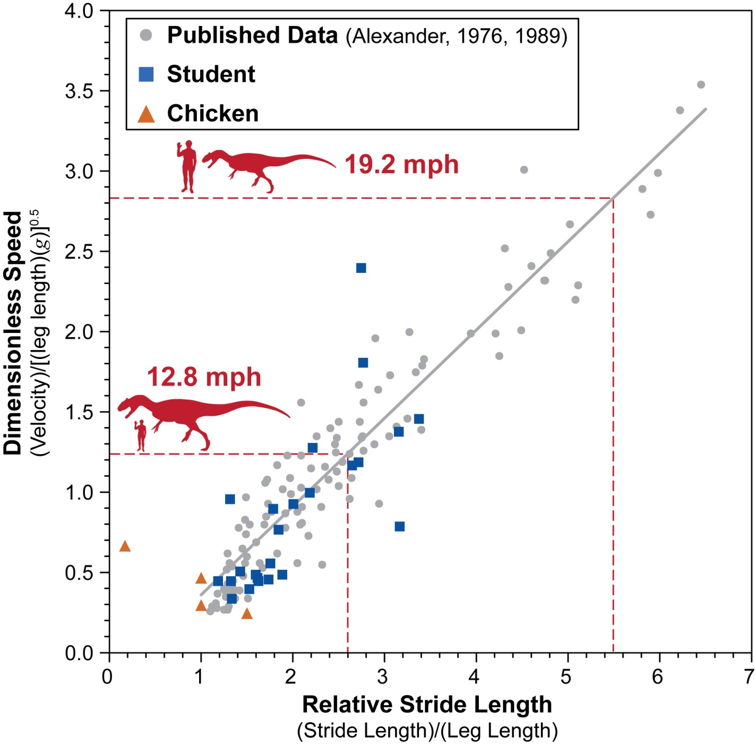
Can mobile technology be used as an alternative to traditional computers in a lab setting?

Slide 9
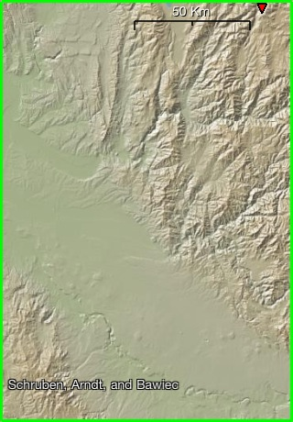
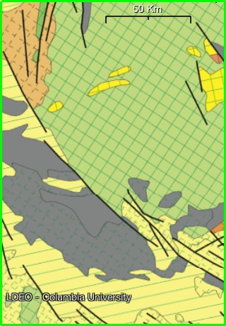
Shaded Relief and Geologic Maps of the Treasure Valley

Slide 10
Can mobile technology be used as an alternative to traditional computers in a lab setting?
ADVANTAGES:
– Apps have basic functionality of desktop software
– Spreadsheet (Numbers, Office², Documents 2)
– Graphing (Numbers, 123 Charts, Graph)
– Statistics (Numbers, Statistical)
– Discipline-specific apps exist
– Satellite imagery (Google Earth, Measure Map, KMZ Loader)
– Remote sensing data (EarthObserver)
– Topographic Maps (Topo Maps, Google Maps)
– Geologic Maps (Geology ID, Geology MT, etc.)
– Stratigraphy (iGeoLog)
– Seismology (iSeismo)
LIMITATIONS:
– Need to adapt to a very different user interface
– File management?
– Handheld devices limited by screen size

Slide 11
Can mobile technology be used for formative and summative assessment in a lab setting?

Slide 12
Can mobile technology be used for formative and summative assessment in a lab setting?
ADVANTAGES:
– Blackboard app is very user-friendly
– Students have immediate feedback
– stimulus for student-instructor dialogue
– Can be used for broader assessment
– University Foundations?
– comparison across lab instructors
LIMITATIONS:
– Handheld devices limited by screen size

