Slide 1
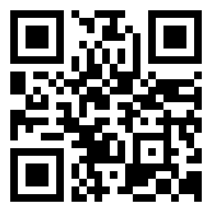
QR Codes: A Guide for Libraries
Memo Cordova
#ILA 11
Twitter: m3mo

Slide 2
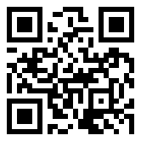
Twitter: m3mo

Slide 3
Twitter: m3mo

Slide 4
2D Barcode Encoded info Phone camera Scanner app
Twitter: m3mo

Slide 5
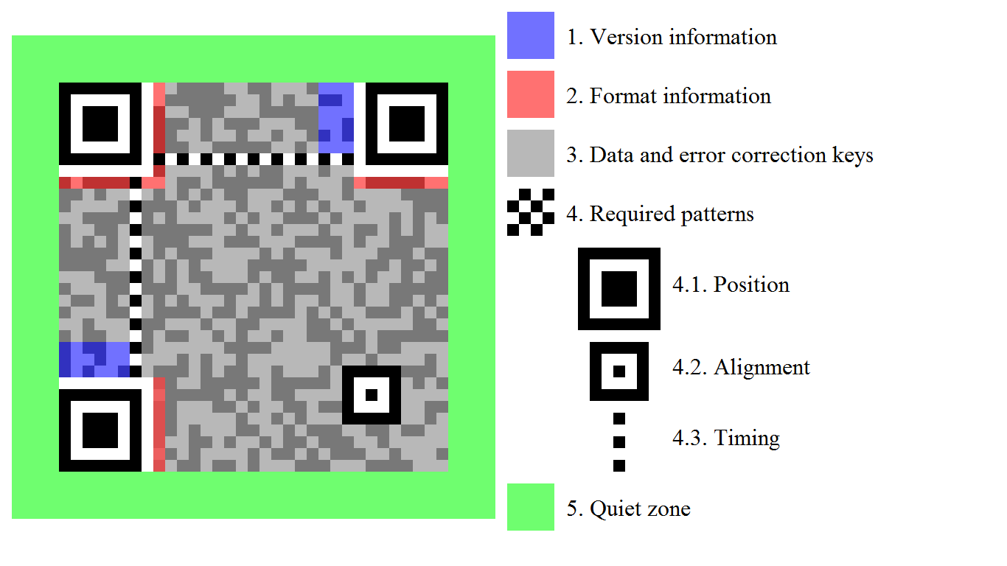
http://en.wikipedia.org/wiki/QR_code

Slide 6
=

Slide 7
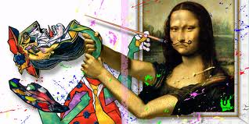
=

Slide 8
“A Mobile’s Secret Decoder Ring” http://goo.gl/0evMA
Twitter: m3mo

Slide 9
Stick it where?
Twitter: m3mo

Slide 10
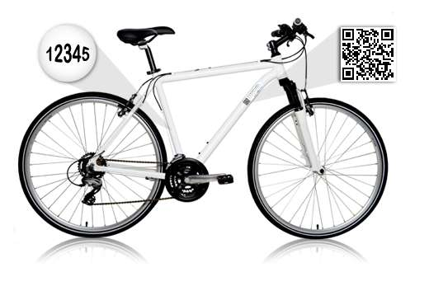
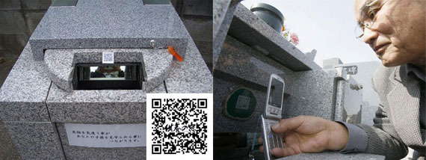
http://goo.gl/Vy7w8
http://goo.gl/0rlU4
Twitter: m3mo

Slide 11
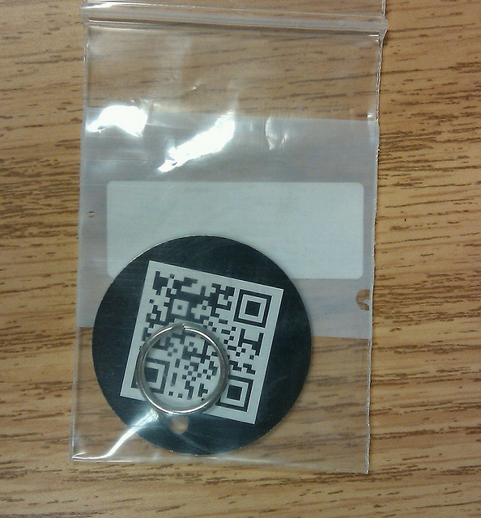
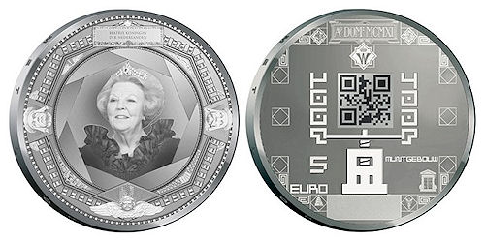
http://goo.gl/zRQkB
Twitter: m3mo

Slide 12
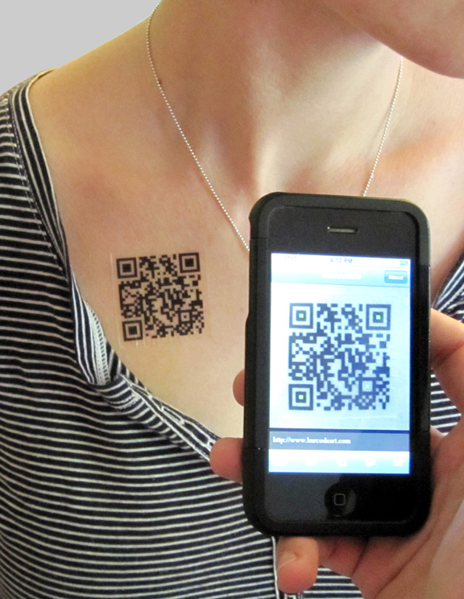
http://goo.gl/0rlU4
Twitter: m3mo

Slide 13
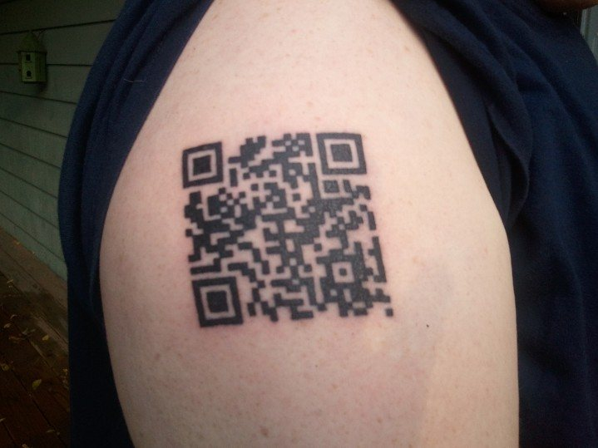
http://goo.gl/PyiIr
Twitter: m3mo

Slide 14
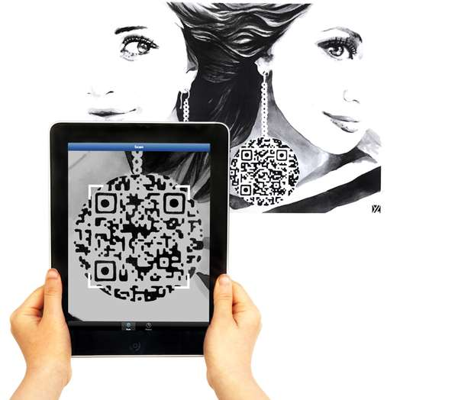
http://goo.gl/4eqOb
Twitter: m3mo

Slide 15
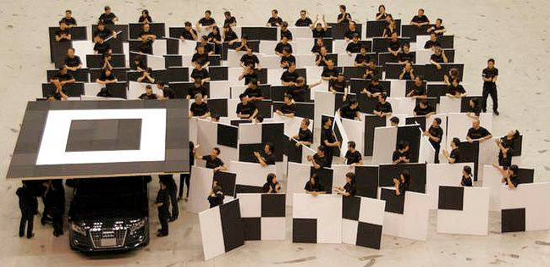
http://2d-code.co.uk/audi-qr-code/
Twitter: m3mo

Slide 16
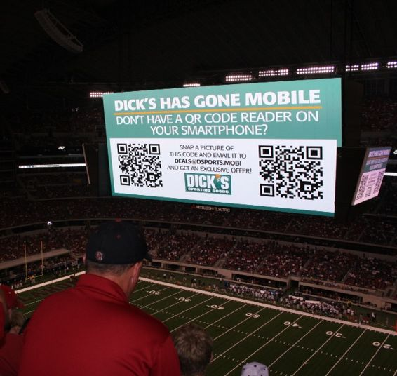
http://2d-code.co.uk/hdtv-qr-code/

Slide 17
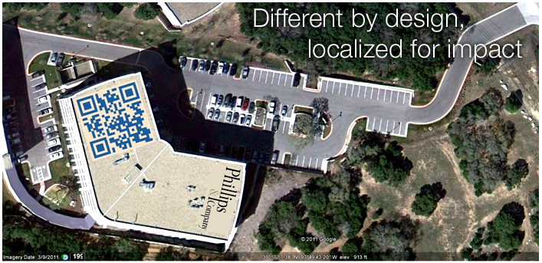
http://bluemarblebrand.com/

Slide 18
QR Codes for libraries
Twitter: m3mo

Slide 19
Possibilities Point of need Presentation
Twitter: m3mo

Slide 20
Use short links (Bit.ly) Simple design Link: mobile page Test. Test. Test.
Twitter: m3mo

Slide 21
1”
1”

Slide 22
1”
1”

Slide 23
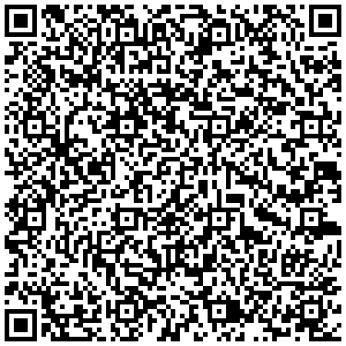

Slide 25
Library entrance - link to library’s mobile website or a specific page (hours, Circulation, reference phone number, etc.). Near the stairs or elevators - linked to a map or specific section of the library (floor plan, etc.). Near displays - linked to a collection of new books or takes the user to an RSS feed of newly purchased library materials. Reference desk - linked to an email, text, or chat reference service. Librarian’s door or window - linked to personal profile or subject guide. Circulation desk - linked to checkout procedures, fine information, etc. Collection areas - linked to more information about the collection. Outside study or meeting rooms - linked to room policies. Handouts/flyers
Physical spaces
Twitter: m3mo

Slide 26
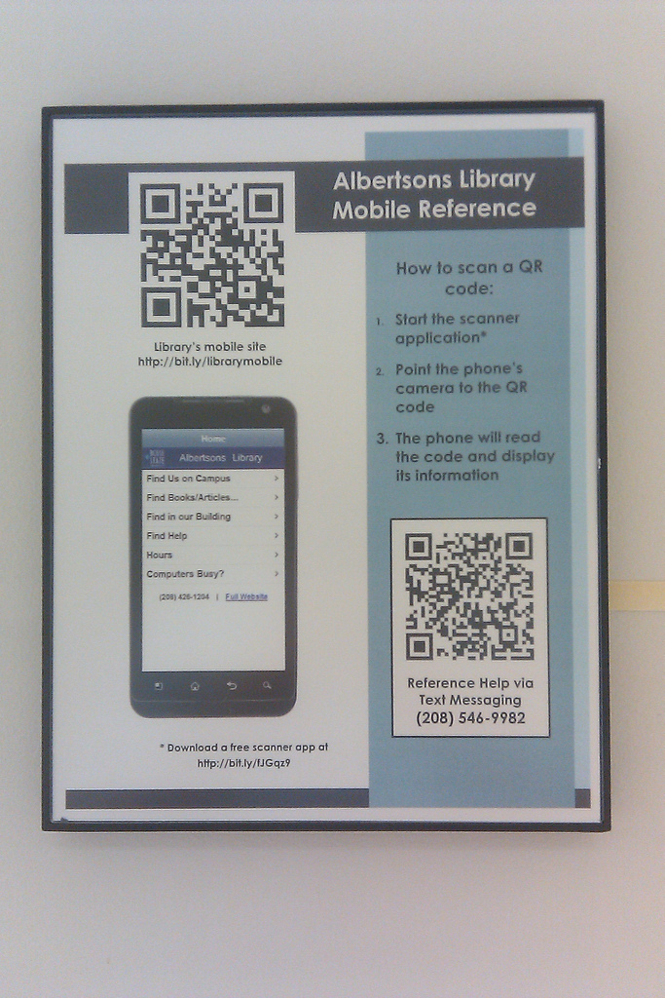
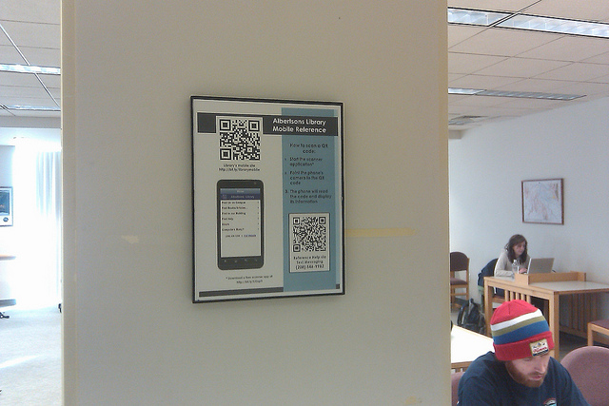
Twitter: m3mo

Slide 27
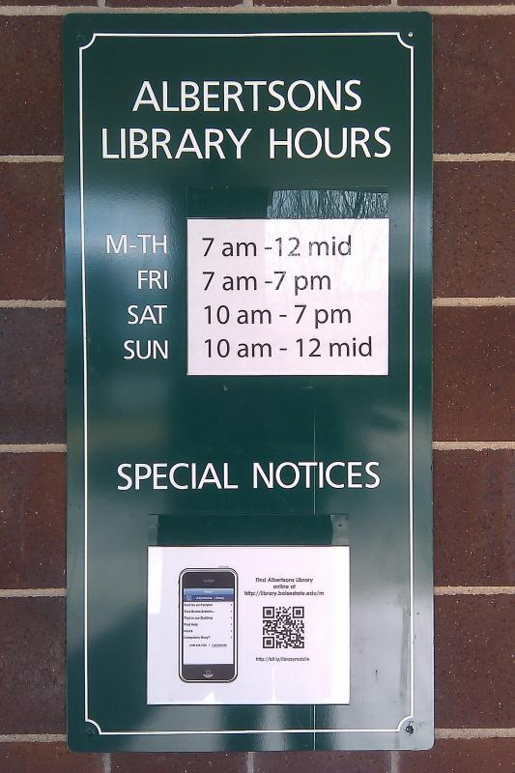
Twitter: m3mo

Slide 28
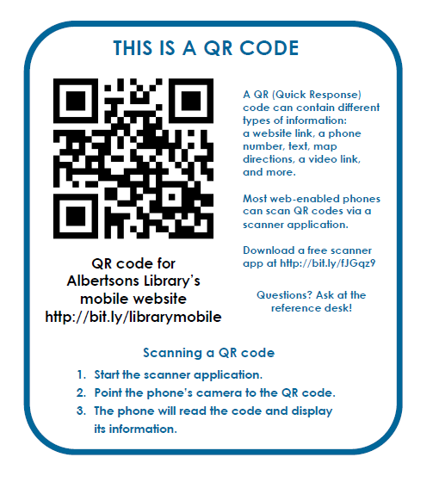
Twitter: m3mo

Slide 29
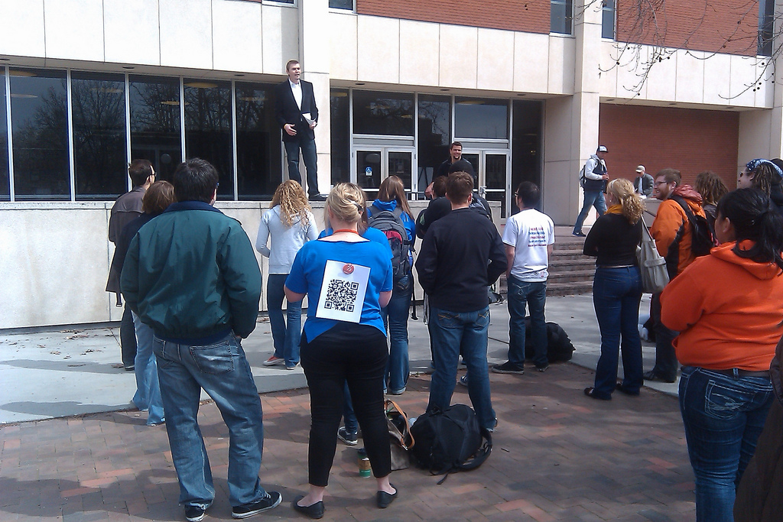
Twitter: m3mo

Slide 30
Twitter: m3mo

Slide 31
Main library website Projected on digital frames Library subject guides Staff web pages Subject-specific database pages Librarian profiles
Online spaces
Twitter: m3mo

Slide 32
QR Code tools
Twitter: m3mo

Slide 33
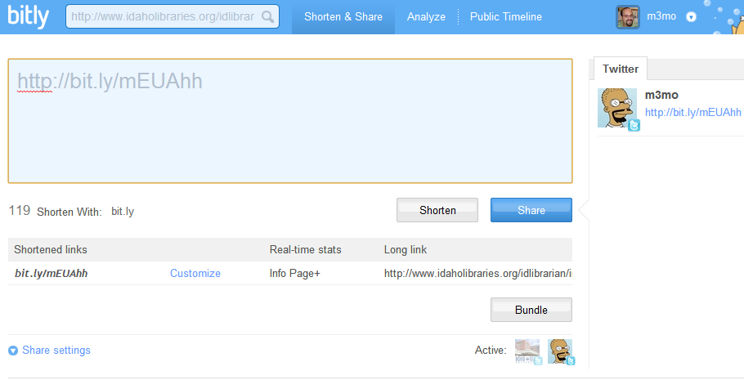
http://bitly.com/
http://bitly.com/

Slide 34
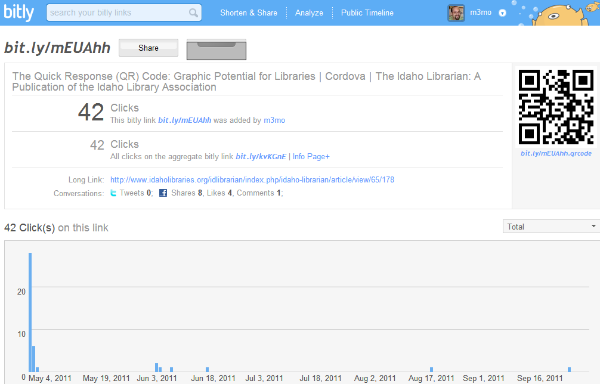

Slide 35
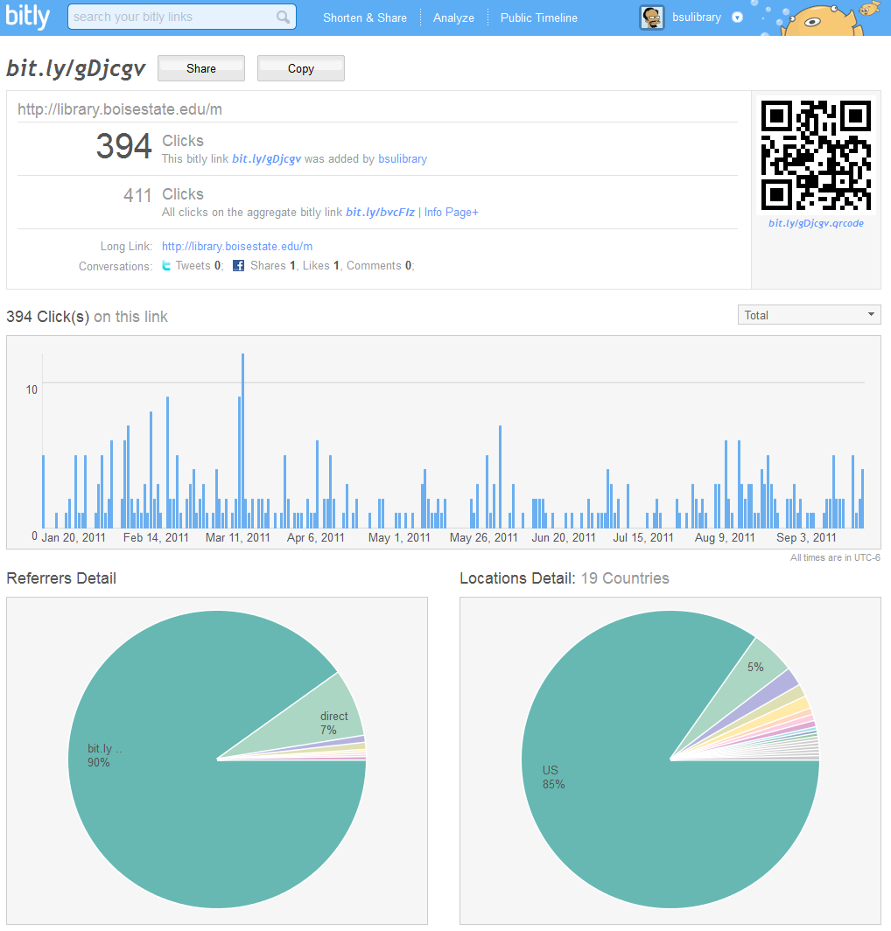

Slide 36
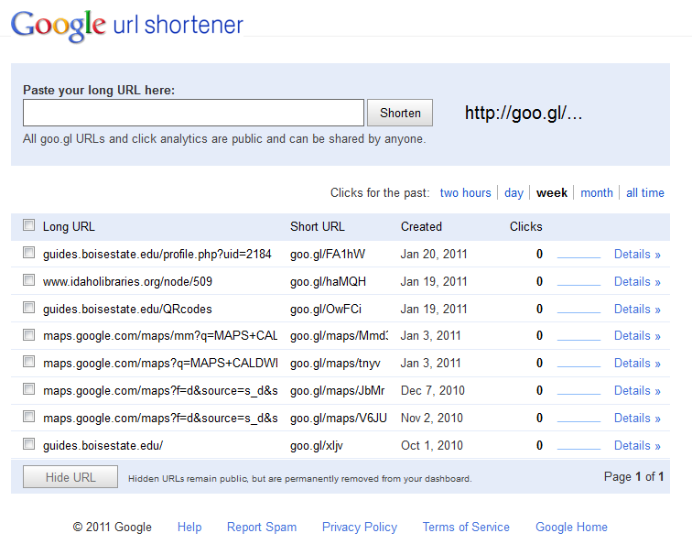
http://goo.gl/

Slide 37
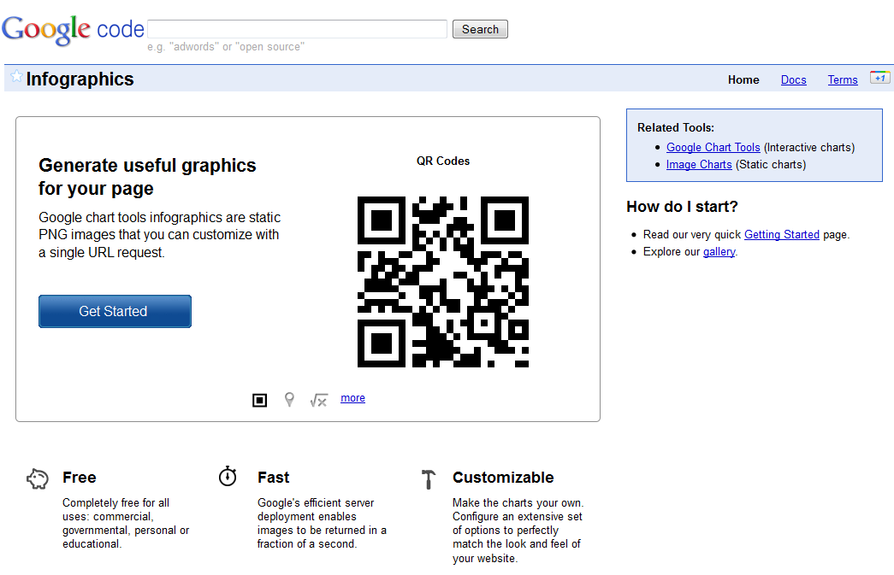
http://code.google.com/apis/chart/infographics/

Slide 38
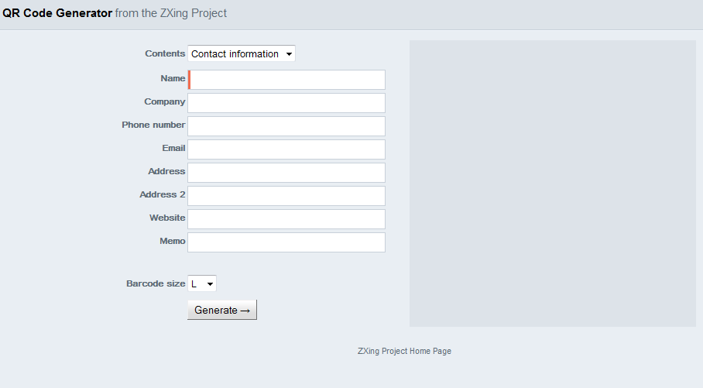
http://zxing.appspot.com/generator/

Slide 39
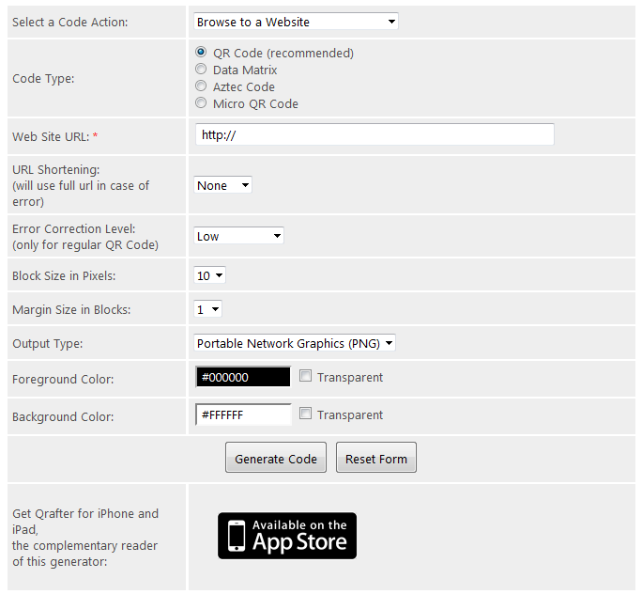
http://bit.ly/pzUx5Z

Slide 40
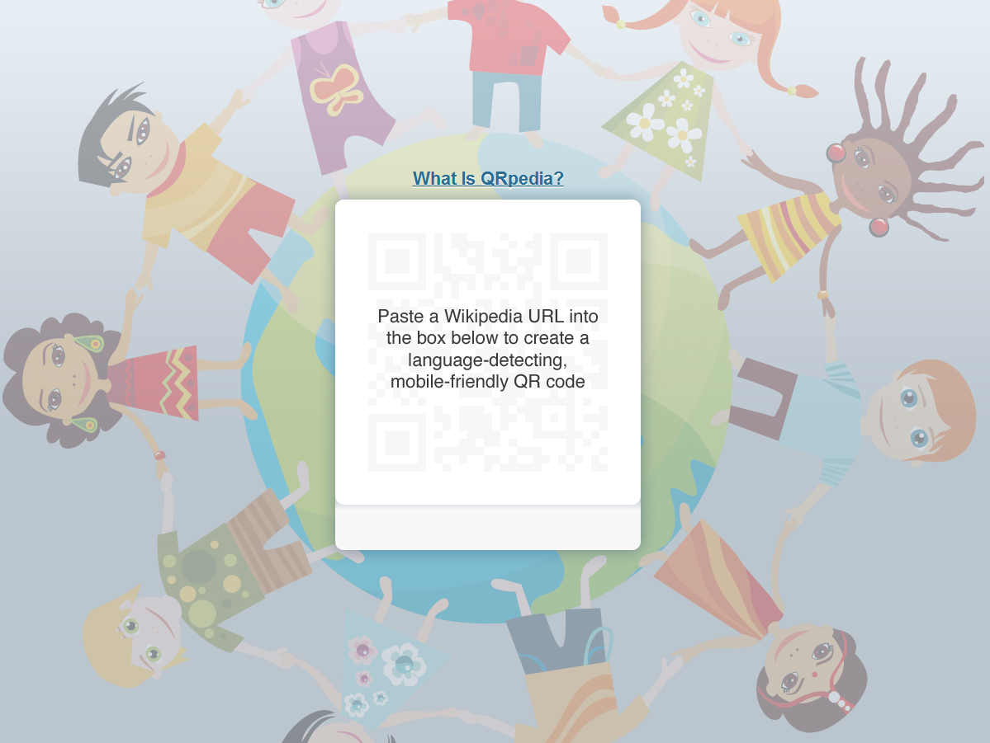
qrpedia.org

Slide 41
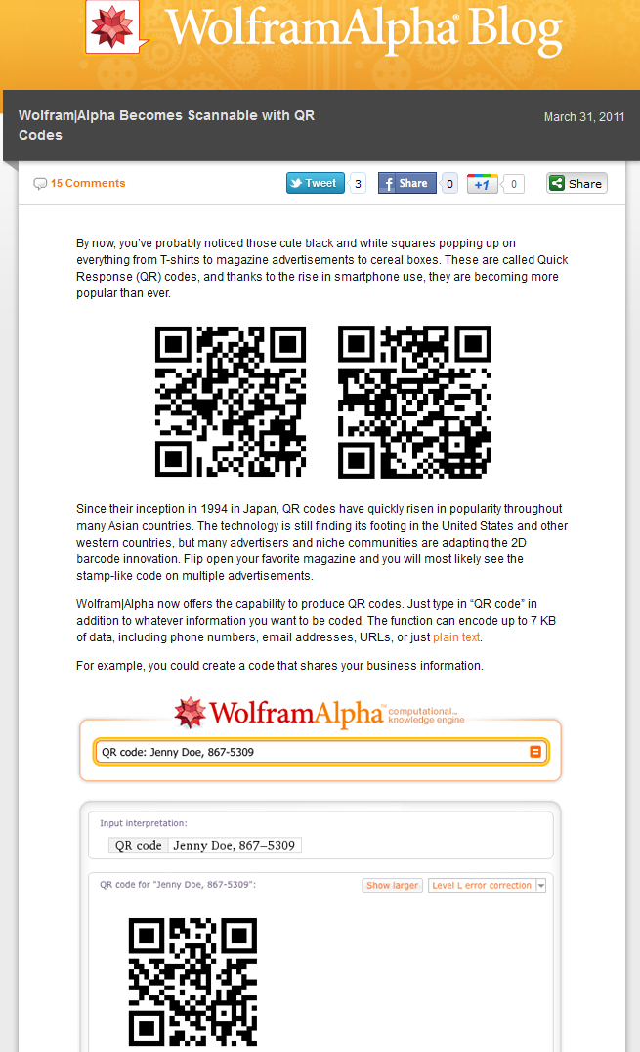
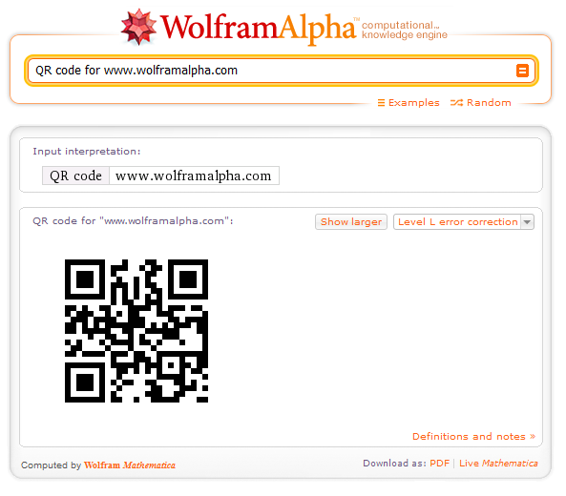
Twitter: m3mo

Slide 42
http://www.classtools.net/QR/index.php

Slide 43
Scanners - Readers
Twitter: m3mo

Slide 44
Barcode
Scanner
QuickMark
QR Droid
RedLaser
Google Goggles
NeoReader

Slide 45
No Scanner?
www.jagtag.com
http://snapmyinfo.com
www.scanlife.com
Twitter: m3mo

Slide 46
Mobilize your stuff
Twitter: m3mo

Slide 47
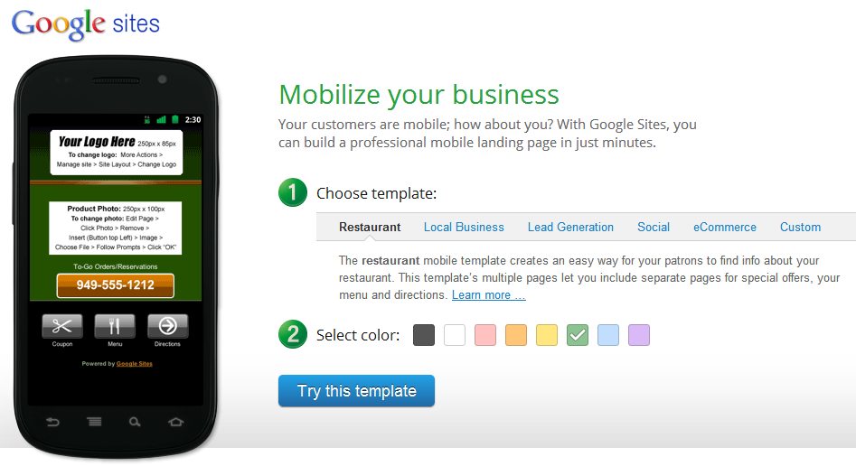
http://goo.gl/0oL6w
Twitter: m3mo

Slide 48
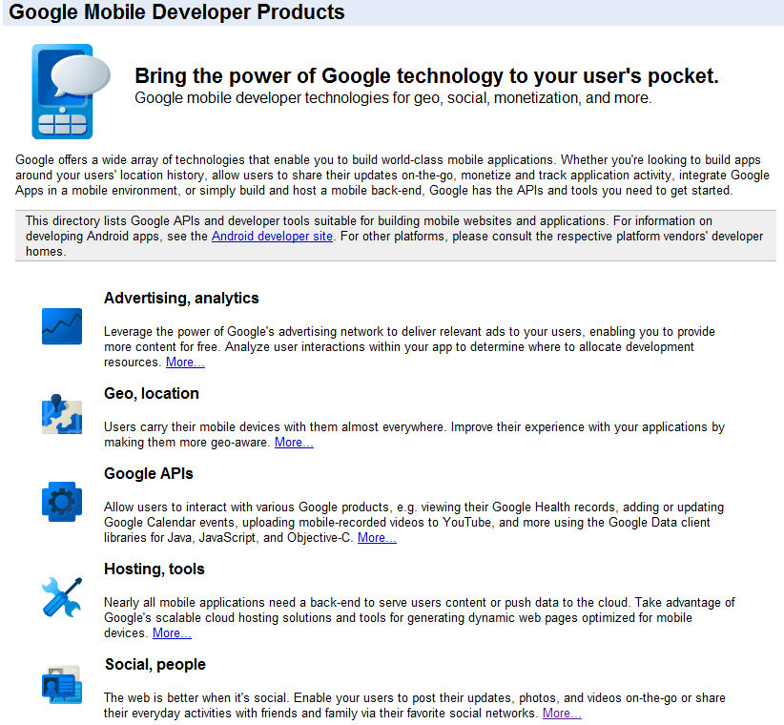
http://code.google.com/mobile/

Slide 49
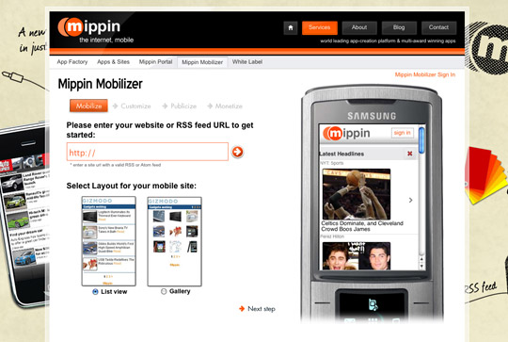
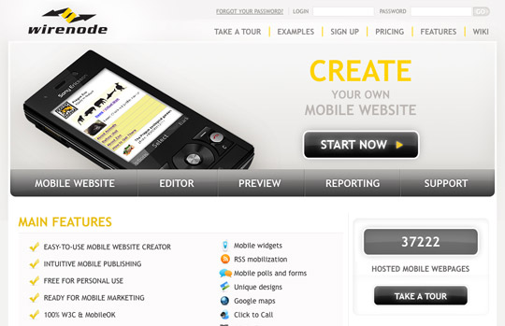
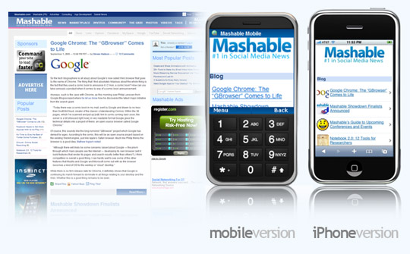
http://goo.gl/sjr7
11 Excellent Solutions for Making Your Website Mobile Friendly

Slide 50
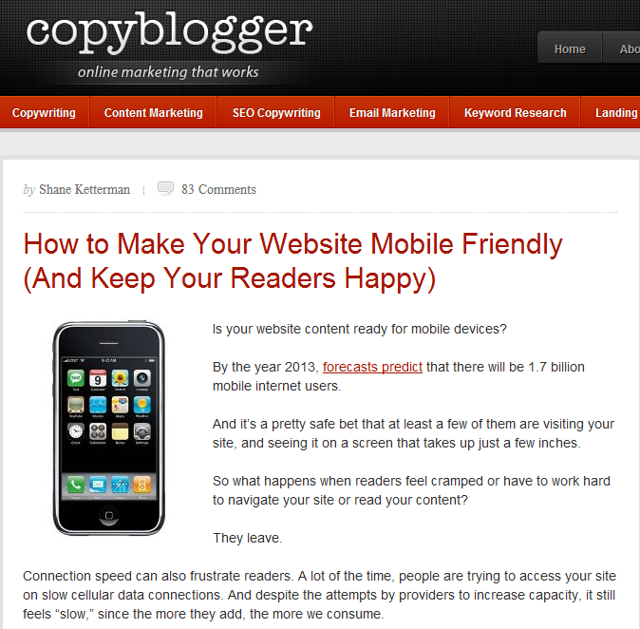
http://goo.gl/MsZrV

Slide 51
Resources
Twitter: m3mo

Slide 52
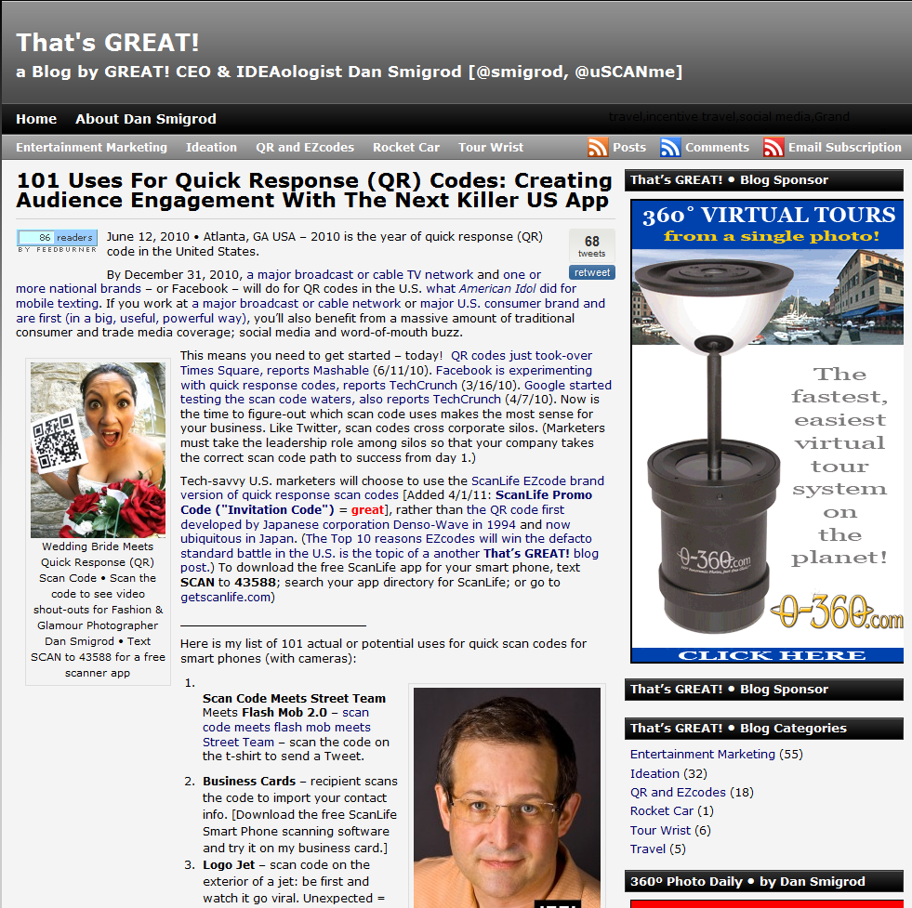
http://bit.ly/djcvqM
Twitter: m3mo

Slide 53
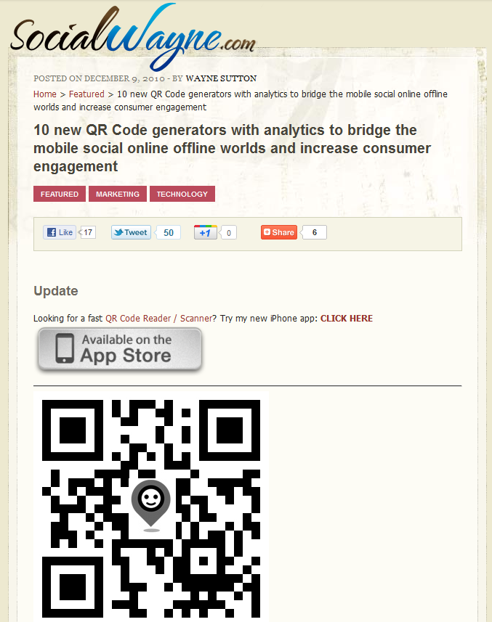
http://bit.ly/eyK8oX
Twitter: m3mo

Slide 54
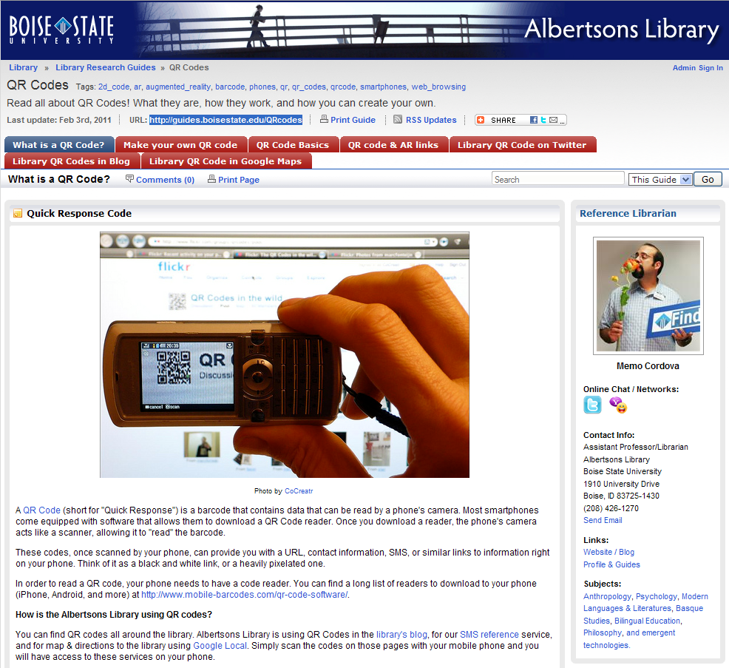
http://guides.boisestate.edu/qrcodes

Slide 55
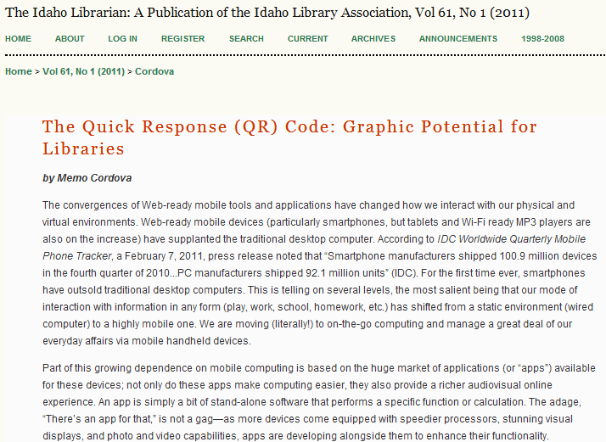
http://goo.gl/rWR9k

Slide 56
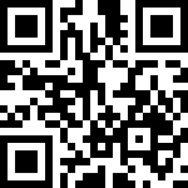
Thank you!
Twitter: m3mo

