Slide 1
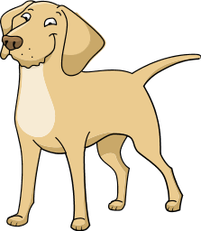
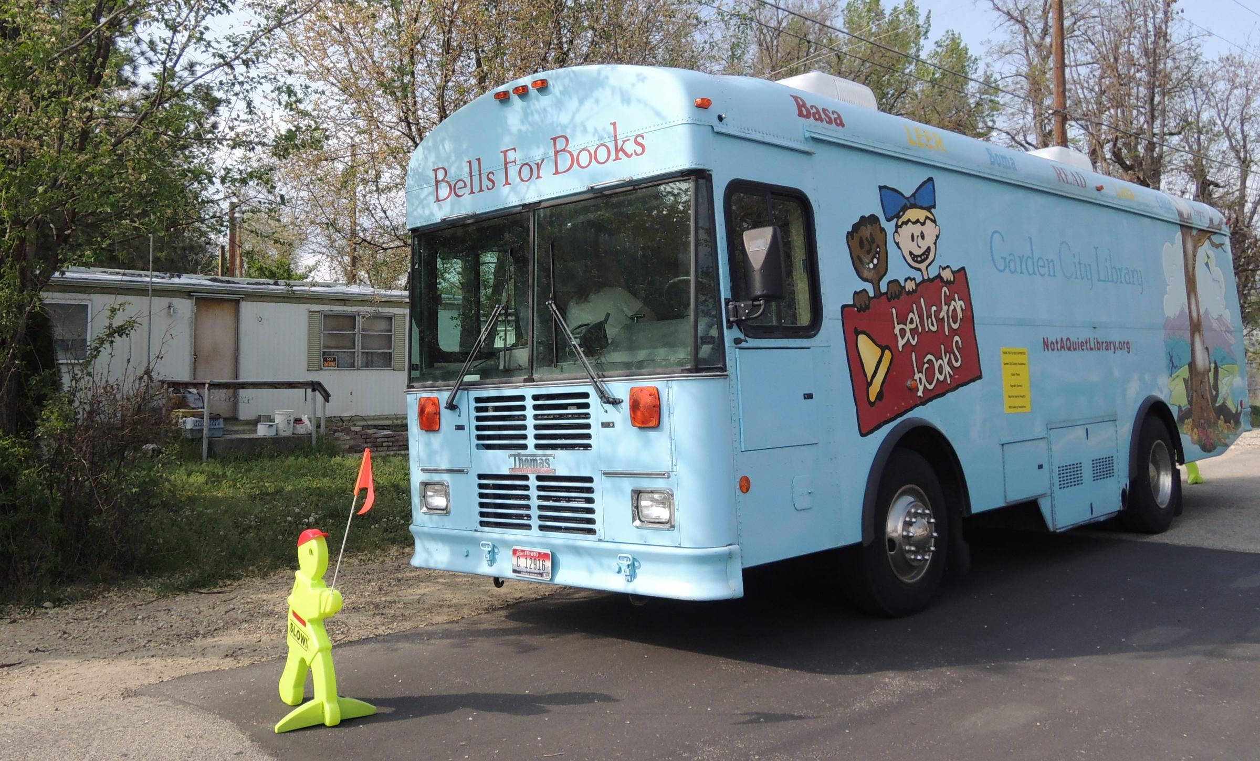
The Best of Friends Barbara Ward UF200- Civic and Ethical Foundations- Dr. Sass
Community Partner:
Name: Garden City Library
Mission Statement
To engage and enrich the hearts and minds of the community.
Project Purpose /Need:
The purpose of this project is to teach kids about diversity and empathy through awareness.
Reflection:
I wrote a children’s book about one common thing we all share and that is love for one another. Rather than pick apart all of differences between a cat and dog, to love one another.
At first, I was not sure how to do this. I started out by writing a super-hero story and decided after talking to my mom that I should choose something that I see happening everyday. Once the words started flowing, I could systematically put the artwork with the book. Using the story jumper application made the process a lot easier than I expected. I am very happy about how it came out and my own family likes the story. I even mailed one to my mom for her to keep.
I was happy to meet with the kids and librarians on the book mobile and to read my story to them. Some of the kids listened intently while others were distracted. During the reading process, I would stop and ask questions to keep the kids interested and a part of the story. A little girl came up to me at the end and said love helps everyone. It made me smile.
Introduction:
Learning goals
To write a book about cultural diversity and empathy towards others. We are all different in the way we look, behave and our thoughts. To teach children to show empathy when looking at differences amongst others.
As adults, we get to busy with our daily lives and often forget to slow down, be caring of one another and to learn about what each of us has to offer to each other and to our community.
My personal goal from this was build a better relationship with my own community. I have visited garden city library many times but had never gone to the book mobile to see what it was about. Now that I have seen it first hand, I hope to volunteer more of my time to reading to the kids.
Course Concepts:
What course concepts have you applied to your service learning experience? I would say through this course material, I try to not be so quick to judge, to show empathy to people, and to care about my community.
Did your experience support or contradict course concepts? This service learning project supports the idea of community and how we can help them. First of all, I thought that most libraries in communities are funded federally. Now I see that this isn’t always the case. Garden City needs our help. Without the support of the community with donations and books, this library may not exist.
Reference:
Garden City Public Library. April 2018. http://notaquietlibrary.org/
BestofFriends, Ward, Barbara, March 2018.
https://www.storyjumper.com/profile/barbaraward960
Methods:
Describe what you did and how you did it:
I determined who my characters were and what were they going to teach.
After a few rough drafts, I could now put the images together with the pages.
I used storyjumper to build my book.
Once it was finished, I ordered it and the book arrived in the mail a few days later.
Then I met up with the book mobile and read my story to the kids.
Results:
Results of your work in the community:
Kids are able to read my book along with others and utilize what they read into their lives everyday.
How did your work address the needs of the community? I wrote the book to be given to the Garden City Library for kids to read on the book mobile that goes around various places through-out the town.
6015 Glenwood Street
Garden City, ID 83714
208-472-2942
Place the logo of your community partner here.

