Slide 1
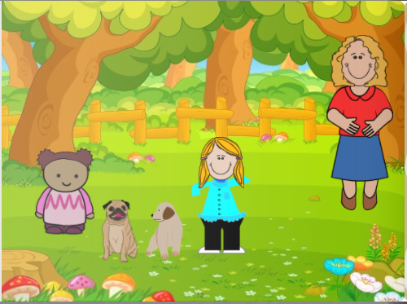
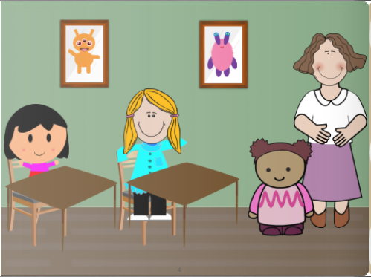
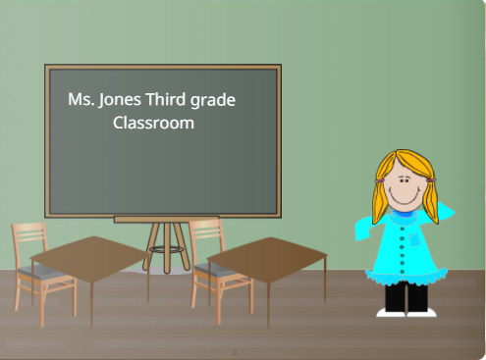
Spotting and Accepting Differences Shadee Edralin UF 200-Civic and Ethical Foundations- Dr. Sass
About the Book:
The book that I wrote is about Kamalani who moves to a neighborhood and she doesn’t quite fit in with everyone else. Another student Emily notices this and asks her mother about why this is. Despite their physical differences, they become the best of friends!
Experience:
I personally did not get to do bookmobile, but I did submit my book to the Library! In downtown Boise in place of reading to the children. My story is on their online database for everyone to read.
Lesson Taught:
In this book, I was trying to teach children who read it that people can look different in many different ways compared to others and that is not necessarily a bad thing. Though they may not look the same as you or those around you, they may share the same qualities, like, and dislikes as you do.
I chose this topic because I do think that this is an important one and it relates to the universal saying of “don’t judge a book by it’s cover”. It also relates to a bigger topic that is a problem in today’s society. It relates to racism or discrimination against others. Through this short story I hope that the younger children can learn to accept others despite their physical appearances and differences.
What was Learned:
In researching a topic to write about for my storybook, I learned that racism or discrimination is still very much alive. It was a problem in the past and is still a problem today and that was a bit more shocking to me than it should have.
Other than learning how to create a storybook using the software, I also learned ways that could help others to open their minds and understand those who may not be the same as they are.
Methods:
Describe what you did and how you did it:
I researched a topic that needed attention and that could be put into simple terms like a children’s storybook
I tested out websites that would be a best fit for the story that I wanted to create and share
Began to write and put animations together in a way that included the right details and picture to along with it
Link:
https://www.storyjumper.com/book/index/50468696/Spotting-and-Accepting-Differences

