Slide 1
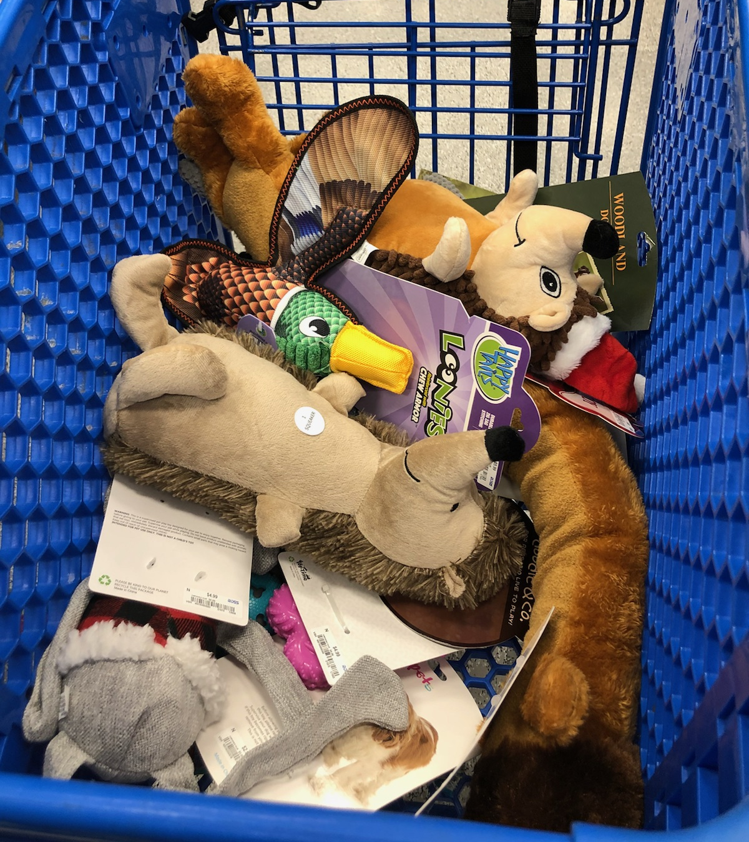
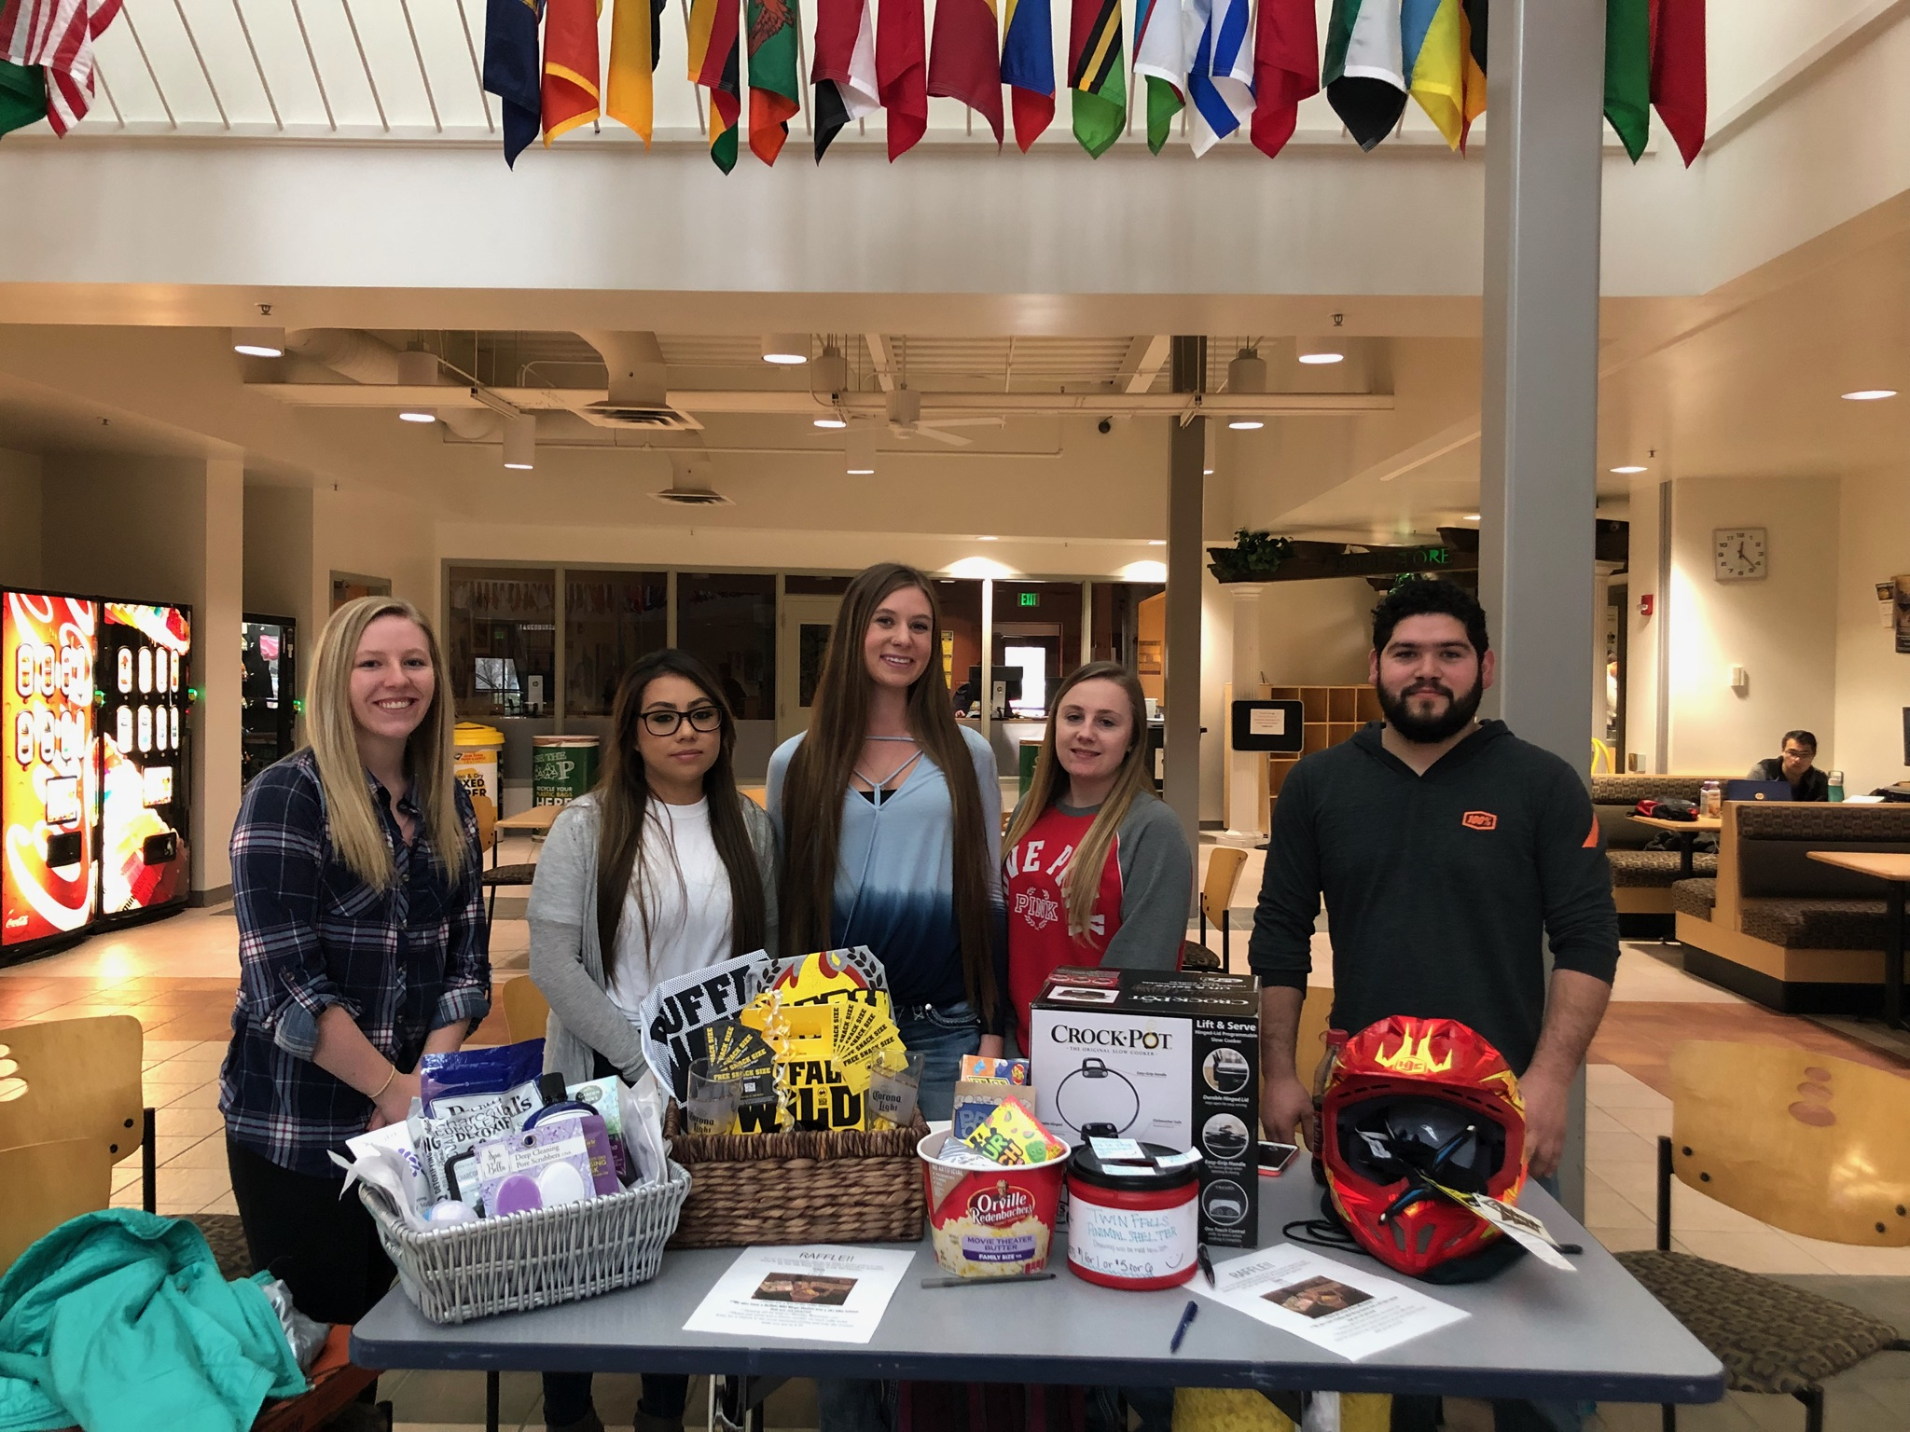
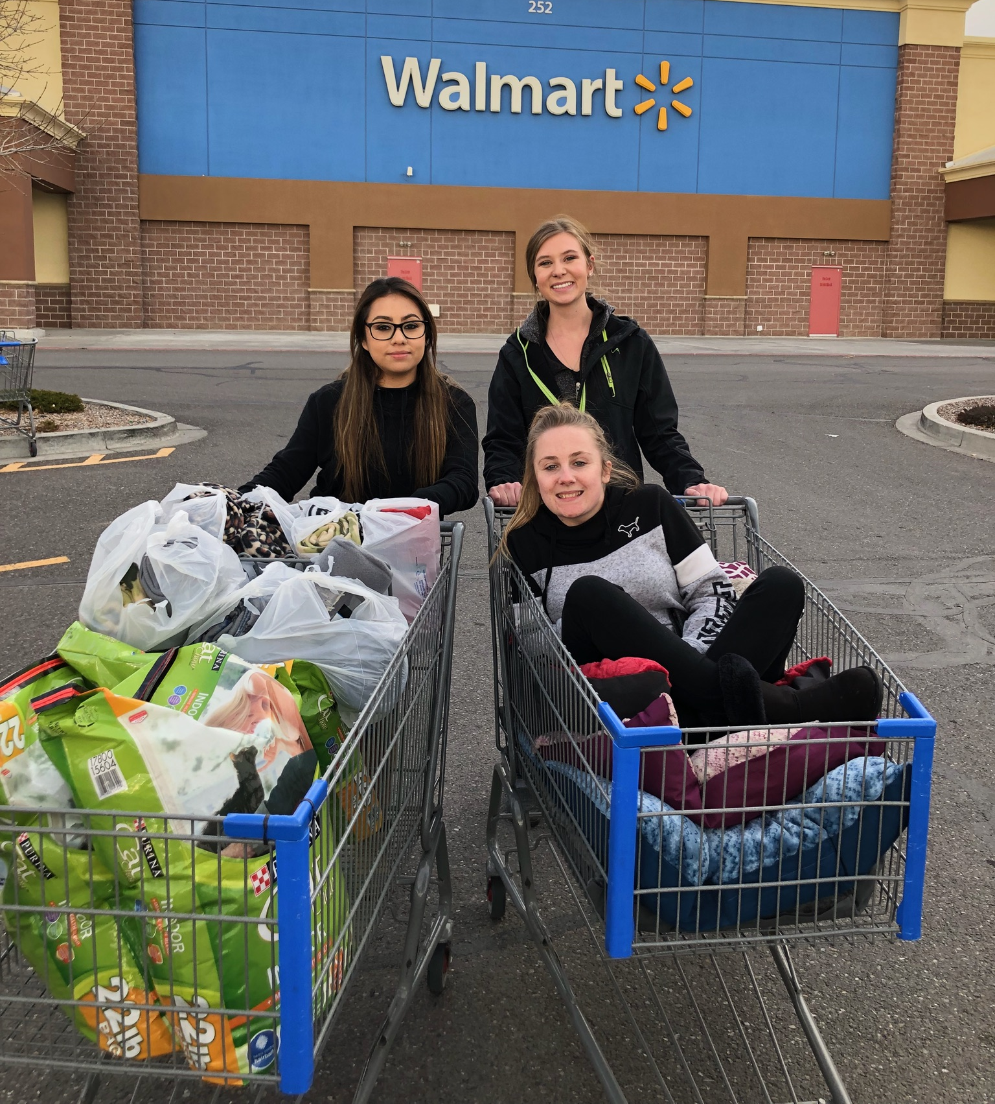
Raffle for Rascals Morgan Betzer, Enolie Perez, Anndrea Horton, Humberto Magana, and Sara Bayless COMM 101- Fundamentals of Oral Communications- Margaret Sass
Introduction:
Learning goals
The purpose of our project was to form relationships within the class as well as within the community. We were learning how to communicate with the people from the public to organize a service project.
Reflection:
Morgan Betzer:
This project helped me understand the gift of giving. I was able to feel the joy that comes from giving. I learned that there is always someone that is in need and helping others is a great thing to do. Reflecting back on this project helps me realize that being of service of others is always a good thing.
Anndrea Horton
This project helped me to realize that giving back is easier than I thought it would be. Giving back was easy when having multiple people willing to help out to gather supplies and money to donate. After seeing the animals I was more inclined to help raise as much money as I could. It left me feeling of fulfillment.
Enolie Perez
This project helped me become more aware of the fact that its important to help not only the people in need but the animals. I realized how important it is to adopt animals from shelters and give them permanent homes. This project made me happy knowing we are helping furry animals.
Humberto Magana
This project was a good stepping stone for me. It helped me get out of my shell and participate with a group. We all had our different points of view but at the end we all came together to make a great team. The other great part was being able to help our community. To create a better future for the animals at the shelter.
Sara Bayless
Animals have always been a huge passion of mine. Working together in a group to support animals in need taught me how easy it is to get out in the community, and how many others are willing to help you with a cause you truly care about.
Community Partner:
Name: Magic Valley Humane Society
Mission Statement
Our mission is to provide a humane shelter for cats and dogs in Twin Falls City and County. Our shelter is an Animal Control facility for stray, lost, found, and abandoned pets. We reunite pets with their owners and adopt pets who have lost their owners.
Project Purpose /Need:
The Magic Valley Humane Society was in need of a variety of items for the animals. Supplies such as food, blankets, and toys were needed. The purpose of our project was to raise money to help the animals of the Magic Valley Humane Society.
Course Concepts:
Public Communication- We contacted the humane society to see what needs they had. We also interacted with the public to gather donations and sell raffle tickets.
Group Communication- We worked within our group to plan who was responsible for what. We also worked to plan what works best for everyone.
Methods:
We organized a raffle to raise money to buy items for the local humane society.
We went into the community and found sponsors such as Buffalo Wild Wings, Action, Cycles, and Sleds, and Furniss Farms.
We made baskets to raffle off in order to raise money.
The money we raised was used to buy dog and cat food, beds, blankets, and toys.
We donated the items as long as money.
Results:
As a result of the raffle, we were able to purchase an abundance of food, toys, beds, and blankets for the animals. We were able to positively impact the community by donating items that were in need. We were able to help people and make life a little better. Helping others was a result that we are very proud of.

