Slide 1
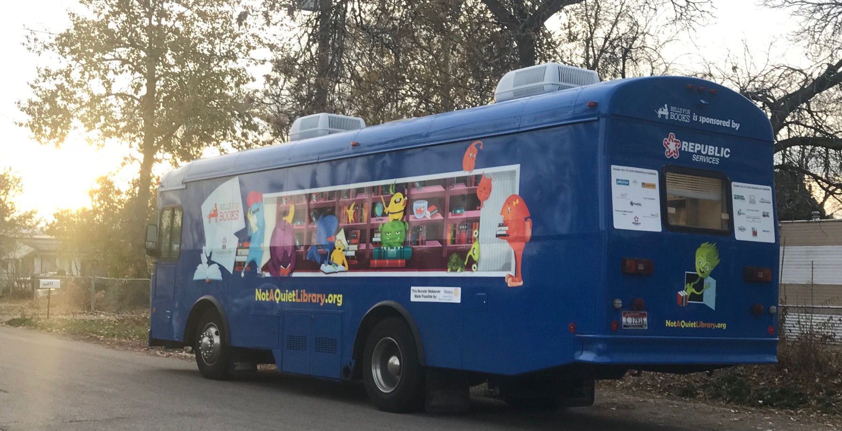
Empathy and Perseverance: Brave Little Phoebe Laurel Rickard UF 200- Civic and Ethical Foundations- Dr. Margaret Sass
Community Partner:
Bells for Books, Garden City Public Library
Mission Statement:
To ensure that every child in Garden City has access to Library books
Project Purpose /Need:
The purpose of Bells for Books is to encourage reading amongst school aged children by ensuring children have access to library books.
Introduction:
The purpose of writing this book was to focus on empathy and awareness. In particular, in a manner that would allow children pre-school to second grade to learn about cultural empathy. In the book Brave Little Phoebe, children learn that being different and having set backs in life does not mean they cannot lead a happy, fulfilled life through perseverance.
Topic:
This book is about a small dog who develops diabetes and goes blind. She learns about acceptance and self-reliance through perseverance.
Objective:
The topic of acceptance of those who are different and perseverance were chosen to help to illustrate to younger children that even though someone has a disability, they have the same hopes and dreams as anyone else. It also helps to demonstrate that even with a disability, through perseverance any setback can be overcome.
Results:
The children on the Bells for Books Bus were very responsive to the reading of the book. They clearly displayed empathy when the main character had setbacks. The children responded well to the topic and understood the objective of the story.
Reflection:
The experience of reading to the children on the Bells for Books Bus was extremely enjoyable. The children responded very positively to the book. One of the older children approached me with a summary of the book, which was very rewarding. Cultural empathy is an important topic, especially for children to learn, and being able to impart that to the children on the bus was truly as much fun for me as it was for the kids.

