Slide 1
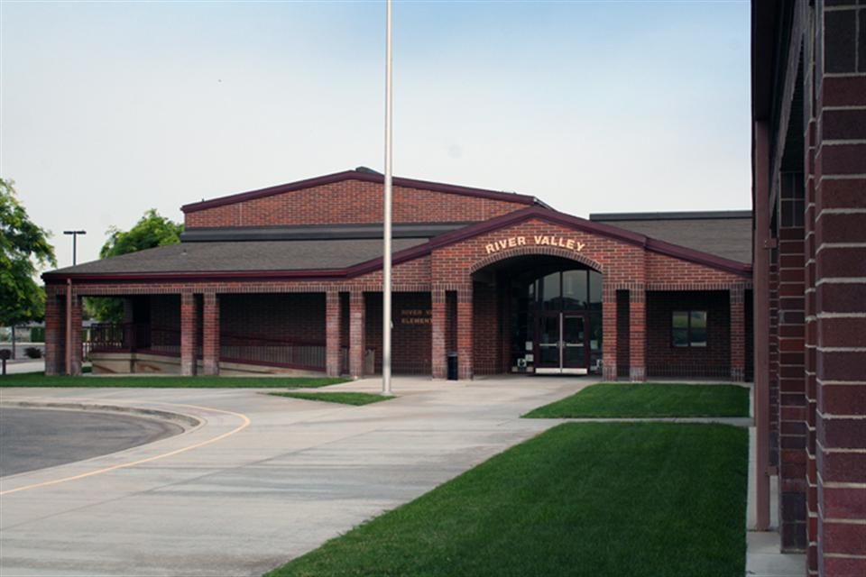
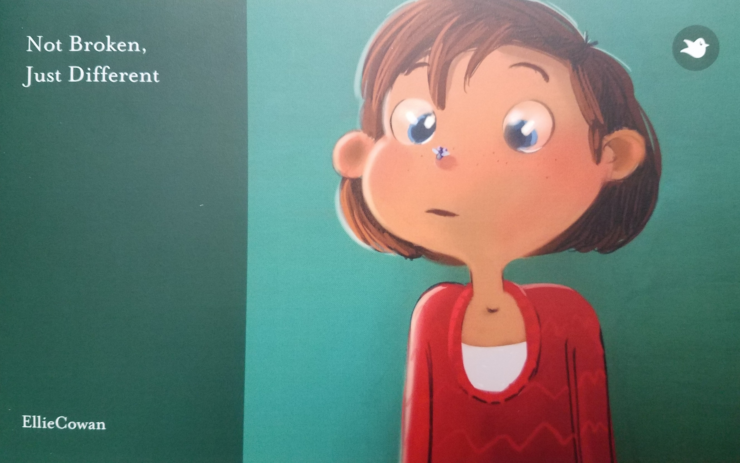
Not Broken, Just Different Ellie Cowan UF 200- Civil and Ethical Foundations – Dr. Margaret Sass
PHOTO (highest resolution possible) or GRAPH or TABLE
You are responsible for obtaining release forms to use photographs of community participants (agency clients, children). Release form available on the SL website at http://servicelearning.boisestate.edu/students/files/2011/11/photo-release-form-long.pdf
Introduction:
Learning goals
To contribute to cultural sensitivity in the community.
To work with school age children and help them learn about people with different challenges.
To learn to look at differences in the community with compassion and understanding, as well as be an active part of making a difference.
River
VALLEY ELEMENTARY
Reflection:
I enjoyed going and sharing the experience of the book with the children. I was very nervous about being able to write a book that would be able to teach empathy and understanding for children who have ADD/ADHA.
In the book I told a story about a young girl who struggles with being distracted, and other children think that she is odd. She learns to be able to do things to keep her on track and the other children learn how to enjoy her spontaneous and creative characteristics.
I was excited to see the responses from some of the kids who had struggled with their disability. Having someone that they could identify with and that there wasn’t something wrong with them. Having a way for them to articulate how they think and feel was exciting to them and they.
Sometimes disabilities can not be easily seen. Mental health struggles can isolate not only those who are struggling with them but the community around them becomes unsure of how to respond to them. Being able to share knowledge and experiences allows people to be exposed in a safe and educational way.
Community Partner:
Name: River Valley Elementary School
Mission Statement
To prepare all students to be successful learners and citizens.
Project Purpose /Need:
To engage with children in a creative way to encourage learning, empathy and cultural sensitivity.
Logo Image credit https://www.westada.org/Page/53
Course Concepts:
The course concepts covered in this children’s book experience are learning about ourselves and what makes us different. Learning about disabilities and how to be sensitive to those who have them as well as being your true self, and contributing your own unique attitudes as well as uniqueness to the community.
Methods:
Identify and write a children's book to help with developing cultural sensitivities.
Using Storybird create an online draft and publish the book..
Take the book to a community resource and share it with children there.
Donate the book to the organization for future use.
Results:
Results of your work in the community:
The children in the classroom were able to enjoy the shared story time. The teacher was able to relate the story to another lesson that they had previously talked about. The classroom will be able to use the book for future discussions and lessons and the school counselor is ordering her own copy to be used with other programs.
How did your work address the needs of the community?
The book helps to educate about disabilities and teach compassion to school age children. It provides a creative expression for children struggling with ADD/ADHD to have someone to identify with.

