Slide 1
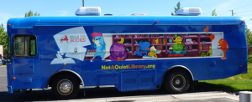
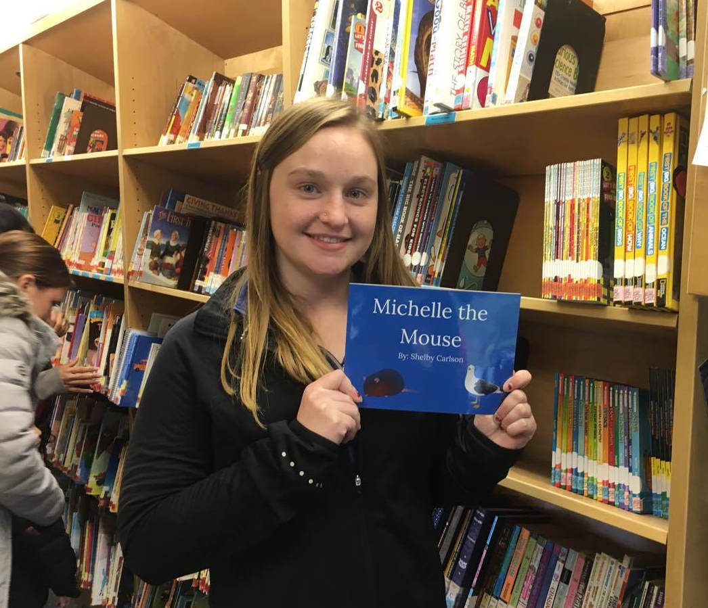
Michelle The Mouse Shelby Carlson UF 200 – Civic and Ethical Foundations – Dr. Margaret Sass
Community Partner:
Name: Garden City Book Mobile: Bells for Books
Mission Statement
To ensure that every child in Garden City has access to Library books.
Project Purpose /Need:
This book mobile provides an environment for at risk children to learn to love books and reading. This gives the children something to look forward to every week.
Introduction:
My book Michelle the Mouse is about a mouse who lives in France and she was playing Hide-and-Go-Seek with her friends. She gets on a ship and ends up in California scared and alone. She then meets Sammy the seagull. Sammy and Michelle then work together to find her the right ship to get her back home.
Reflection:
Reading to the kids was not what I expected at all. I thought it was going to be kind of boring, but the look on the kids faces was priceless. I enjoyed every second even the waiting and talking to the driver and his assistant. They really love providing that experience for the children. The children were so excited to hear a new book and to get to check out new books they could hardly contain themselves. That was one of the coolest experiences I have had and I learned so much from them.
References:
[Garden City Book Mobile Logo]. (n.d.). Retrieved from http://notaquietlibrary.org/bells-for-books/
[Garden City Mobile Library]. (n.d.). Retrieved from http://notaquietlibrary.org/bells-for-books/
What I Learned:
What I learned from this experience is that some of us take learning and the availability of books for granted. These kids were so grateful to be in a safe environment learning and reading. You could tell that this is something they look forward to. This is something that helps to keep them out of trouble and danger and help guide them to the right path.
Objective:
My objective was to write a story to help children bestow confidence in themselves, learn how to communicate and work together to overcome an obstacle. I wanted it to be an enjoyable and fun book that wasn’t overly complicated for their age group.

