Slide 1
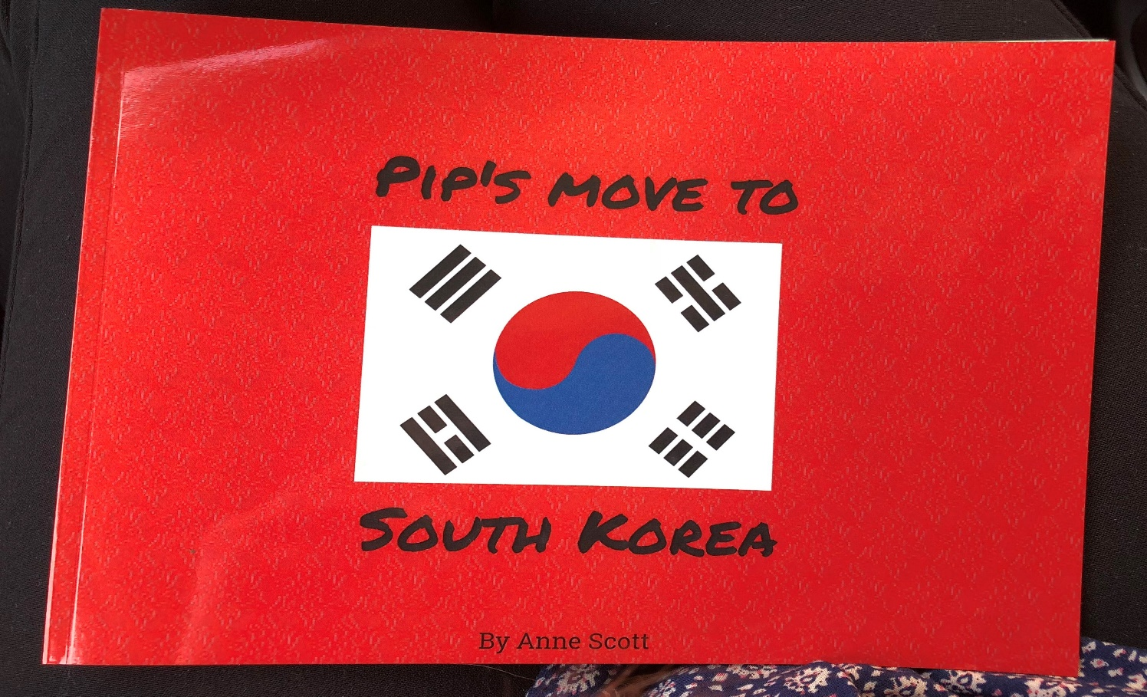
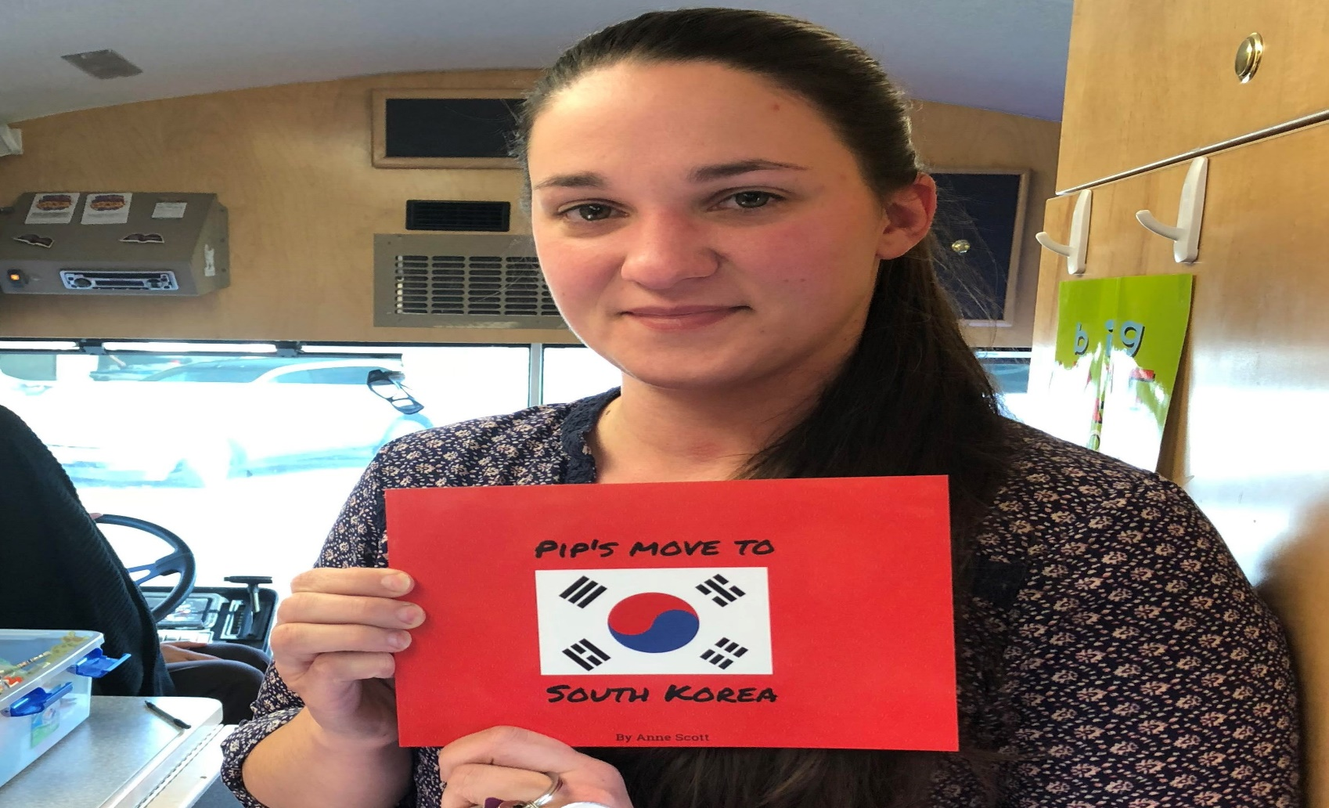
Pip’s Move to South Korea Anne Scott University Foundations 200 – Margaret Sass – Fall 2017
Community Partner:
Name: Bells for Books
Mission Statement
Library’s Mission: “At the Garden City Public Library, we engage and enrich the hearts and minds of our community” and to “support the Garden City Public Library in its efforts to inspire lifelong learning, advance knowledge, and strengthen the community of Garden City, Idaho.”
Project Purpose /Need:
I served as an example to the children who visited the bookmobile. Reading a book I wrote about cultural sensitivity helped show them a positive influence who advocates inclusion and acceptance.
Reflection:
The book I wrote was written to reflect a personal experience within our family. We are a military family, living in Korea, with a daughter in elementary school. Making friends has been hard, so this book also served to encourage her to be more inclusive.
“Pip’s Move to South Korea” is about a little girl, Pip, who has a hard time making friends at her new, South Korean school. She couldn’t speak the language, so no other kids wanted to play with her. One day, a student named Allen approached her. He taught her simple Korean words and encouraged other kids to play with her.
This book has made me realize that too many kids struggle making friends, and the difference in culture often hinders kids from being inclusive. Encouraging our children, who are the future, to bring awareness to cultural sensitivity serves as a stepping stone towards greater acceptance.
Introduction:
Learning goals
The goal was to create a children’s book that focuses on diversity and inclusion. I created my children’s book to display cultural empathy in a way that elementary aged kids could understand.
Course Concepts:
My goal is to live in a world where being culturally sensitive comes as an inclination. Kantian ethics include the inclination to do what you “naturally want to do”. Accepting all people shouldn’t be a decision we ponder on. It should be a decision we make naturally. We should also be in control of our inclinations, with proper reason to be wholly good to all people.
References:
Garden City Public Library. (2017, Nov. 10). Garden City Public Library Foundation. Retrieved from http://notaquietlibrary.org/about-us/foundation/
Panza, C., & Potthast, A. (2010). Acting on Inclination: Doing What Nature Wants You to Do. Ethics for Dummies. Indianapolis, IN: Wiley Publishing.
Methods:
Brainstormed ideas on what to write
Made an outline to structure the story
Wrote a rough draft
Adjusted the draft and entered it on to the Storyjumper website
Made illustrations to go with each page of the story
Ordered my book to be printed and mailed out
Read to the children on the Bookmobile
Results:
The kids on the bus were excited to have someone there to read to them. They especially liked having a new story that they hadn’t heard of before. They sat quietly and paid close attention to the whole story. Another kid came on the bus late, and so they asked me to read the story again. Those kids were very inclusive! Seeing their reactions made me realize that being culturally insensitive is learned by examples as children get older. We have the power to change that!

