Slide 1
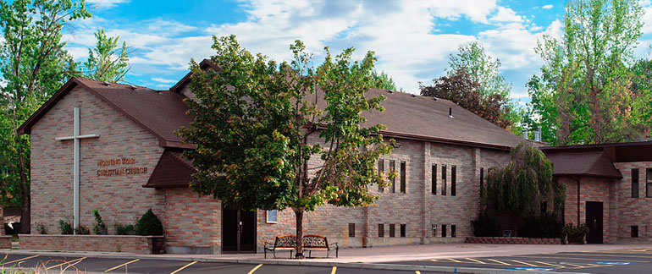
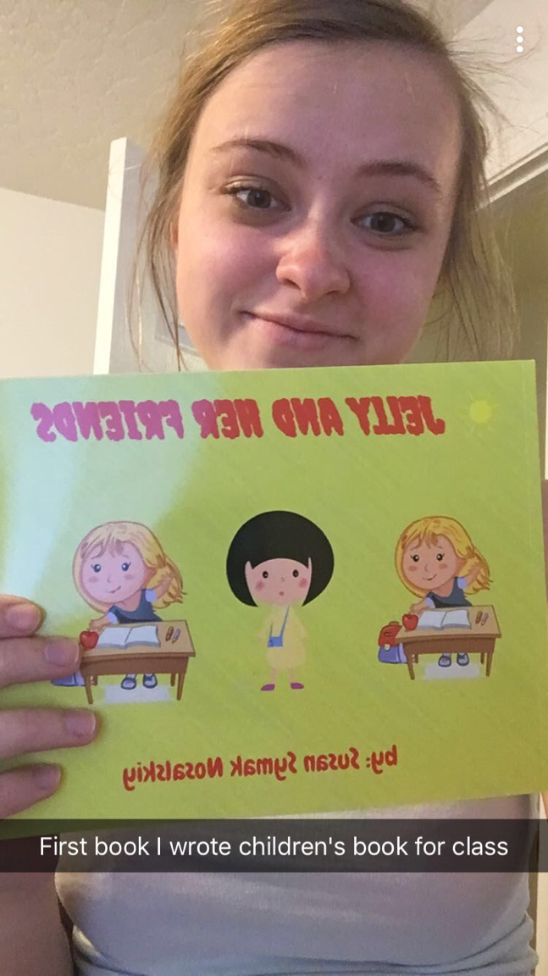
Jelly and her Friends Susan Nosalskiy UF200 – Civic and Ethical Foundations –Margaret Sass
.
Community Partner
Objective
Topic
I picked the topic of language and accents, because growing up that is what I had to deal with. When children learn that cultural differences, like language, ethnicity, habits, food, and other things, are something to embrace and not run away from, they get a whole new world of opportunity.
This book is about Jelly, who moves to America from Ukraine, and gets picked on because of her accent. Until one day when she helps popular boy Jack, when he gets hurt. Then the whole class realizes that differences shouldn’t make us different in a bad way and they all become friends and embrace each other.
Name: Morning Star Christian Church Sunday School
Mission Statement: To teach children about the love of the Lord through the Bible and daily living.
(Project Purpose /Need:
To educate the kids, in this classroom, about ethical issues we have in our community, and how to overcome them, in this book about Jelly and her Friends, and how they overcame these differences, in their classroom.
PHOTO (highest resolution possible) or GRAPH or TABLE
You are responsible for obtaining release forms to use photographs of community participants (agency clients, children). Release form available on the SL website at:
http://servicelearning.boisestate.edu/wp-content/uploads/2014/02/photo-release-form-long.pdf
Reflection
This experience was one of the most enjoyable ones, that I have had in university. I loved to be able to create a children's book, and to be able to print, and fell like a real author. The minute it was printed I had to snapchat it to my whole family, and they were really proud of me. I then took the book to my local Sunday school, at my church. The minute I was introduced to the class, all the kids got really quiet and attentive. They were really excited, as I read my book to them, and loved the pictures that went along. I read the questions at the end, and was surprised that each question was answered thoughtfully, and the kids, were really intrigued and asked me what an accent was. The Kiddos were the 4-5 year olds. This experience I will not forget for a long time, and I treasure my new book that I wrote, it lays on my nightstand, because I am that proud of it. I hope the kids got a deeper meaning of accepting different people around them, and having a more positive look, on anyone who doesn’t fit their mold.
Response
Impact on Community
The response I got from the kids, in the Sunday school classroom, was overwhelming. Many of the kids, kept asking for me to re read the book, at least 3 more times. They loved he pictures that went with it. And soaked in every single word. When I read the questions to them, they thought deeply about them, and replied with very thoughtful responses. They are now definitely more aware of kids with accents, and will embrace them.

