Slide 1
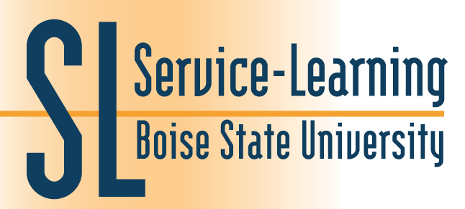
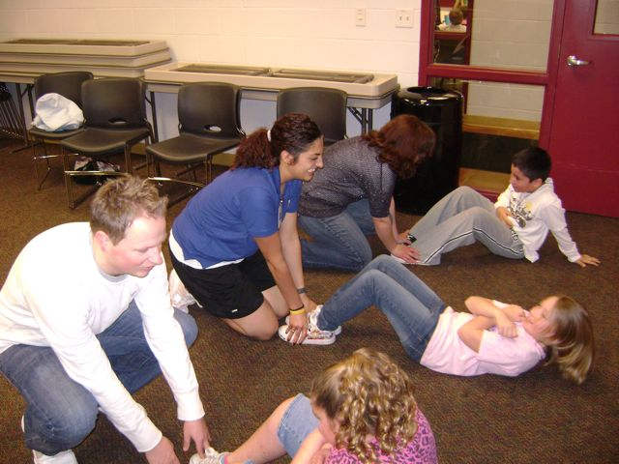
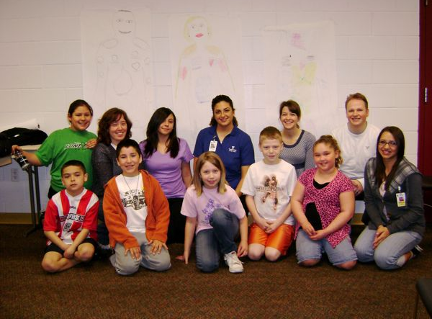
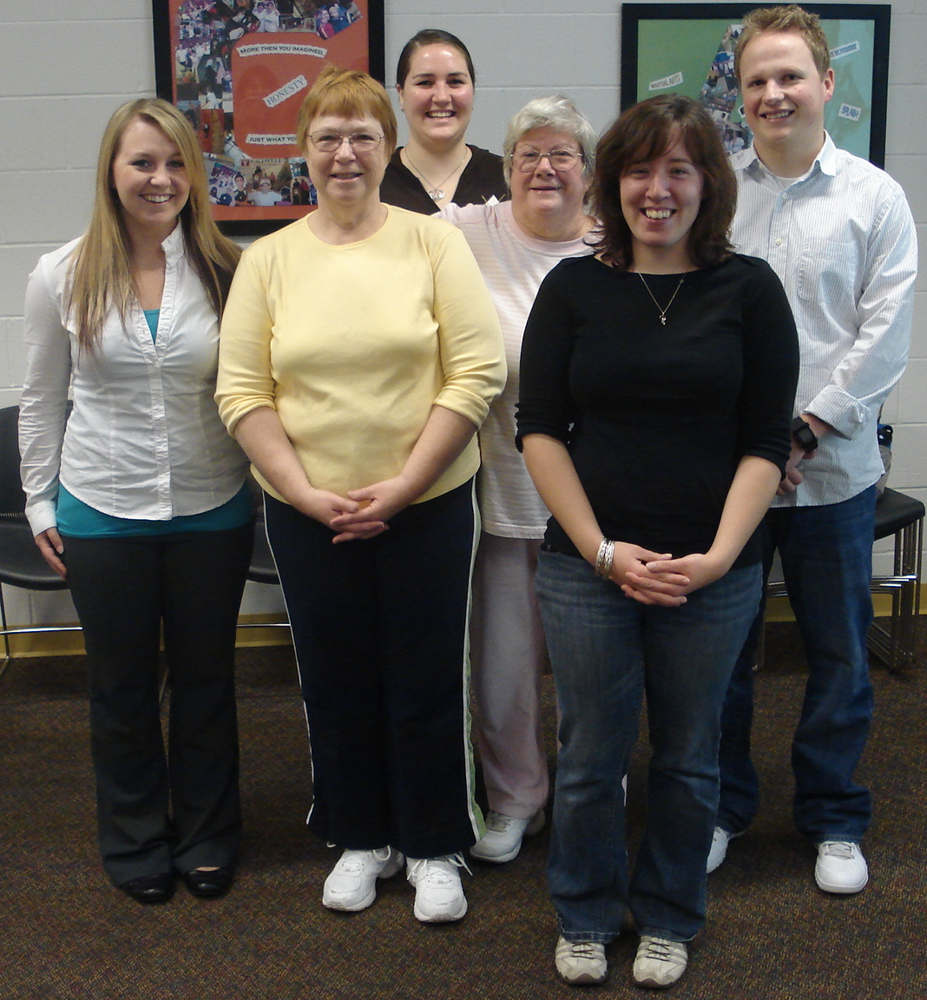
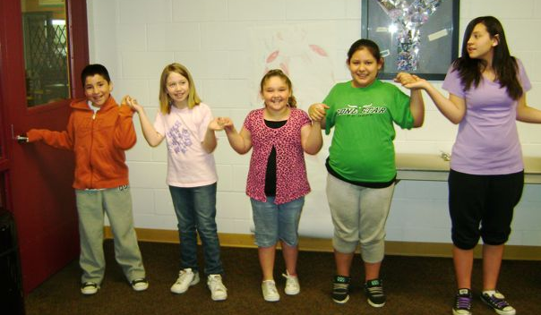
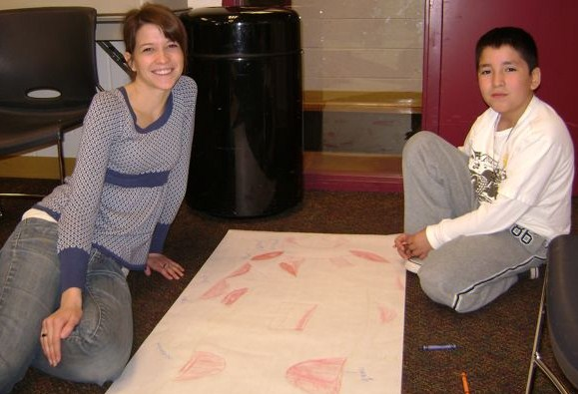
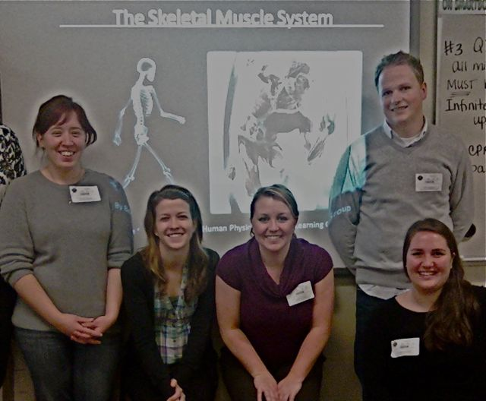
Civic Engagement in Action: Human Physiology Community Education Sasha Volgamore and Kristen Mitchell Department of Biological Sciences, Boise State University
Overview
CLASS: Human Physiology (ZOOL 401) Fall 2010
INSTRUCTOR: Dr. Kristen Mitchell
PURPOSE: To encourage community members to become responsible for their own health by providing them with relevant scientific information based on topics covered in ZOOL 401.
Service Learning Student
Muscles in Action
Introduction
YMCA Children
People are bombarded with health information on a daily basis. Every day there seem to be new diet and exercise trends that claim to guarantee health success for the average person. We believe that having a basic understanding of human physiology may steer people towards making informed choices and motivate them to choose a healthy lifestyle.
The purpose of our project was to educate community members of all age groups to provide them with a basic knowledge of the fundamental workings of the human body, with specific emphasis on skeletal muscle physiology and cardiovascular physiology. It is our hope that members of our target audiences will use this information for future self-directed inquiries into human physiology with regard to their own bodies.
Regardless of their age, everyone can decide to eat healthier and live a more active lifestyle. With the knowledge we provided the community, we hope they will appreciate that a healthy lifestyle is paramount to maintaining optimal functions of the major organ systems.
Drawing Life-Size Muscle Man
YMCA Senior Citizens
Life-Size Muscle Contraction Model
Project Details
Outcomes
Presentations:
10th graders, Borah High School, March 22nd
3rd-5th graders, Caldwell YMCA, March 29th
Senior citizens, Caldwell YMCA, April 9th
Senior citizens, Nampa Senior Center, April 16th
5th graders, Whitney Elementary, April 23rd
5th graders, Roosevelt Elementary, April 26th
The project was a great way to expose college students to the public health field. In general, people have a desire to learn and discover how their bodies work. However, there is a lot of information out there for people to shift through to find the real facts. Our goal was to provide people with a basic understanding of how the skeletal muscle and cardiovascular system function. We hope that, with this knowledge, they will be able to make better educated decision in regards to their health and well being.
Over the course of the project, we encountered several challenges. One challenge was to find convenient times to work on our project as a group and identify presentation dates that fit into everyone’s schedules. However, email was a great way to communicate when our schedule’s didn’t coincide. Another challenge was to determine how to relate our lecture material with the various ages of our audience members. We overcame this by combining our experiences, and speaking with other instructors who had experience teaching students at various age levels. This strategy allowed us to gain valuable knowledge and insight to how the different age groups best understand new knowledge.
Overall, the presentations not only increased our audience’s knowledge of human physiology, but we were also able to correlate class material with real life. This can be very difficult in many college courses, but our project proved that it can be done.
Our Service Learning group consisted of five BSU seniors with diverse career goals:
Sasha Volgamore, Public Health
Lauren Troy, Veterinary Medicine
Jade Grimett, Physician Assistant
Joey Hanson, Medicine
Nichole Knox, Undecided
Outline of a sample 40-minute presentation:
Overview of skeletal muscles
Muscle anatomy
Muscle physiology
Fast-twitch and slow-twitch muscle fibers
Sliding-filament model of muscle contract
Busting commonly held myths
Age-appropriate conversation topics
Z401 Service Learning Students
Reflections
“To see the various age groups so excited to learn really increased my desire to join the public health education field.”
What We Did
Tools Used:
Power Point presentation augmented with:
Videos and animations
Hands-on activities (especially for children)
Life-size models
Q & A session
“My fear of public speaking has dramatically decreased, and I feel a lot more confident in my speaking abilities, which will be beneficial not only in future classes, but in life as well.”
This semester five students participated in the optional Service Learning component of Dr. Mitchell’s Human Physiology class (ZOOL 401). During the first half of the semester, we met once a week to organize our presentations and discuss topics related to communication, leadership and civic engagement. During the second half of the semester, we typically spent one morning each week (usually 3-4 hours on a Friday morning) visiting a community site.
The sites and audiences were varied in order to provide students with experience presenting scientific information to diverse groups of people. In addition, a variety of age-appropriate approaches were used to modify each presentation according to the audience .
“I acquired a new appreciation for the duty I have to help out my local community.”
“We all have a role in helping the members of our communities. I’m glad that I was able to use my newly obtained knowledge from class and further that by helping people in my community make better life choices.”
ACKNOWLEDGEMENTS: We would like to thank the directors and teachers at the Caldwell YMCA, the Nampa Senior Center, Borah High School, and Whitney and Roosevelt Elementary Schools for participating in our project. We also thank Dr. Louis Nadelson for sharing his knowledge and experience working with children in a science classroom and for providing us with suggestions on how to engage young students in the classroom. Finally, we are grateful to Kara Brascia and Laura Allen in the BSU Service Learning Program Office for providing guidance, support and enthusiasm for this new Service Learning project.

