Slide 1
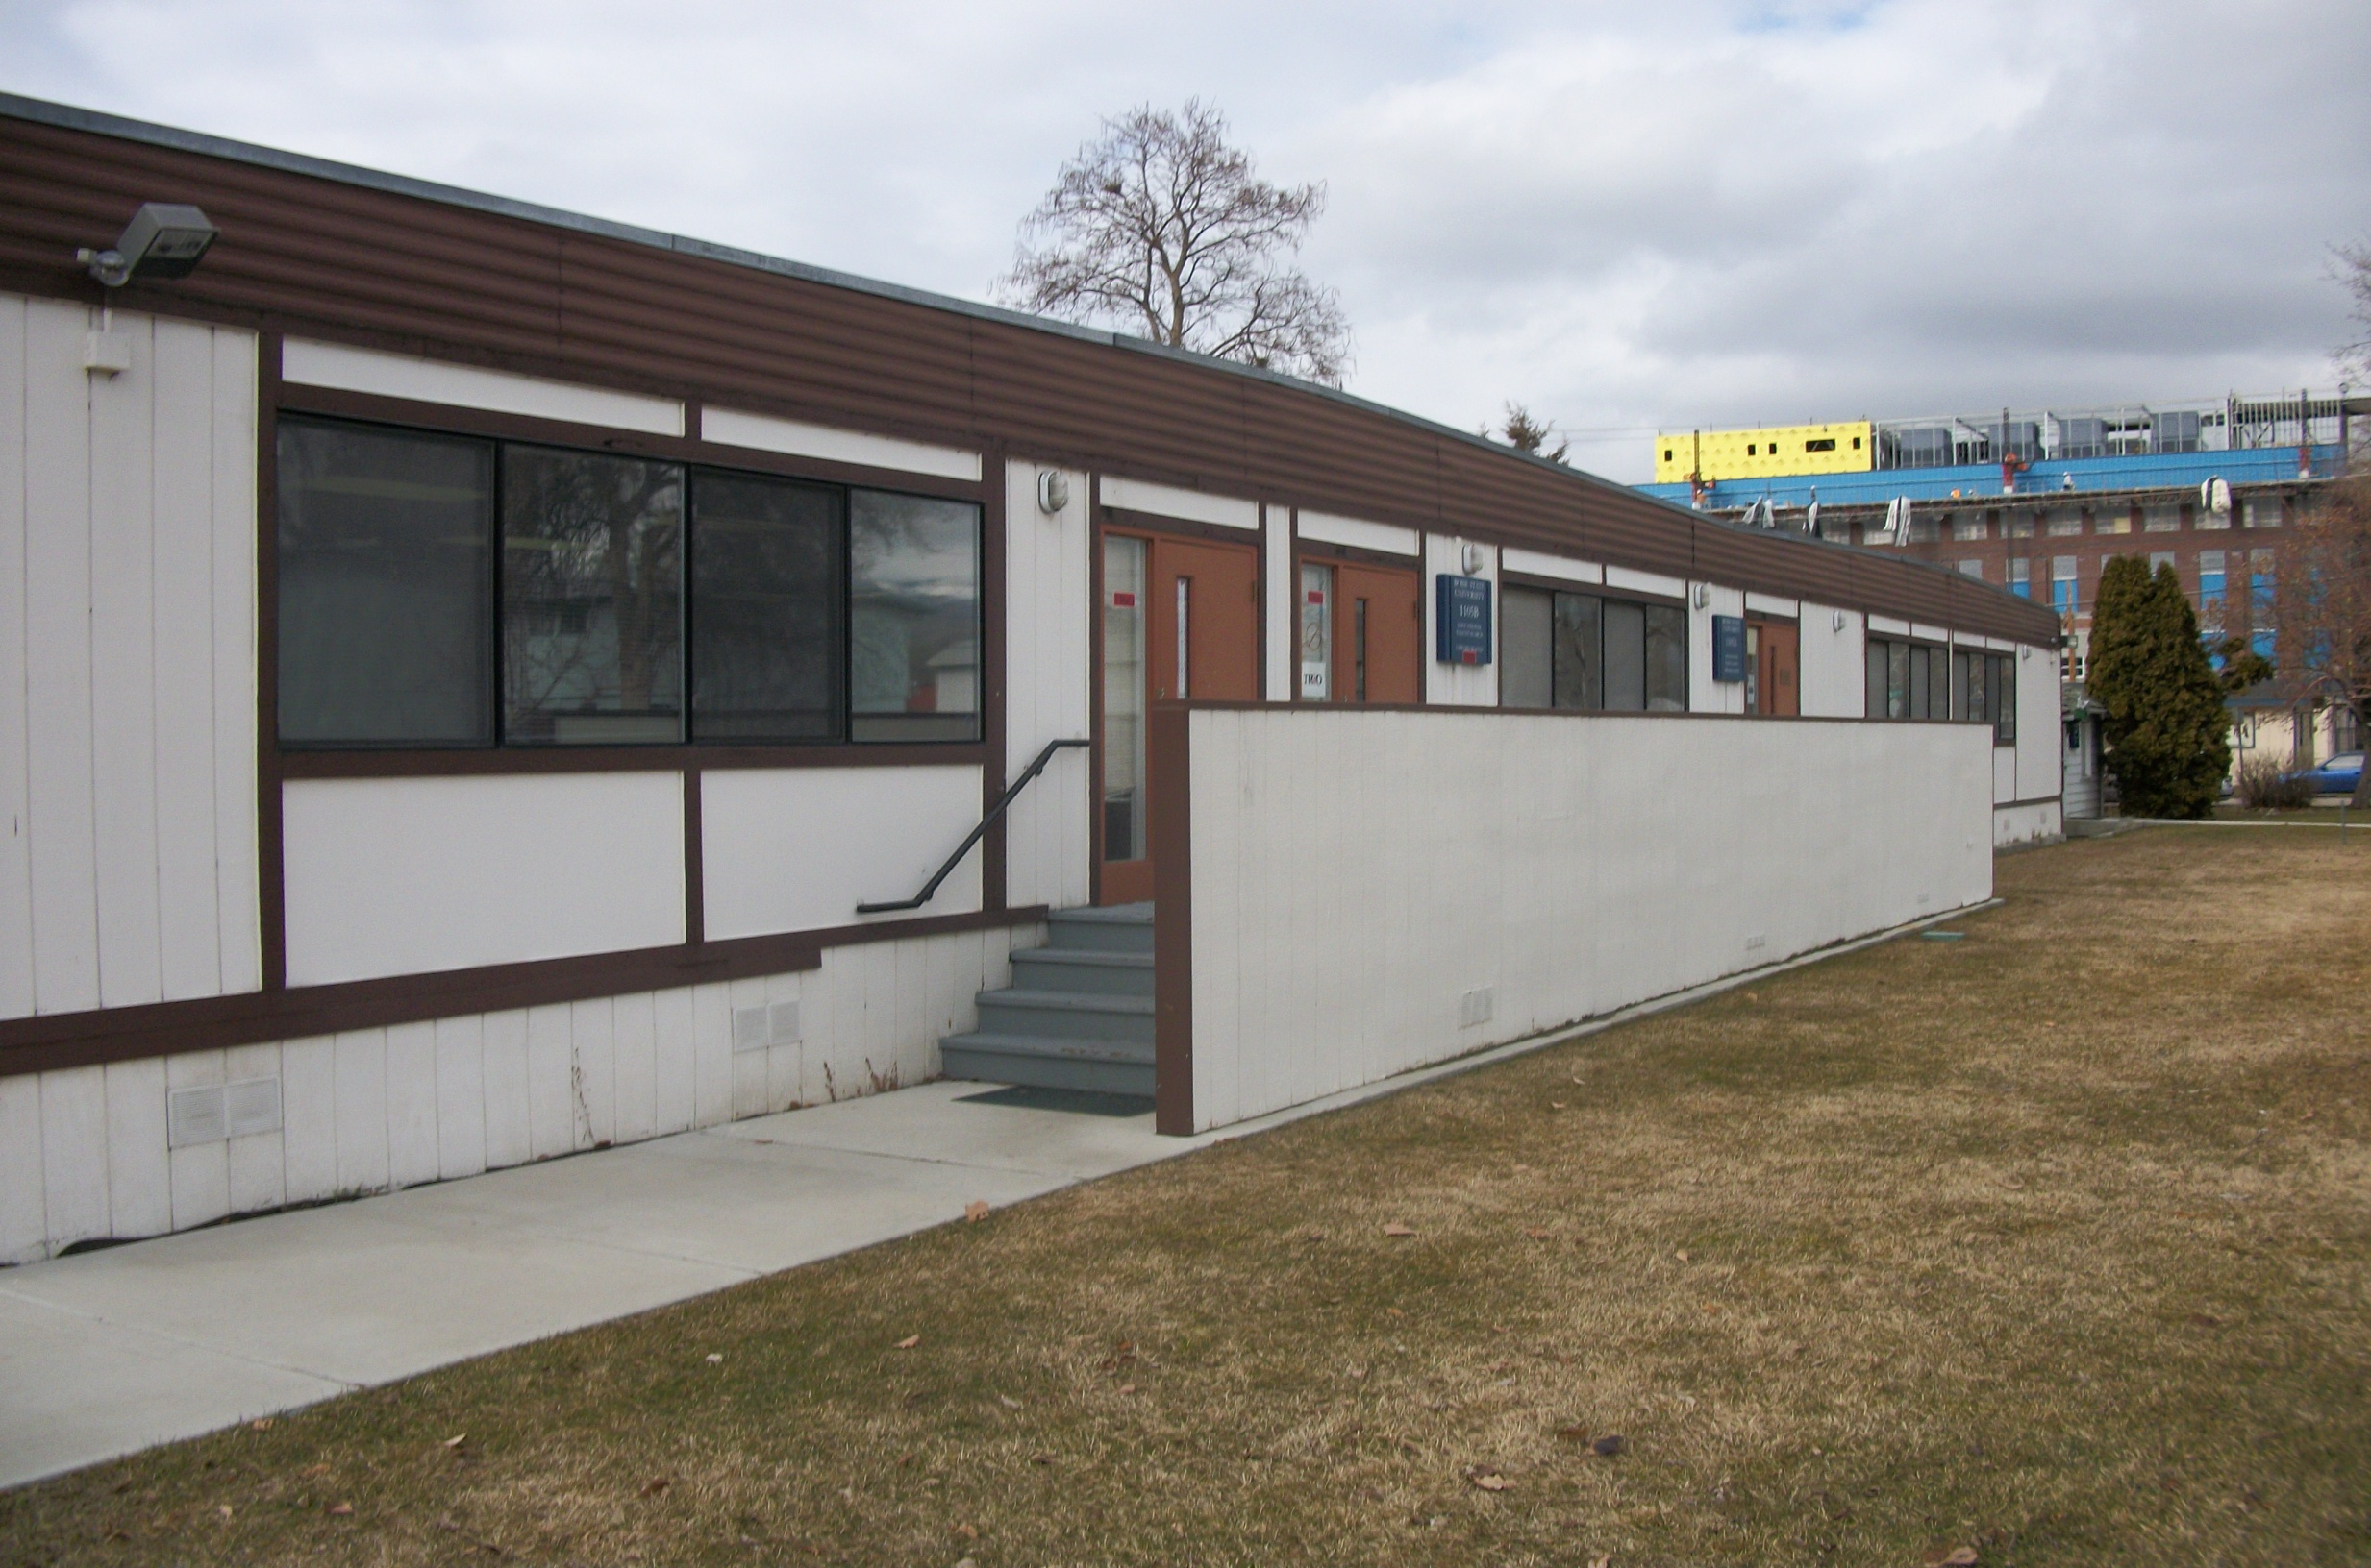
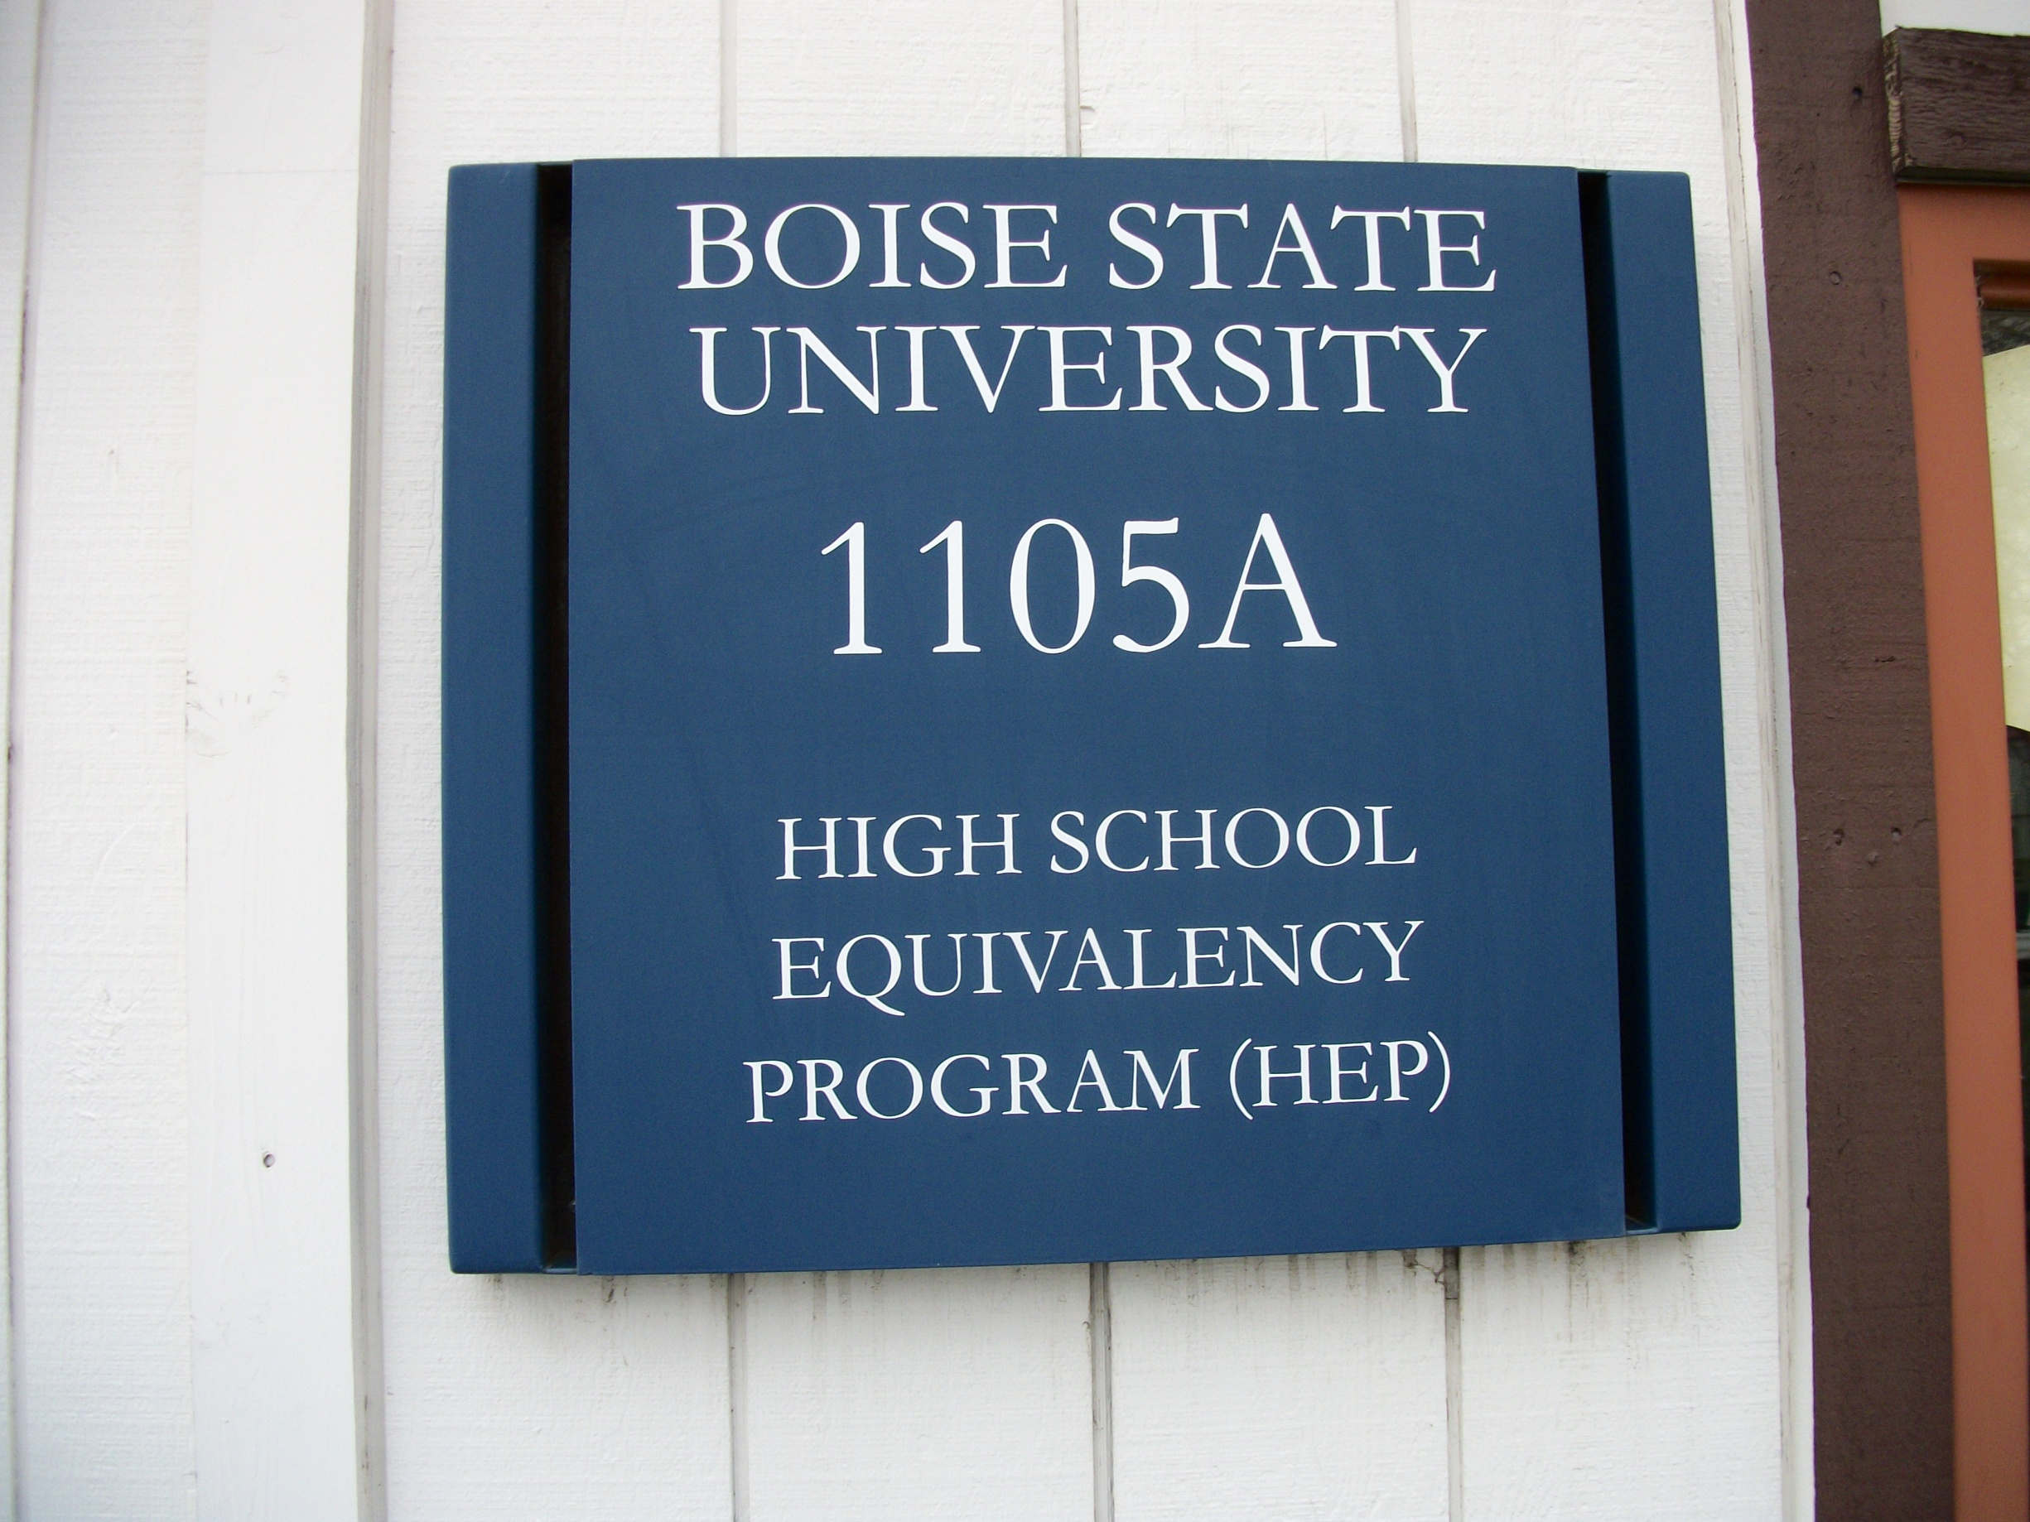
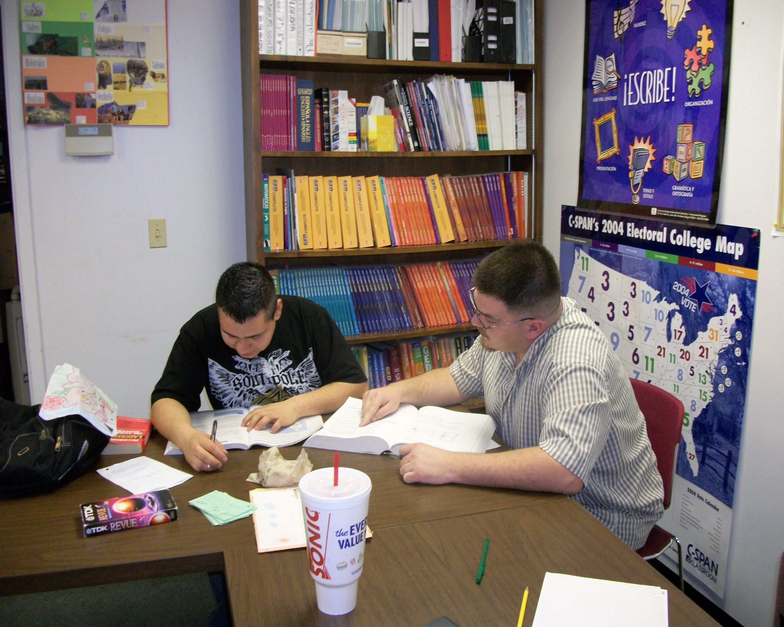
Civic Engagement in Action: High School Equivalency Program (HEP) Ricky Morris
Spanish 303-003: Advanced Conversation and Composition, Spring 2010
Izaskun Kortazar
High School Equivalency Program (HEP)
Boise State University's High School Equivalency Program (HEP) is a Migrant Education Program designed to assist migrant and seasonal farm workers and their children in obtaining a high school equivalency diploma or GED certificate.
The purpose of HEP is to help migrant and seasonal farm workers who have worked in an agricultural job for at least 75 hours, and their children, who are 16years or older and have at least an 8th grade skill level in reading and math, to enhance socioeconomic mobility through education by providing an opportunity to take advantage of federally-sponsored GED training and tests. HEP also provides suitable lodging, meals, and health care for the duration of the student’s time in the residential program, as many of the students would otherwise be unable to attend.
The learning goals for Service Learning in this class include: Gaining a more profound comprehension and awareness of the Hispanic language and culture, serving the Boise community employing the Spanish skills learned at BSU, expansion of vocabulary and skill in communicating in Spanish, interact with people from backgrounds that may be different from that of the service learning student, and providing a way to get the student significantly involved in the affairs of the local community.
Service Activities:
I helped Spanish-speaking students prepare to take GED tests.
I have been assisting the Spanish teacher, Angeles Gomez by helping Spanish-speaking students with homework assignments and explaining various methods of finding answers to questions they are having difficulties with.
Mostly, I tutored in Spanish because the students I work with either know very little English or feel more comfortable learning and studying in Spanish.
So far, I have helped students study U.S. Government, high school math, high school biology, and vocabulary skills (using context clues, inferred meaning).
I tutored one student in math and science who subsequently passed his test and finished the program.
I acted as a tutor for an hour and a half, one day each week.
I shared my own tips and methods of studying, and explained to the students how I use given information to find answers when I am in doubt, in the hope that they can use the same method to their advantage.
I learned about the student’s backgrounds during conversation in class and during breaks.
PHOTO (highest resolution possible) or
GRAPH or
TABLE
Reflection: I already spoke Spanish before taking this course, but since I came to work at HEP, my fluency has improved substantially because of the consistent practice while tutoring. I have found this placement to be extremely rewarding because when a student that you personally tutored, who was pessimistic at first, passes a test that they thought they were going to fail, they are more confident, which in turn makes you more confident. One student in particular told me that he was worried that he was going to fail the math test because he was struggling with it. We went over several different approaches to solving different problems. The next week when I came back, he had a big smile on his face and as soon as I walked in the door he told me that he passed his test. It feels really good knowing that you were able to help someone to achieve something that they may have never achieved if not for someone taking the time to show them that they could do it. While working as a tutor at HEP, I have learned that I have the ability to help someone change their life and their life circumstances drastically by showing them that they are capable of doing so.
PHOTO (highest resolution possible) or
GRAPH or
TABLE

