Slide 1
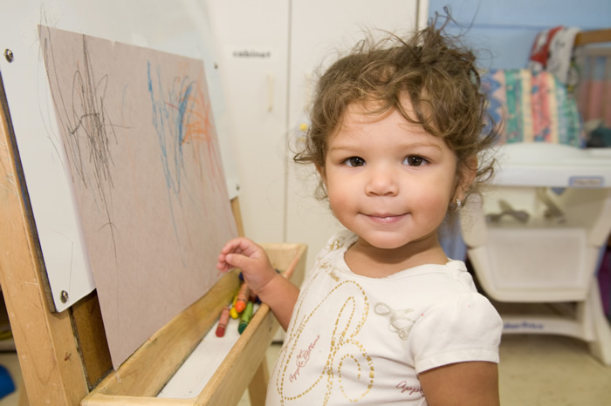
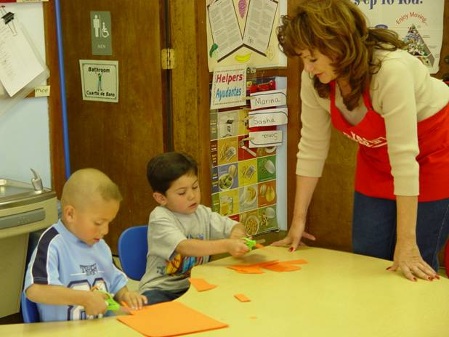
Civic Engagement in Action: Head Start Hailey Wall
Spanish 303: Advanced Conversation and Composition, Spring 2010
Izaskun Kortazar
Head Start
Friends of Children and Families, Inc. is dedicated to serving families and their children by providing quality, comprehensive, family-centered early childhood services.
The purpose of my service project was to help the ‘English only’ teacher interact with and teach the bilingual or ‘Spanish only’ speakers at Head Start. I also got to spend a lot of time with the children. ¡Muy divertido!
The learning goals of my service project with Head Start include: to gain a deeper understanding and appreciation of the Hispanic language and culture, to serve the Boise community, to know the community and interact with people from other countries, and finally to help create an international community where different cultures and languages can thrive together
Reflection
My Service Learning project with Head Start helped me to improve my Spanish skills in a big way. I was able to use Spanish in a natural context while speaking to young children, instead of being put in a classroom of peers forced to know the ‘right’ answer. Being out in the community practicing Spanish made it seem more real, and even if I used the wrong word or conjugated something incorrectly I was practicing. The kids made this project very fun, and I also learned a lot!! ¡ Service Learning es una oportunidad gran!
Service Activities
For my project at Head Start I was able to interact with the Spanish speaking children through games, stories, and other pre-school activities.
QUESTIONS?: Contact Jilliana at 426-5631 or jillanafinnegan@boisestate.edu

