Slide 1
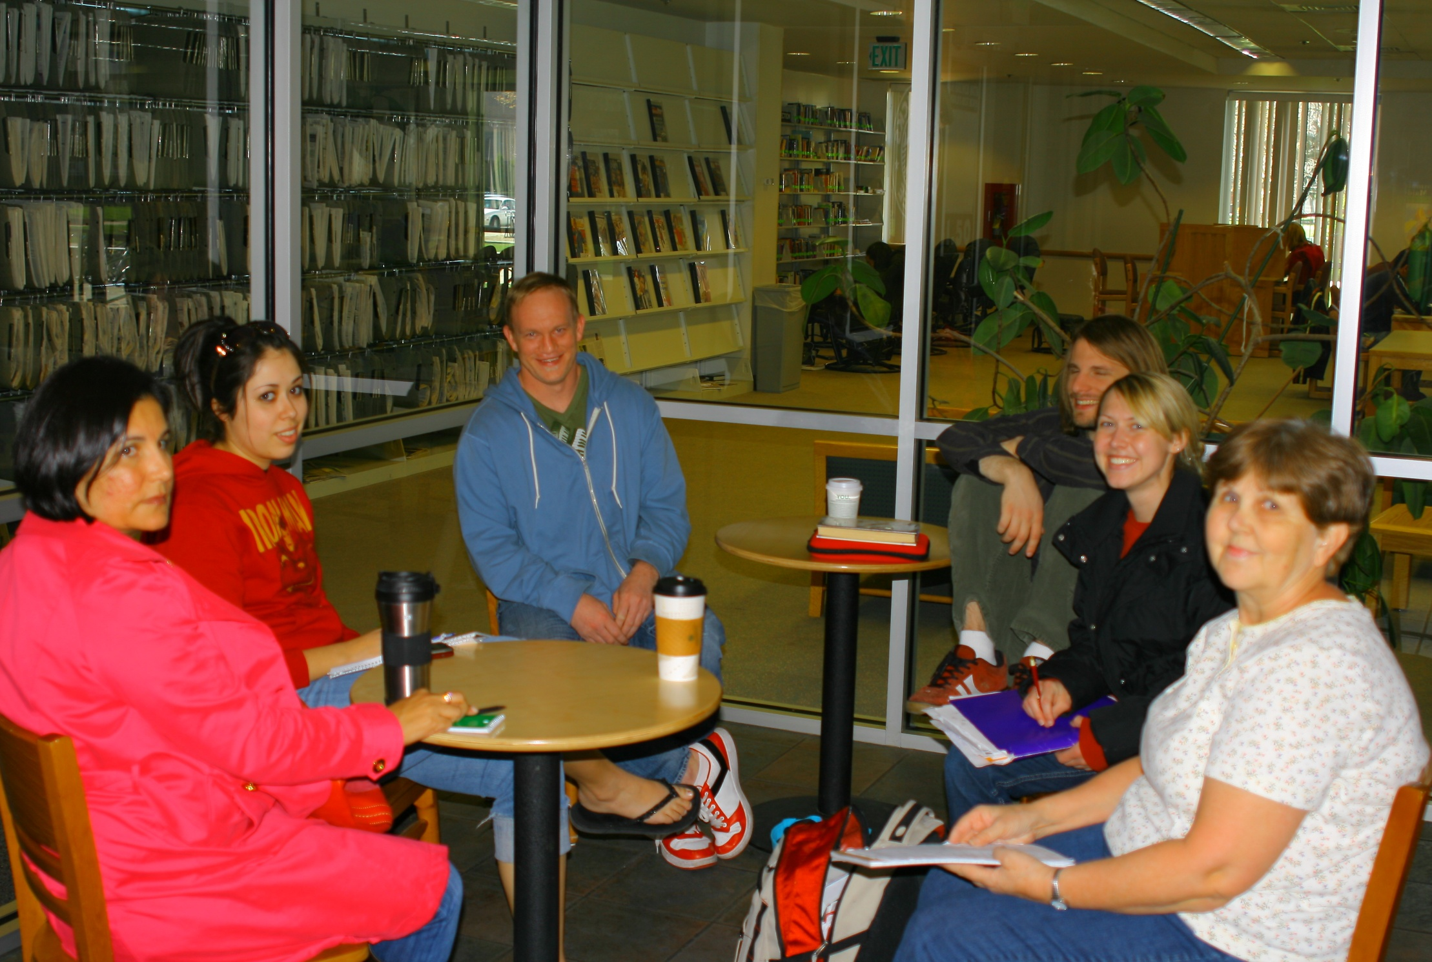
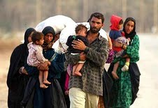
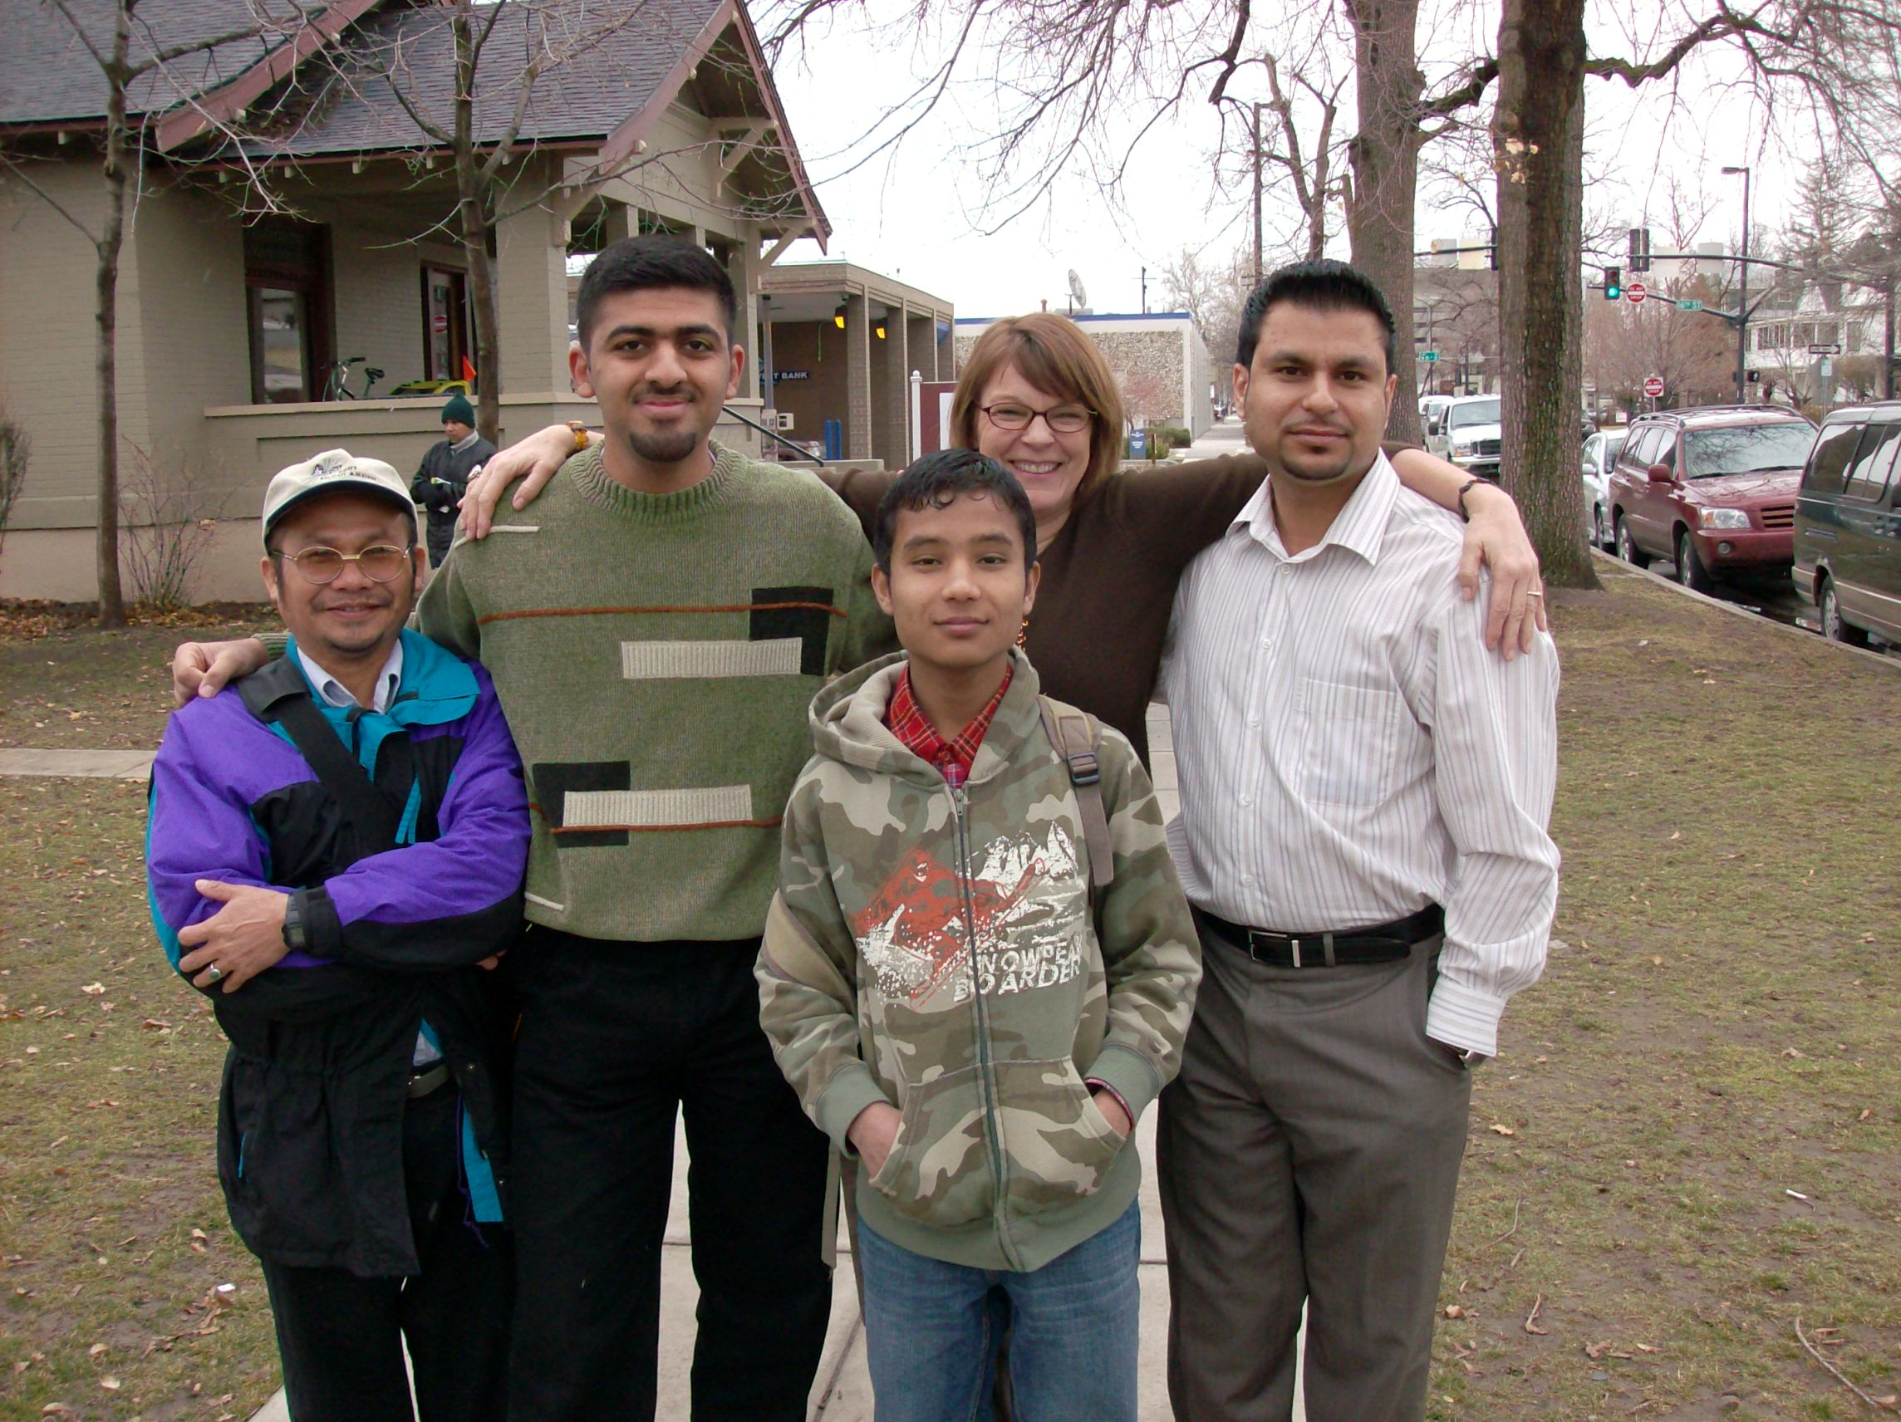
Civic Engagement in Action: ANA Refugee Services Evaluation Laura Hezeltine, Susan Kerr, Rich Kilfoyle, Katie Wilson, and Ryan Zimmerman
Class: Psychology 489: Capstone Perspectives on Psychological Issues, Spring 2010.
Instructor : Dr. Linda Anooshian
Community Partner: Agency for New Americans
Community Partner’s Mission Statement: Agency for New Americans (ANA) is all about providing the education and skills necessary for refugees to become self-sufficient. We are a private, nonprofit provider of employment, case management, and training services for people who have fled their homeland and are unable to return due to fear of persecution based on race, religion, nationality, or membership in a particular social group or political opinion. We believe in human rights, education, and cultural diversity. Americans are the daughters and sons of immigrants; we welcome those who, through no fault of their own, must start their lives anew with the protection of freedom and dignity. ANA provides the opportunity and know-how to rebuild their lives by means of direct job placement following extensive English tutoring, acculturation, and job-seeking skills.
Service Project Purpose: The agency wanted us to interview refugees to determine how refugee services provided by them could be improved.
Learning goals: To address controversial issues and social problems and to acquire a better understanding of the applications of psychological principles, specifically related to working with community agencies. To help sudents gain specific experiences relevant to supporting their understanding and appreciation of civic engagement, complete direct-service hours, and complete a community-based project.
According to the Idaho Office for Refugees, there were 1,153 refugees added to Idaho’s population in 2009 and 5,567 since 2000. Every year, Agency for New Americans welcomes over 200 refugees who now make Idaho their new home. People from all over the world, including Latin America, Europe, Asia, Africa, and the Middle East, have come to Idaho as refugees through the help of ANA.
We were asked to interview current and former ANA clients in an effort to provide quality feedback to ANA regarding the effectiveness of the services provided to their clients and how they may be improved, as well as any issues of concern the clients may be facing during their time of transition.
Our sample consisted of 15 families who have been in Idaho for an average of 3.8 months (with one family, excluded from the average, which has been in Idaho for more than 5 years). Nations of origin for our sample included; Somalia, Afghanistan, Bhutan, Congo, Iraq , and Burma. Families were interviewed, with the help of an ANA appointed interpreter and were conducted at the participants’ home. The interview consisted of open-ended questions touching on 10 areas of interest; participant’s background, arrival, agency orientation, accommodations, agency staff, education, language acquisition, employment, current situation, and overall experience.
Every participating family was having issues with the language barrier and also had economic or job-seeking concerns. Transportation was another major area of concern, with many of the participants requesting bicycles., and bus passes for a longer period of time. Most of the participants were generally satisfied with the educational opportunities provided to them and their children, though many requested more computer access. Participants were satisfied with the agency’s orientation in the apartment but not in the city, stores, and surrounding areas. They also had hoped for a follow-up to the first orientation. There were a few reports of mental health issues concerning the participants, such as depression and PTSD, and the lack of timely doctor visits and treatment. We found that ANA might benefit from an increase in and special focus on fundraising or grant-writing activities so that they may be able to hire more staff to help better address the issues of the clients. A greater number of staff with interpretive skills would be recommended. For adults, a greater focus on higher education could be beneficial to the refugees as opposed to such an emphasis on job placement in low income jobs with little hope for advancement. ANA might also network with temp agencies and other employers to increase job placement for refugees. Better accessibility to doctors is a necessity so that the refugees may better address their physical and mental issues and become better able to meet their daily tasks and obligations.
Introduction, Methods, and Discussion
What is a refugee?
Refugees are individuals who are seeking asylum from their nations of origin and are unable/unwilling to return due to political, religious, and/or social strife and persecution.
Reflection:
Interviewing refuges from a variety of backgrounds and experiences was a powerful and unifying experience; it opened our minds, expanded our thinking, and touched our hearts. We left each interview talking about how we could help. We met many resilient and determined individuals, many of whom were suffering from mental, emotional, and physical problems. We were impressed by their honesty and their determination. All of the men expressed a determination to become self-sufficient and give back to their new country and its government. All the refugee families were trying to make a home for themselves in Boise despite unemployment and health problems. ANA provides the foundation for this life change. Unfortunately, all services and their efficacy are monetarily related. The funds to help refugees are provided by the government and are limited as to amount and duration. It is not enough. The clientele load per staff member is overwhelming and both case workers as well as refugees are struggling. Despite strongly felt language, employment, and culture barriers, optimism prevails as refugees work to successfully integrate into the community. ANA relies heavily on donations and volunteers to continue improving the lives of refugees and we sincerely hope that our observations and recommendations will improve agency services and the lives of the refugees the agency and its staff are so committed to help.
Service Activities:
We had two informational meetings with our agency contact, one at the beginning and one at the end of our project. Aided by this contact, we designed a questionnaire to assess the services offered by ANA. Using it and the help of interpreters, we interviewed Afghani, Somali Bantu, Iraqi, Bhutanese, and Burmese refugee families. We gained, recorded, and assessed their answers. We submitted our results and recommendations to the agency. We also worked at the agency organizing and filing refugee records and at the Tenth International Women’s Day Celebration fundraiser.

