Slide 1
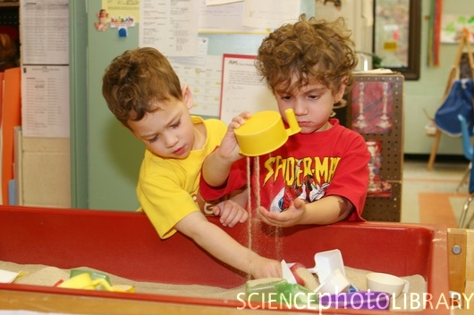
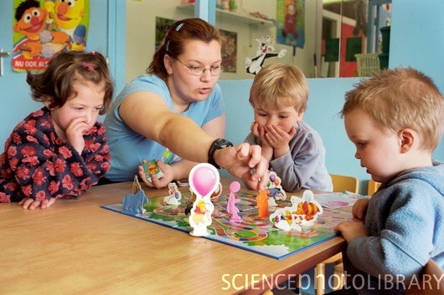
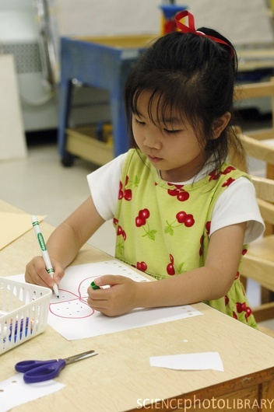
Civic Engagement in Action: After-School Programs Community Perceptions Influencing Involvement
Shirree Reynolds; Jackie Mosier; Chanel Peisner; Matt Hallowell; Ashley Murphy; Linda Anooshian, PhD
Psyc 489, Capstones, Spring 2010
INTRODUCTION
AFTER-SCHOOL PROGRAMS
RESULTS
According to the U.S. Bureau of Labor Statistics, in 2000, 69% of-two parent families and 71% of single-parent families reported young children in need of supervision outside of school hours due to parents' work schedules.¹ There is a critical need for organizations that can provide an enriching environment with quality adult supervision for children outside of school hours. We investigate some of the perceptions and factors that contribute to involvement or non-involvement of children and families in after-school programs to evaluate possible areas of improvement.
Agency | Ages | Cost
Whiz Kid Daycare and Preschool | 1 to 12 | Varies
Boise WaterShed Environmental Ed. Center | 1 to 18 | Free
Library! | 1 to 18 | Free
Swimming Pool Centers | 1 to 18 | starts at $1.50 - depends on age/time
Eagle Y's Kids | 1 to 18 | Varies
First Presbyterian Church | 1 to 18 | Varies
Foothills Christian Church | 1 to 18 | Varies
King of Glory Lutheran Church Youth Programs | 1 to 18 | Varies
Ninth Street Y's Kids | 1 to 18 | Varies
Ustick Y's Kids | 1 to 18 | Varies
Washington Street Y's Kids | 1 to 18 | Varies
Y's Kids on the Bench | 1 to 18 | Varies
City of Boise, Camps, Visual & Performing Arts | 2 to 18 | Varies
Madison Early Childhood Center | 3 to 5 | Varies
Young Rembrandts | 3 to 12 | $9.00 / class
Vellotti's Chess Kids | 3 to 12 | Varies
Dance Unlimited | 3 to 18 | $36-$42/month
Idaho Shakespeare Festival Spring Drama | 3 to 18 | $60 - $675
Idaho Ice World - hockey and ice skating | 3 to 18 | $78 - $400/program and $6/visit
Bridgepoint Church | 3 to 18 | Free
Boise Peak Fitness Rock Climbing | 3 to 18 | Varies
Warm Springs Golf Course | 4 to 18 | $46/session, drop in starts at $10
Capitol Youth Soccer / Idaho Rush Soccer | 4 to 18 | $50-$750 - varies by program
Idaho Music Academy | 4 to 18 | $65 - $150 per month
Columbia Heights Baptist Church | 4 to 18 | Free
Boise Art Museum Camps and Classes | 4 to 18 | Varies
Elementary School Programs | 5 to 11 | Varies
Just for Kids | 5 to 12 | $49-740/month
Berlitz Kids | 5 to 12 | Varies
Cole Valley Christian Schools Extended Care | 5 to 12 | Varies
Puentes 4 Kids - Spanish | 5 to 12 | Varies
Christine Donnell School of the Arts | 5 to 13 | Varies
Hunter Y's Kids | 5 to 14 | Varies
YMCA | 5 to 15 | Varies
Girl Scouts | 5 to 18 | $12/annual
An Daire Academy of Irish Dance | 5 to 18 | $60/month
Mobile Recreation Unit | 5 to 18 | Free
Foothills Learning Center | 5 to 18 | Free except summer camps
City of Boise Playcamps | 6 to 12 | $63-76/week for residents
Boise Rock School | 6 to 14 | $125/month
ParkCenter Youth Fitness | 6 to 15 | $15-25 monthly
The First Tee of Idaho | 6 to 17 | $15-$100/program
Boys and Girls Club | 6 to 18 | $10/school-year and summer
Big Brothers, Big Sisters | 6 to 18 | Free
City of Boise After School Programs | 6 to 18 | Free
Girls on the Run Idaho | 8 to 14 | $35-$105
The Cabin | 8 to 18 | $145 and up
Especially Me! | 9 to 12 | $20
Boise State University Lacrosse Camps | 10 to 17 | $119/camp
Middle School Programs | 11 to 13 | Varies
Girls Youth Softball Tournaments | 11 to 18 | $265 per team
Boise Language Academy | 11 to 18 | Varies
Treasure Valley Math and Science Center | 11 to 18 | Varies
East Jr. High | 12 to 15 | Varies
1 Way Jesus Youth Ministry | 12 to 18 | Free
Eastwind Community Church Youth Group | 12 to 18 | Free
Emerge Youth - ParkCenter Assembly of God | 12 to 18 | Free
IGNITE - Ustick Baptist Church | 12 to 18 | Free
THIRST | 12 to 18 | Free
The Exchange - 2nd Baptist Church | 12 to 18 | Varies
St. Paul Baptist Church | 13 to 18 | Free
Fort Boise Community Teen Activity Center | 13 to 18 | Varies
Technical Eduation Center | 15 to 18 | Free
High School Programs | 15 to 18 | Varies
Marian Pritchett School at Booth | 15 to 18 | Varies
Demographics:
Our population of Psychology 101 students consisted of 44.5% males and 55.5% females. Of these participants only 16% are parents and only 16% of those parents report having a stay-at-home parent in their household. We found that 68% of parents have their children involved in after-school activities and 37% of the parents have children in after-school programs. About 35% of the participants in this study attended after-school programs when they were growing up and the majority of the time it was during the school-year (55%).
After-School Programs Evaluation/Opinion:
Our survey found that 81% of involved participants were in favor of after-school programs. It also found that 93% of involved participants thought after-school programs to be beneficial.
The top three reasons not to be involved in after-school programs were cost (23%), transportation (16%), and other (51%). Of the participants who attended after-school programs during childhood or adolescence, 24% quit after-school programs for reason other than because of age.
PARTNERING AGENCIES
Boys & Girls Clubs
Mission Statement: To inspire and empower all young people, especially those who need us most, to realize their full potential as productive, responsible and caring citizens.²
YMCA
Mission Statement: The Treasure Valley Family YMCA welcomes all people and provides an atmosphere to enrich spirit, mind and body. We are dedicated to the values of caring, honesty, respect, and responsibility. Our programs enhance individual health and well being, strengthen personal and family relationships and develop leadership skills. We build strong kids, strong families, strong communities.³
METHODS
A survey was administered to Psychology 101 students through the online Experimetrix program at Boise State University. The survey topics included: demographics (age, sex, marital status, job status, and family demographics), student’s perceptions of after-school programs, parents’ use and perceptions of after-school programs, students’ past involvement with after-school programs, and knowledge of available after-school school programs in the community. This study has the potential to elucidate current perceptions of after-school programs and benefit agencies (The Boys & Girls Club and Parks and Recreation) by providing them with information on areas they can improve community knowledge about their program benefits.
DISCUSSION
Our main focus for this research survey was to get a subjective perception on after-school programs from a wide range of participants. We wanted to see if the participants thought after-school programs were beneficial to the development of a child or adolescent.
We found that participants were in favor of after-school programs and we also found that they think after-school programs were beneficial. Even though we didn’t specifically ask the participant “what part of development do you think after-school programs benefit a child or adolescent,” we think it is safe to infer that the participants view after-school programs and/or activities as beneficial to development in general. Future research is still needed to evaluate future improvements that can be made in after-school programs.
DEMOGRAPHICS
Male Participants | 53
Female Participants | 66
Age Range | 18-47
Age (mean) | 23
Parents | 19
# of Children (mean) | 2
Part-time Students | 16
REFERENCES
U.S. Bureau of Labor Statistics. (2000). Employmentj characterisitics of families: summary table 4. Washington D.C.: U.S. Census Bureau.
Boys & Girls Clubs of Ada County. (2009) Our mission. Accessed April 13, 2010 from http://www.mybgclub.org/who_we_are.html.
YMCA. (2010) Your YMCA. Accessed April 13, 2010 from http://www.ymcaboise.org/index.cfm?ID=93,23,0.
http://www.cityofboise.org/After3/

