Slide 1
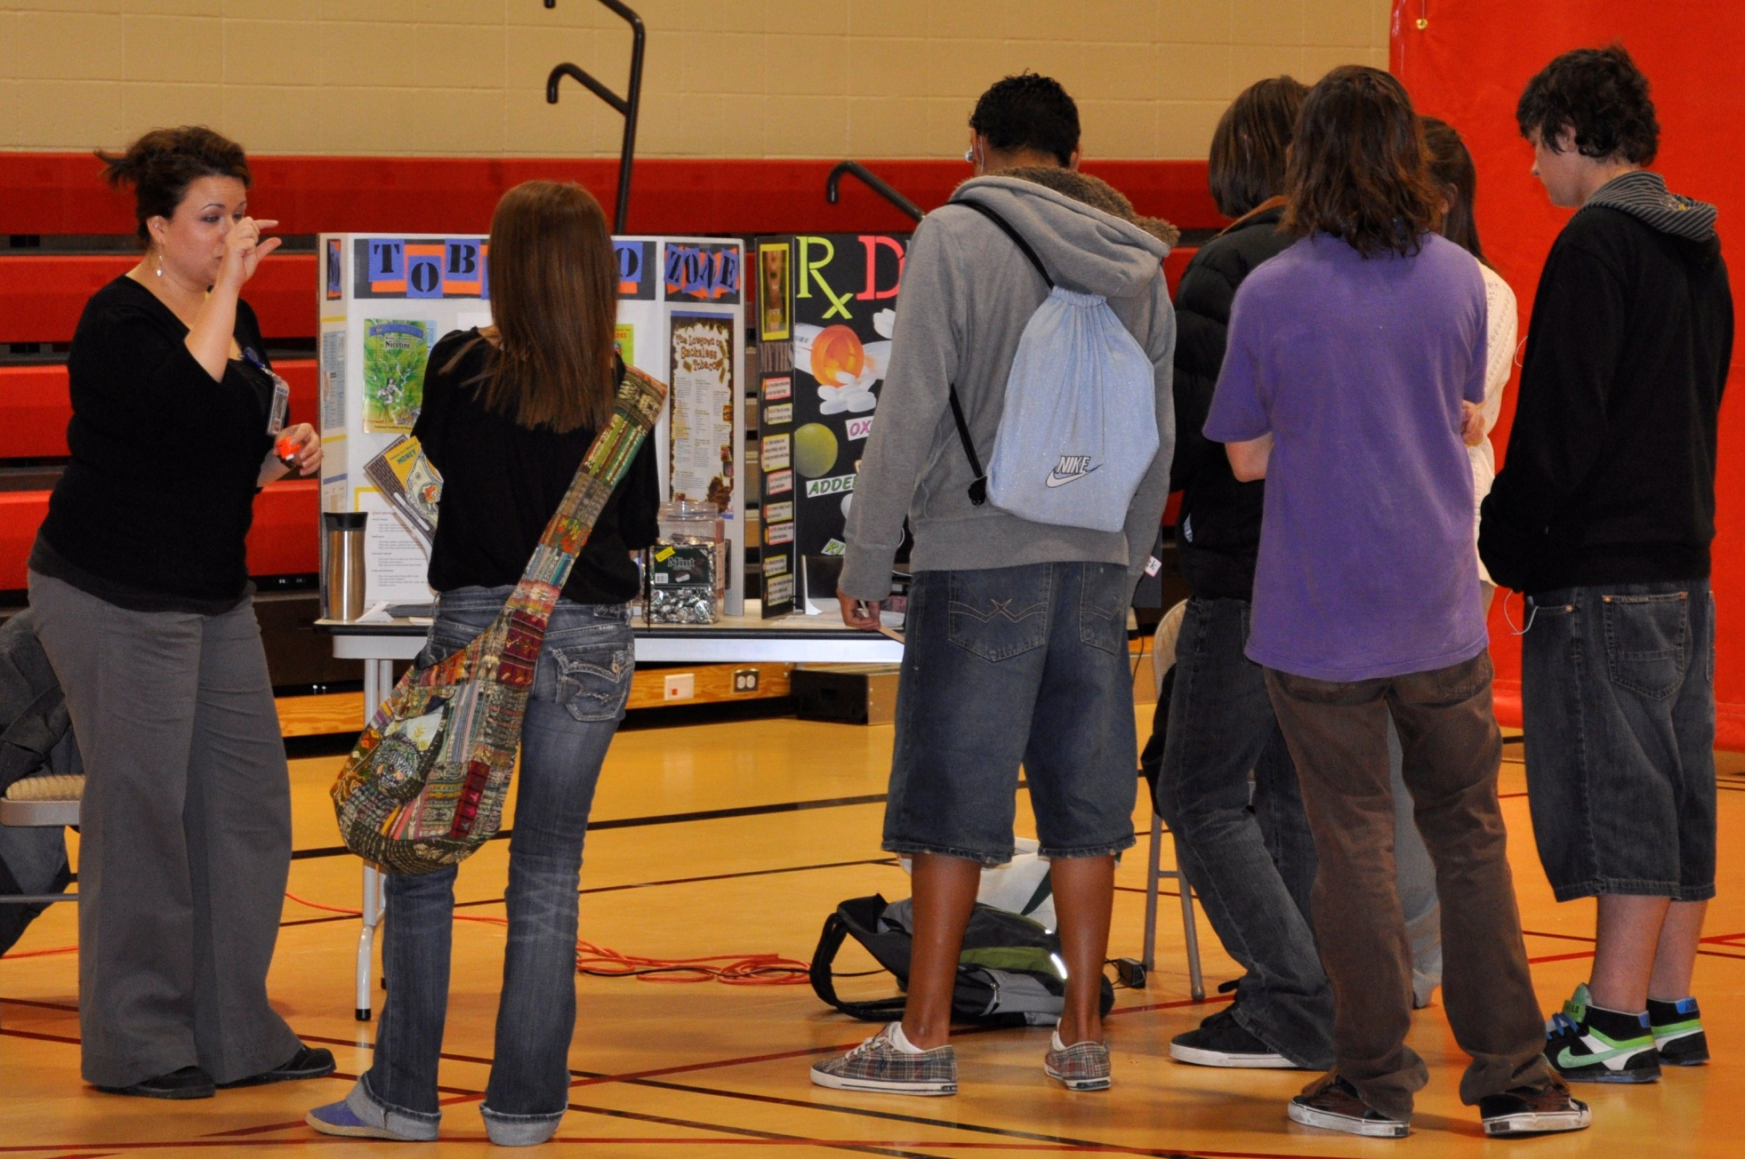
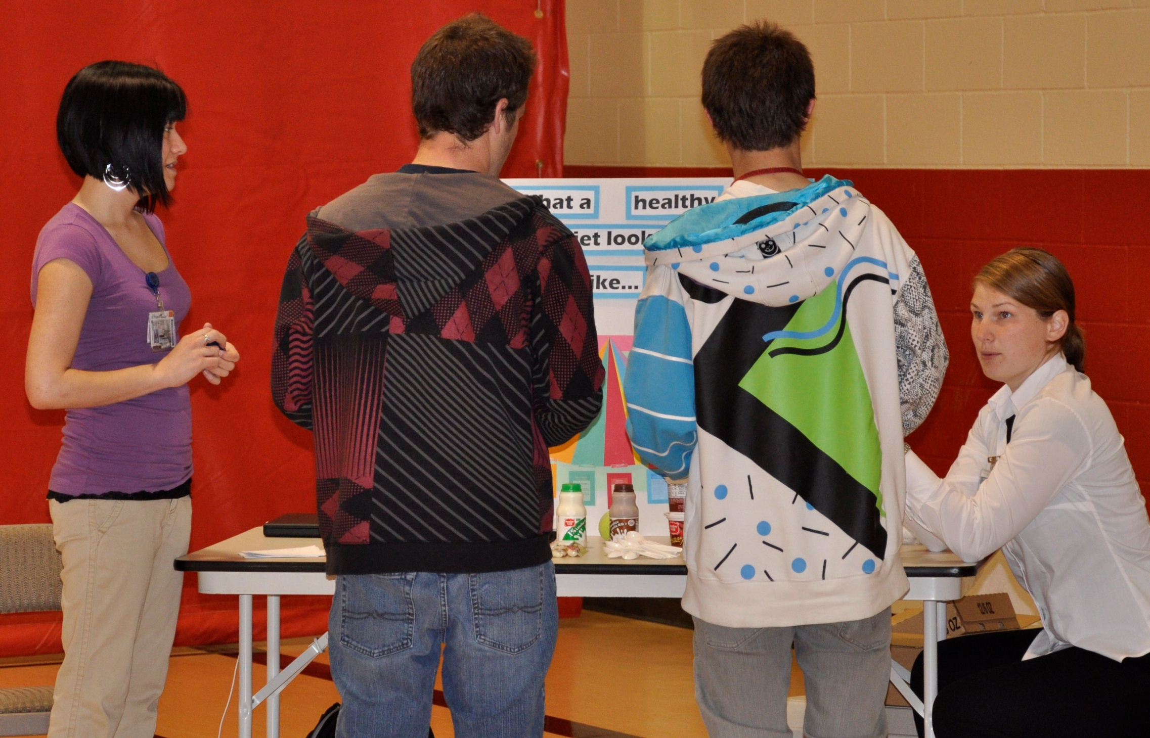
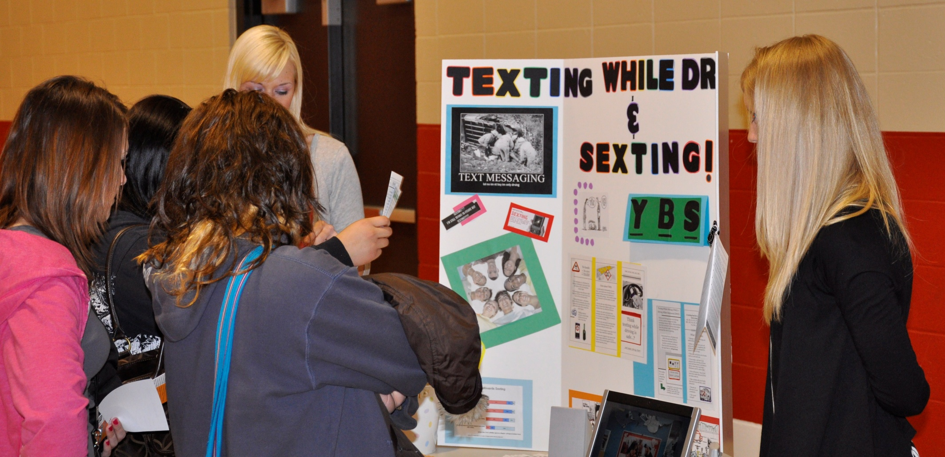
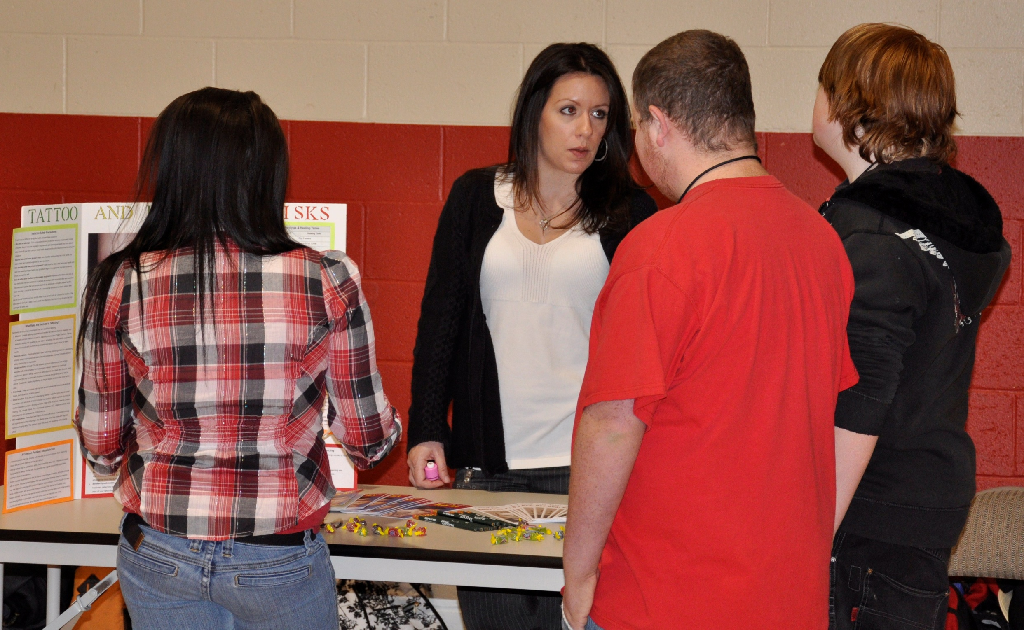
Civic Engagement in Action: Empowering Adolescents to Take Control of their Health Summer Nave, Meghan Cunningham, Christine Duncan, Kami Bellomy, Kathryn Cooperstein, Nichole Murphy, RN, Johnny Glogowski, Rachel Kendall, Amanda King, Jessi Christensen-Bybee and Kayla Salcido
Project Purpose:
To develop a health fair which was designed to educate and improve the health of the community agency population through health promotion activities.
Outcome:
Objectives obtained were:
Gained understanding of population through assessment and intervention.
Students were visibly engaged and related the booths to personal experiences; they asked various questions related to the impact on their own health.
Learning was confirmed by comment card responses.
Interactive activities proved effective as evidenced by participation and seeking of information.
Activities:
Posters and booths focused on:
Education beyond high school, sexting and texting, piercing and tattoos, smoking, and prescription drug abuse.
Providing detailed information about the long term effects that these activities could have on a person’s health.
Motivating student education through awarding prizes for participation at the booths.
Evaluating student satisfaction and response pertaining to the information provided.
Key Points:
Community & Public Health Nursing Lab, NURS 417, Spring 2010
Instructor Name: Pamela Gehrke
Community Partner Name: A local area high school
Community Partner’s Mission Statement: “We help students achieve their educational potential and become contributing members of our community.”
Service Project Purpose: Provide health assessment data to faculty and student at the high school, as well as conduct a health fair tailored toward specific student health needs.
Learning Goals: To assess the health needs of students at the local high school and produce a summary report of findings.
Reflection:
As a result of time spent at the local high school, we learned:
Prior to visiting the school there were trepidations about our ability to complete the assessment and interact with the students.
Community assessment is a complex process that requires organization and continuous evaluation.
Interaction with the population (high school students) was not only important for planning interventions, but it also provided valuable qualitative data.
Cooperation from the agency was integral in gathering information and also in conducting a useful and accurate assessment.
Interactions with the students showed their desire to learn.
Obstacles:
Difficulties encountered included:
Determining the information that would be most beneficial to our population needs.
Misconceptions and stereotypes about the population.
Integrating information from the health fair to shape our final product in the limited time frame provided.

