Slide 1
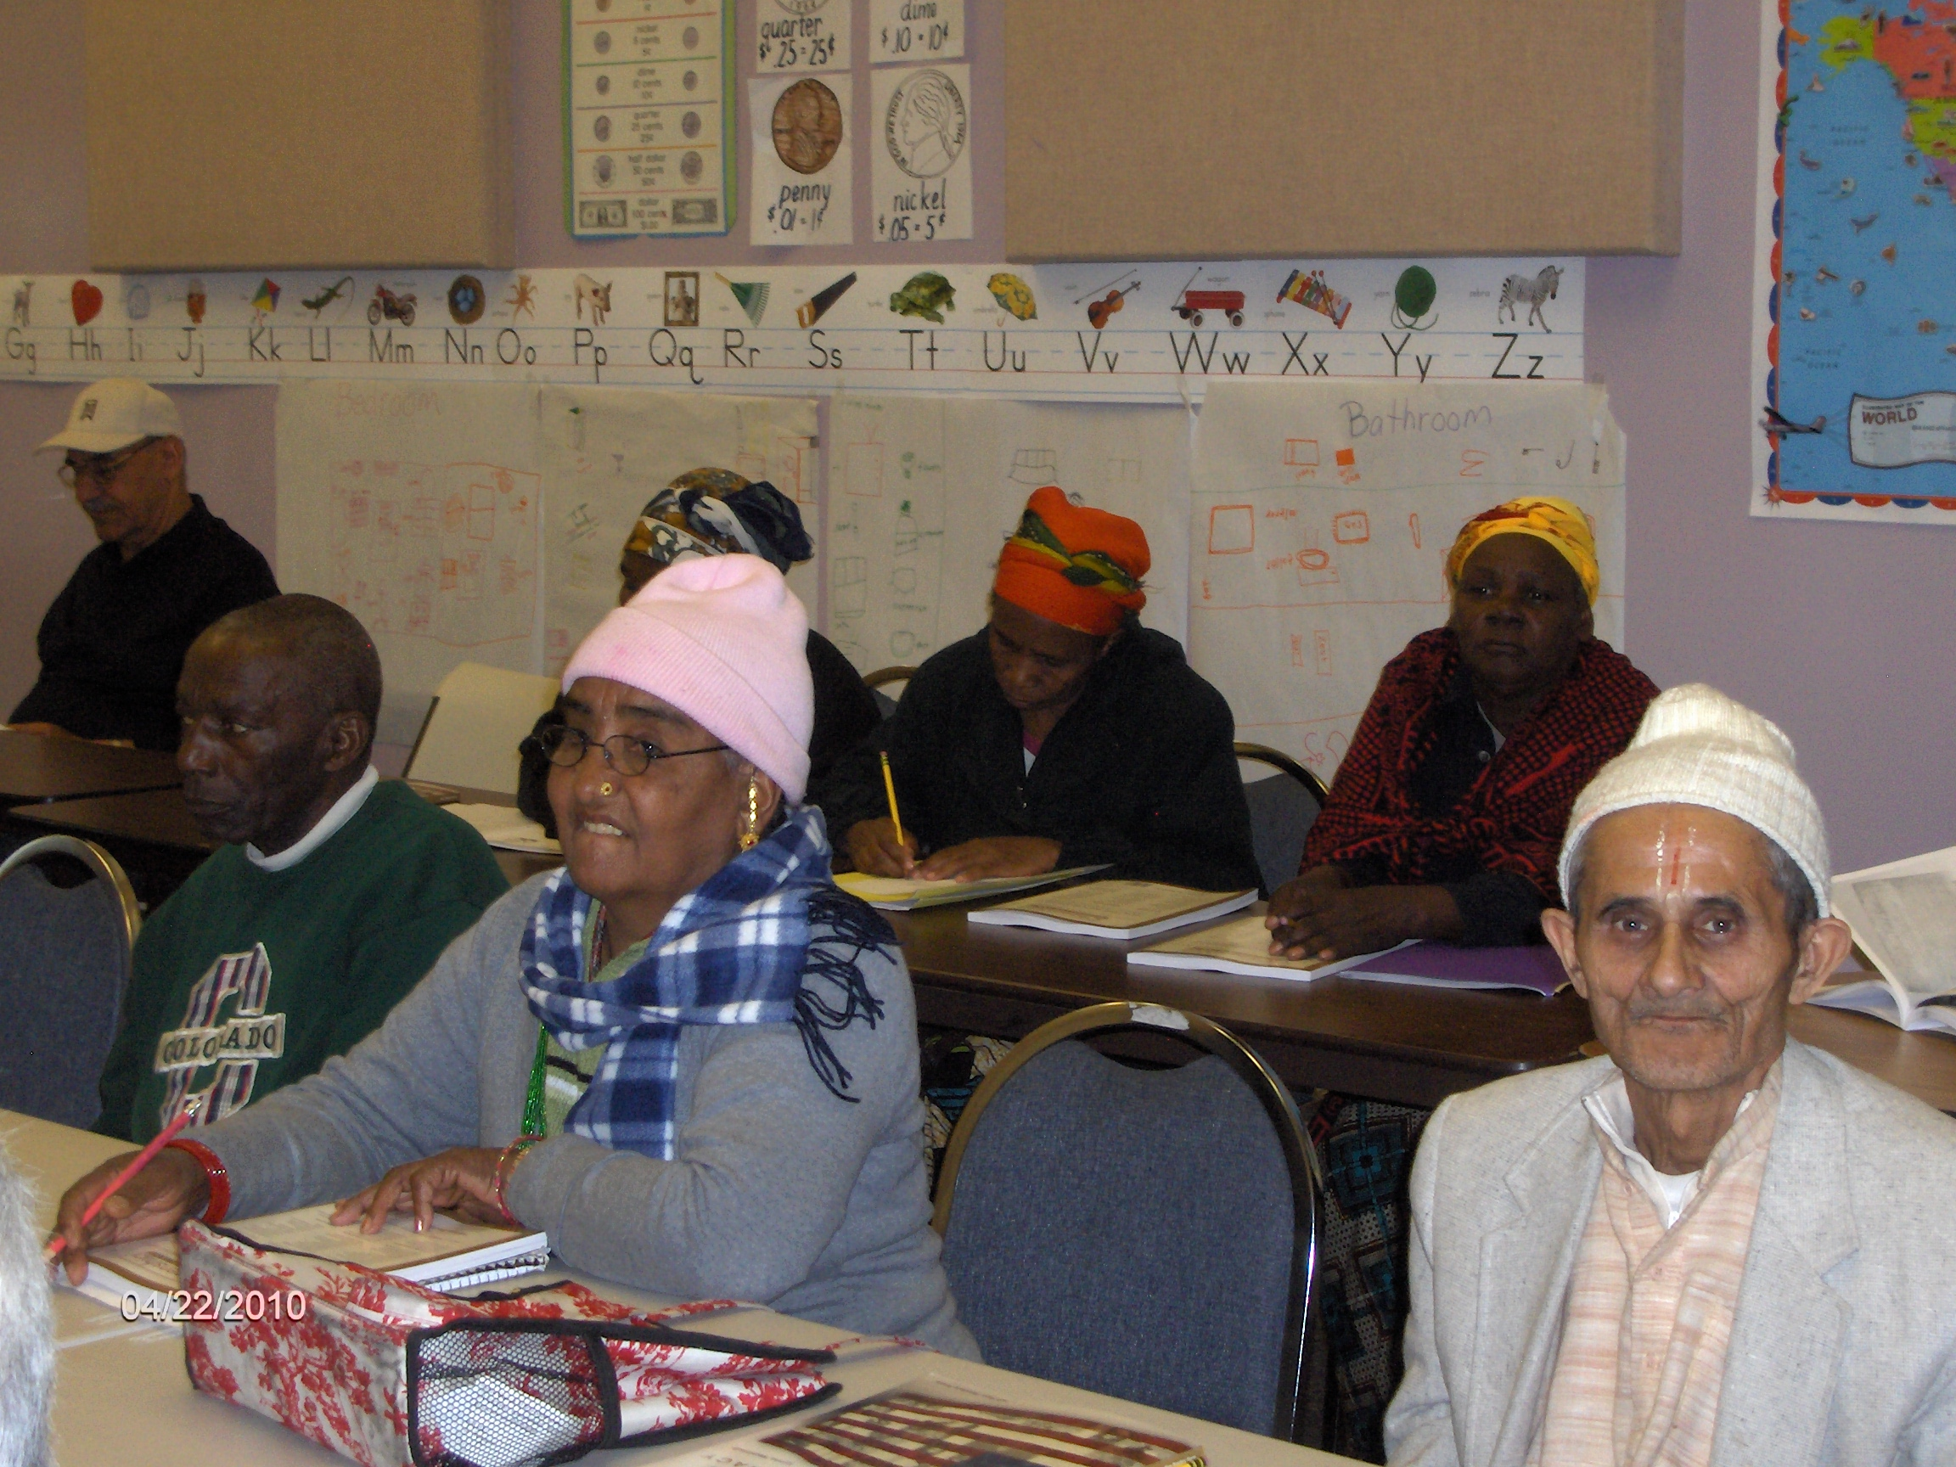
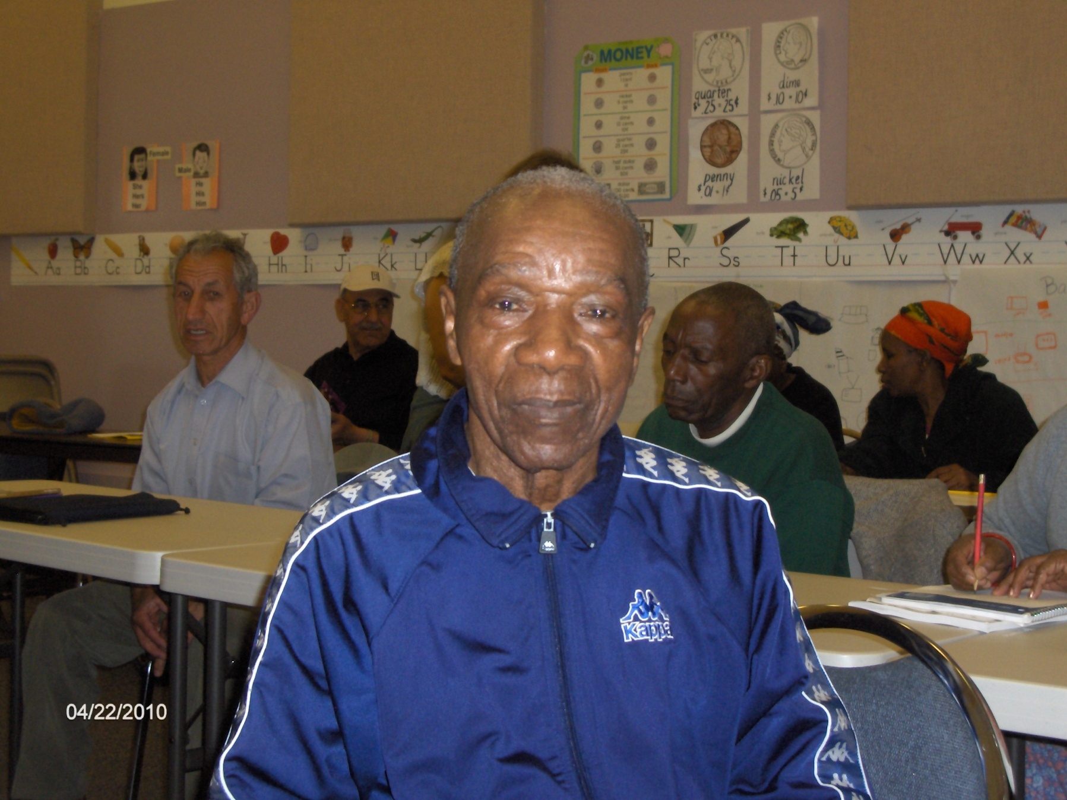
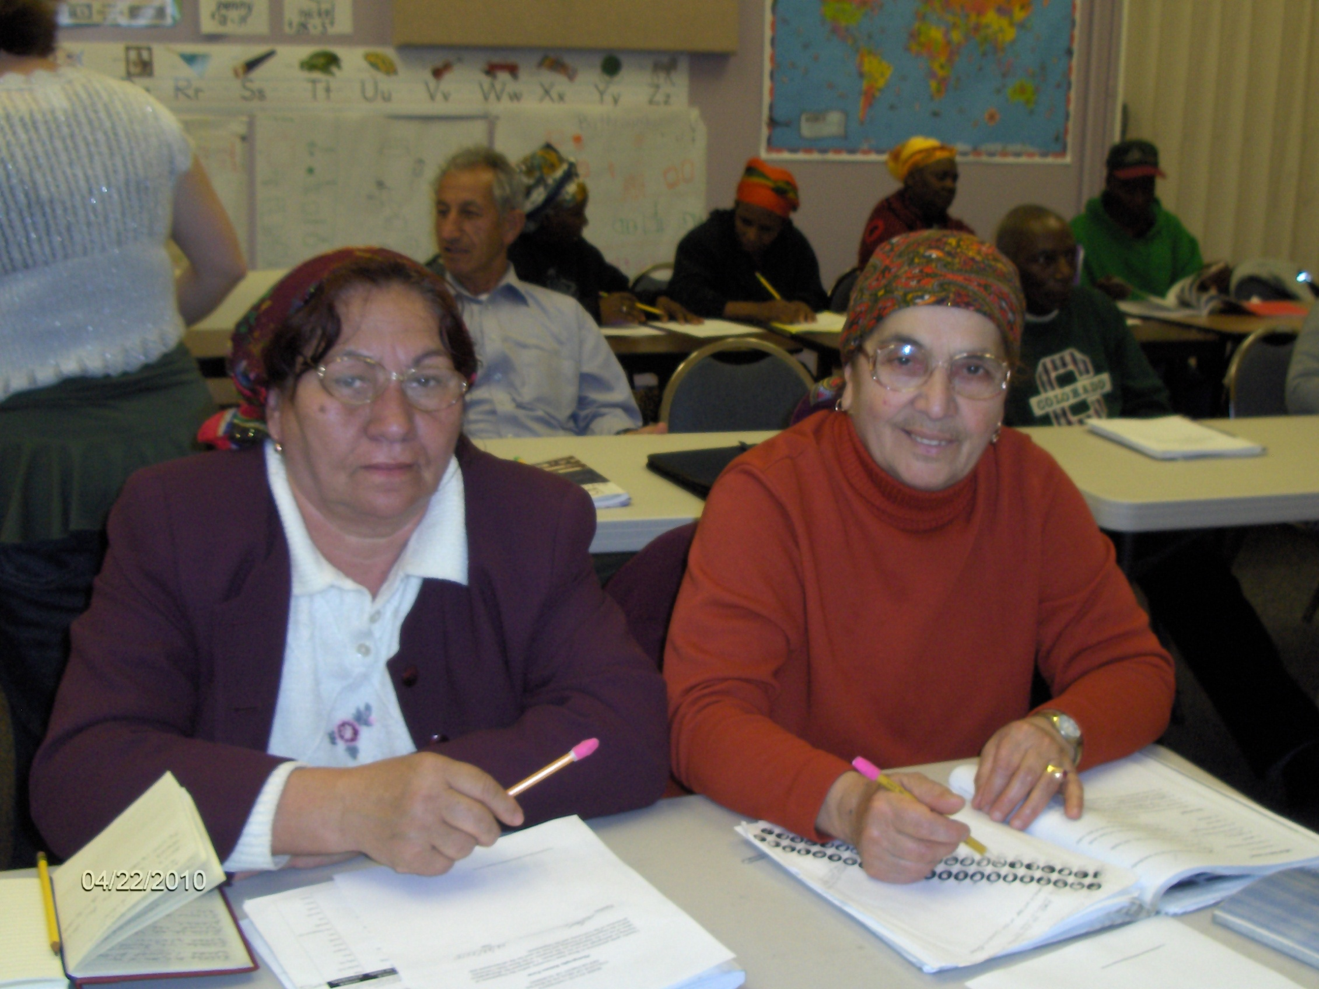
Civic Engagement in Action: Enhancing Personal Care Services for Senior Refugees Alina Austin, Marissa Baker, Joei Beaman, Sarah Harris, Janina Harvell, Joanna Judd, Melody Keiser, RN, Kylie Nebeker, Heather Niehoff, Marianne Palaia, & Kristal Richens
CLASS: NURS 417—Community and Public Health Nursing, Spring 2010
INSTRUCTOR: Molly Prengaman, RN, MS, FNP
COMMUNITY PARTNER : Southwest Idaho Area III Agency on Aging (SW Idaho AAA)
AGENCY MISSION STATEMENT: “Southwest Idaho Area III Agency on Aging strives to provide essential services to enhance quality of life for vulnerable and aging adults. We meet this challenge through advocacy, partnerships, and promoting public awareness, guided by integrity, vision, and sustained commitment.”
PROJECT PURPOSE: To assess the healthcare needs of senior refugees and develop training materials designed to improve the quality of personal care services provided to senior refugees by family members and/or employees of local home health agencies.
LEARNING GOALS: (1) To apply basic concepts of population-focused practice to client situations, and perform targeted community assessments centered on an identified need of an agency working with a population. (2) Implement short-term interventions and make recommendations for short and long-range goals and interventions for the agency/population. (3) To practice skills required by professional nurses working in community and public health.
SERVICE ACTIVITIES: To gather information about the senior refugee community our group members attended English and citizenship courses attended by senior refugees. Group members also served as volunteers at the Somali Bantu Food Distribution Project and attended SW Idaho AAA meetings to gather information about senior refugees and the personal care services being offered by local home health agencies. Our group also hosted an Iraqi refugee guest speaker who is a Refugee Health Advisor for St. Alphonsus Hospital.
REFLECTION: Our group learned that despite the vast differences between senior refugees and ourselves, we are very similar in our basic desires to live and be treated well. Like us, senior refugees want to receive high quality care. To overcome language barriers, family members or refugee caregivers are providing personal care services to senior refugees. To ensure that refugee caregivers receive and understand appropriate personal care service training, our group created a basic manual describing how to effectively and safely perform personal care services. The manual was written with easy to understand instructions, photographs and practice scenarios to enhance understanding. Our group was challenged to write instructions that meet the needs of a wide range of literacy levels. Our materials were created in English with the intent that they would be used in small groups using interpreters to provide native language translations for specific refugee training groups.
Senior Refugee
English & Citizenship
Classes
Methods: Mobilizing for Action through Planning and Partnerships (MAPP) is a strategic approach to community health improvement. This tool helps communities improve health and quality of life through community-wide strategic planning. Using MAPP as a guide, BSU nursing students aimed to enhance the quality of personal care services to optimize the health of senior refugees. Our group accomplished this by gathering information about refugees, seniors, and personal care services while identifying and using available resources wisely. Our group also considered the unique circumstances and needs of senior refugees and their personal care providers while forming an effective partnership with SW Idaho AAA for strategic action.
Results: Our group developed a training manual to enhance the training of family or refugee personal care providers to ensure high quality and safe delivery of care. The manual includes information on: hand washing, lifting technique, medication safety, use of canes, walkers and wheelchairs, linen changes, bedpan and urinal use, changing adult disposable briefs, transferring techniques, home safety, grooming techniques, oral care, skin care, household services, as well as food safety and nutrition tips. A printed and a digital copy of this manual will be provided to SW Idaho AAA for use by local home health agencies to use along with interpreters to improve training for refugee personal care providers.
Abstract: Boise State University Department of Nursing’s partner, SW Idaho AAA, requested assistance to address quality of care issues identified among senior refugees receiving personal care services from a family member or refugee personal care provider. Our group interacted with the refugee community during English and citizenship classes, the Somali Bantu Food Distribution project. Our group worked closely with SW Idaho AAA to determine the need for a consistent training manual to be used in conjunction with interpreters to ensure that refugee caregivers receive adequate training to provide high quality care. Using extensive literature review our group developed a comprehensive, basic personal care manual addressing personal care services, while taking into consideration literacy levels, and limited English skills.

