Slide 1
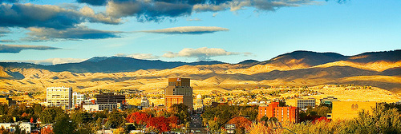
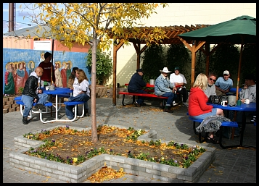
Civic Engagement in Action: Homeless in Boise Lori Henderson
Dr. Mary Pritchard
PSYC, 431, Spring 2010
Corpus Christi House:
The mission of Corpus Christi House is to offer hospitality and services to those in need in the city of Boise.
The Purpose of this service project was to help the homeless by offering friendship and hospitality, while gaining a knowledge of the learning goals related to social psychology. This in turn would allow me to develop: 1) a better understanding of the applications of social psychology principles, specifically related to social influences at work in various interactions in both my personal and professional life. 2) To learn how our community affects us and how we affect it.
Service Learning has provided the means to connect my classroom experience to my service project at Corpus Christi House.
Abstract
Corpus Christi House offers hospitality and every day necessities to the homeless within the city of Boise. Through my SL experience with CCH I have gained new perspectives on homelessness through generosity, acceptance and trust. I have met some truly amazing individuals who strive to “stay strong.” Understanding and acceptance are key to success at CCH, as they help to lessen the gap between social exclusion and social acceptance. The environment provided by CCH enables the homeless to break down those barriers, create meaningful relationships and trust those around them. CCH is the true meaning of acceptance, compassion and altruism.
Service Activities
The main activities include providing daily necessities such as issuing shower supplies, answer the telephone, distribute mail, make coffee, distribute snacks when available, and perform other miscellaneous duties as assigned. The most enjoyable part of doing these activities is offering hospitality, with an open heart and mind. Listening , learning and most of all gaining a new perspective and an understanding of what the homeless face on a day to day basis:
Getting inside, out of the weather to warm up or to iicool down
Using a bathroom
Having a place to sit, read, visit, recreate, without ibeing hassled
Taking a shower or just brushing their teeth
Washing clothes
Storing personal belongings
Through my SL experience I have gained some new friends and met some truly amazing individual with such compassionate and heartbreaking stories.
Social Exclusion
“Homeless people are generally socially excluded, and social exclusion has itself been associated with a lack of future planning and with a tendency to be overly oriented to the present.” Corpus Christi House offers it’s patrons the means to lessen the exclusion they face in our society by offering services such as:
Receiving a message (maybe from a potential employer)
Using a telephone for local calls
Checking out employment opportunities
“ People who are homeless are not social inadequates.
They are people without homes.”
~Sheila McKenchnie~
Steps need to be taken to minimize the gap between the homeless and those who “have homes.” Misfortune has struck many lives throughout this economic downturn and instantly excluded from their “Social existence as they new it.” Understand that each has a story to tell and each has their reasons why they are where they are now. Acceptance rather than exclusion is the key to lessening this social gap.
Social Acceptance
The level of social acceptance that I have observed is very high amongst those at CCH. The patrons there seem to be able to look past prejudices and stereotypes. For the most part they “have each others backs .” Although , “homeless people report high levels of loneliness, which is related to their having unfulfilling intimate relationships and feeling socially marginalized.” The environment provided by CCH enables patrons to break down those barriers, create meaningful relationships and trust those around them.
“And homeless near a thousand homes I stood,
And near a thousand tables pined and wanted food.” ~Wordsworth~
Agency Recommendation 1:
My first recommendation would be to continue always to honor the mission of Corpus Christi House through acceptance, compassion, and hospitality to those in need.
Agency Recommendation 2:
My second recommendation is to pursue a larger building or more space so CCH can continue to grow their mission and help the ever growing homeless population in Boise.
Reflection: A woman at the shelter walked up to me as I was getting ready to leave one afternoon and offered me a vase of freshly handpicked, pink flowers, they were beautiful. She looked me in the eye and asked me “do you have a home, “ I replied “yes, I do” (I almost felt ashamed at that very moment), she said “ I got these flowers for my birthday, would you take them home and make sure they get taken care of, because I have no home to take them to. I want you to have them.” I was speechless for a moment and almost began to cry. I looked at her, gave her a hug and told her “of course, I would love to take care of them for you, thank you.” I have never made sure a vase of flowers lasted so long in my life. Without the opportunity provided to me by SL and Dr. Pritchard’s Social Psychology class, I never would have understood the true meaning of social acceptance, compassion and altruism. Thank you!

