Slide 1
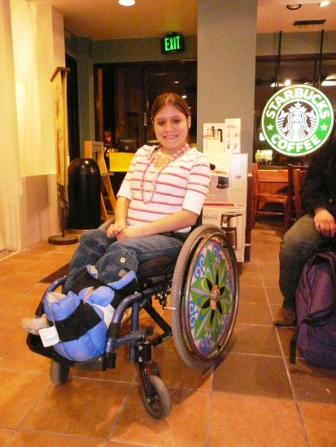
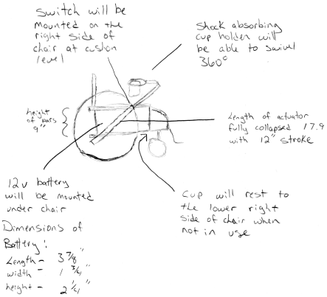
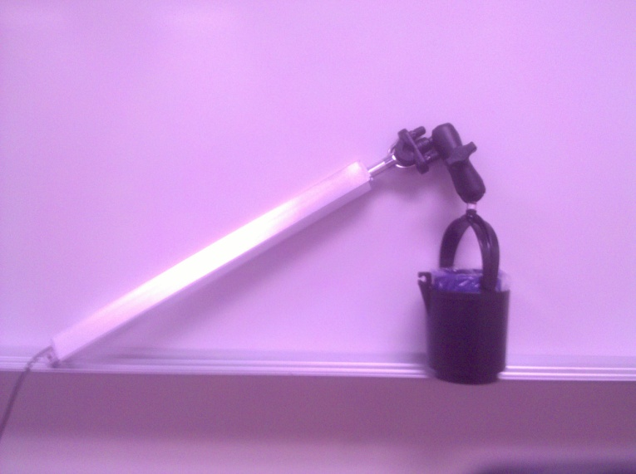
Civic Engagement in Action:
Kendall’s Cup holder
Created by:
Dan Leavitt
Josh Mann
Ian Van Tassel Corbin Vanleeuwen
Intro to Engineering – Spring 2010
Client: Kendall
Instructor: Bill Brudenell
Steps of the Engineering Process:
1. Problem Definition
- Using the problem statement provided by Carol, and the information Kendall provided us via interviews, we developed the detailed problem statement at the right.
2. Concept Design
- We developed sketches of what we thought our different ideas would amount to and selected the best design using the best option for each function.
3. Proof of Concept
- We developed a working model of the design we selected, we had an exemplar actuator and a wire-frame cupholder.
4. Detailed Design
- We went into how we would put our concept to work and found the parts we needed and had them ordered.
5. Fabrication
- We assembled the parts and attached them to Kendall’s wheelchair such that she could activate the actuator easily.
Problem Statement:
Kendall uses both of her hands to operate her manual wheelchair. She would like to have a way to hold a drink and still allow her to use both hands to operate her wheelchair.
Rough sketch of prospective outcome
Detailed Problem Statement
This is Kendall
Function/Design Options | Option A | Option B | Option C
Hold drink | Build a cup holder out of scratch | Purchase a pre build unit and construct an attachment | Purchase the entire rig and attach to wheel chair
Storable | Using an actuator to lower cup holder out of the way | Using a joint mechanism to fold cup holder to the side of chair | Swivel joint to swing cup holder our of the way
Removable | Using wing nuts to attach cup holder to bottom of chair | Using a spring loaded clamp to attach cup holder to bottom of chair | Plastic knob
Absorbs vibration | Rubber on mounts | flexible connecting rod | loose fitting ball joint
Location | On the right side
Interference | Bend support out of the way of hands | place cup holder more forward on chair | Have cup holder extend over shoulder
Final product before mounting

