Slide 1
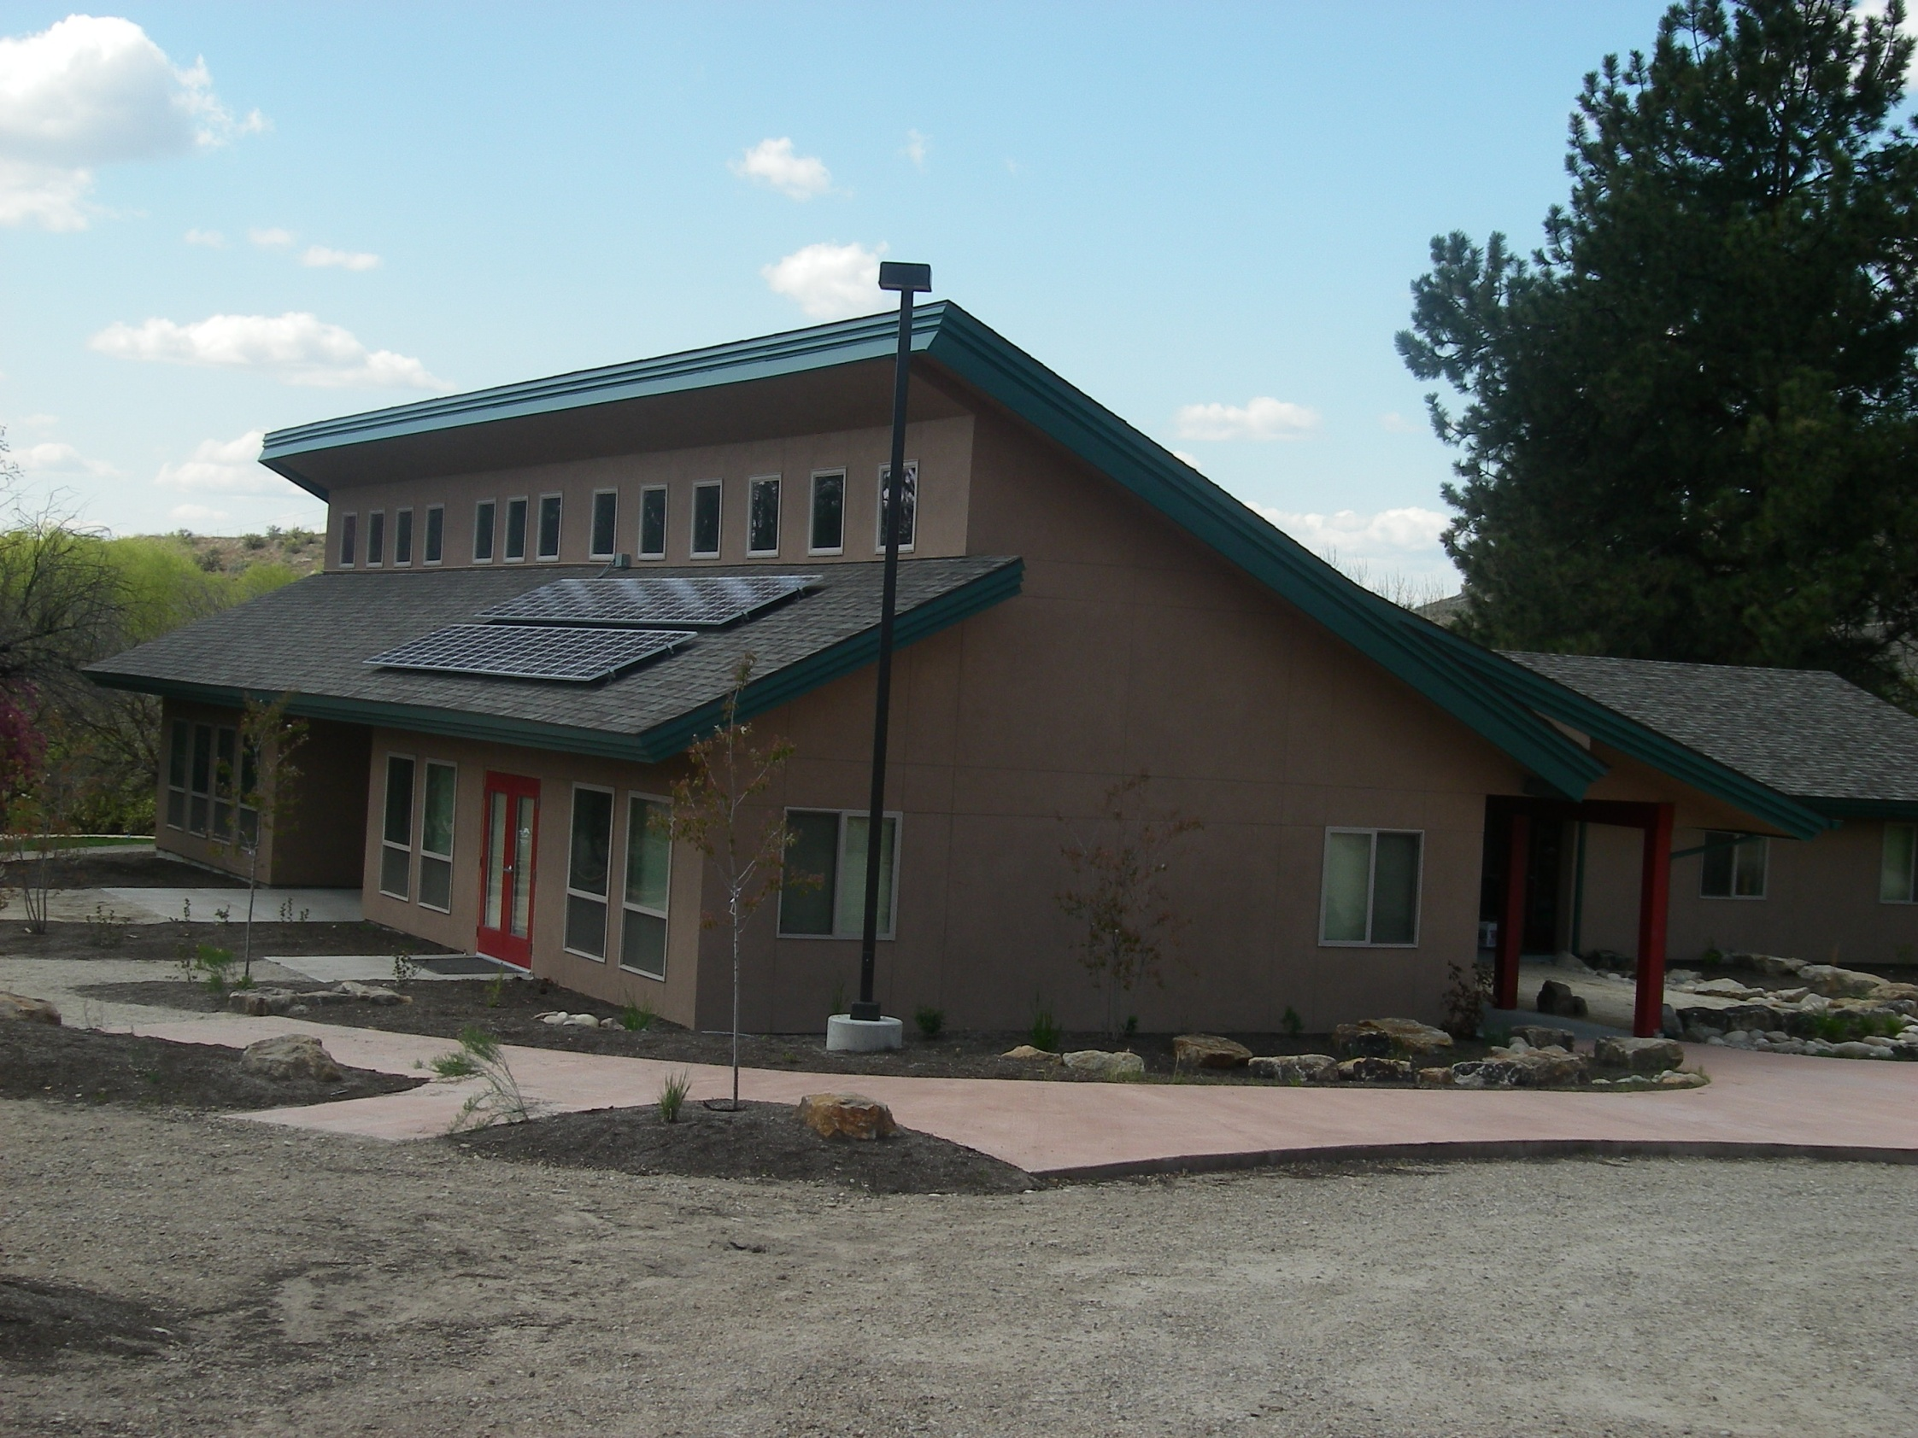
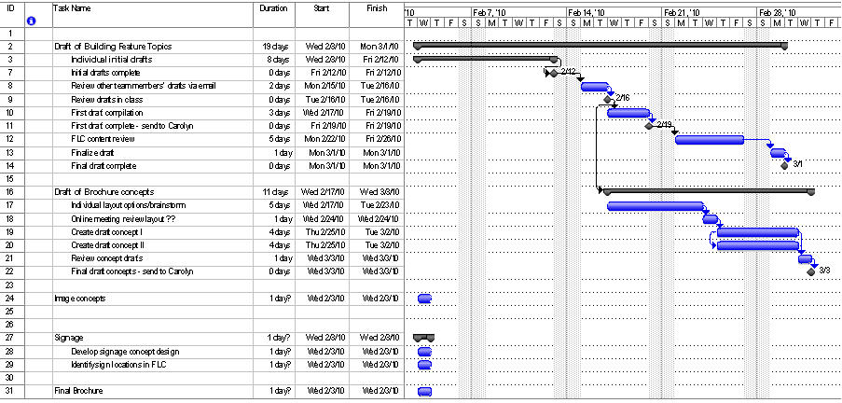
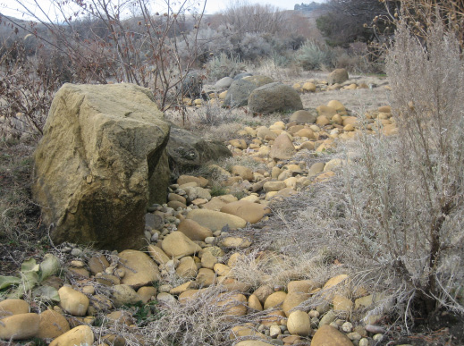
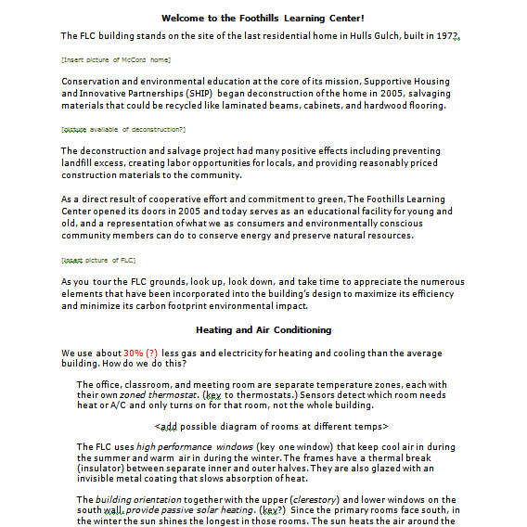
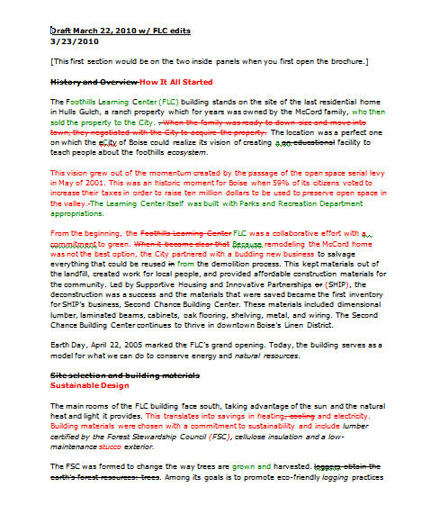
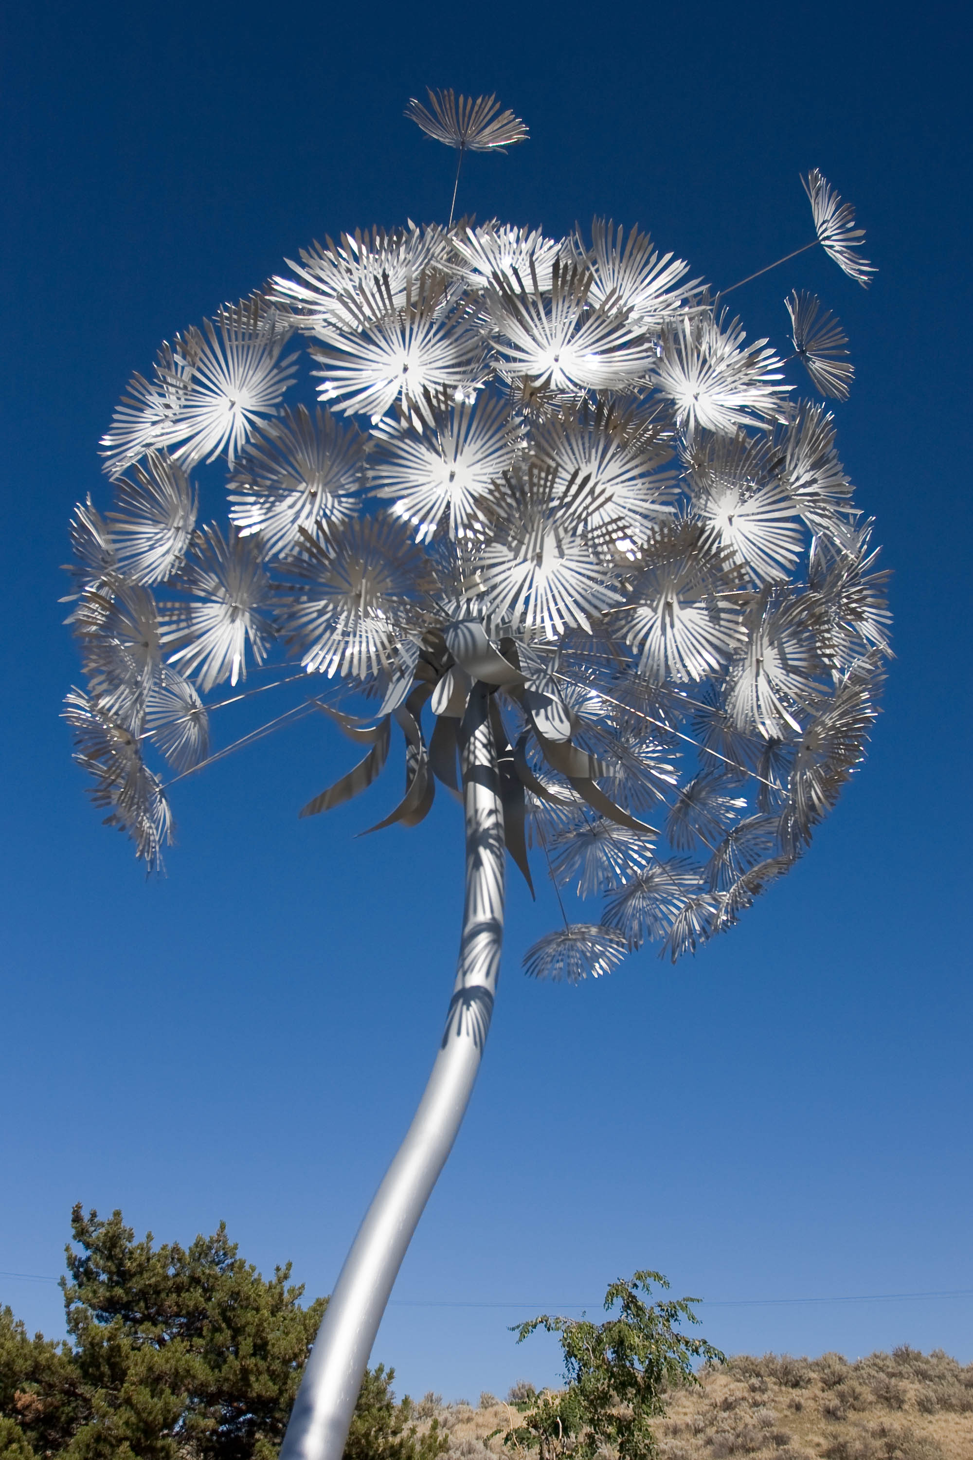
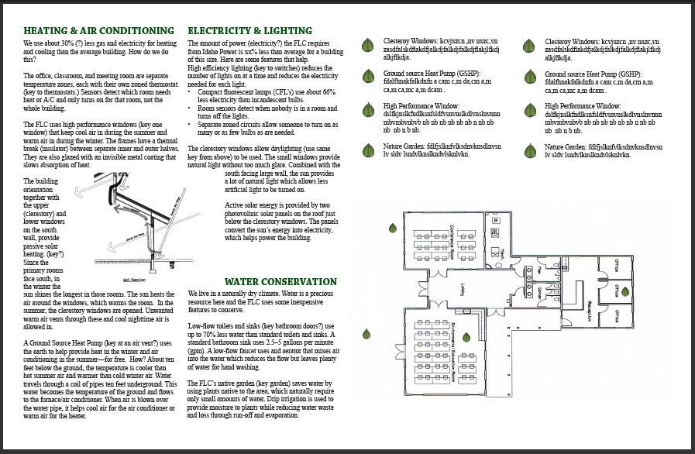
Civic Engagement in Action:
Boise Foothills Learning Center Cindy Holley, John Kuhn, Raluca Serban ENGL 512: Technical Rhetoric and Applications, Dr. Munger , Spring 2010
OUR PURPOSE
Write the text for a brochure to be used as a walking tour to help raise awareness of the green features of the Foothills Learning Center (FLC) building. The brochure should inspire people to make changes to their homes and workspaces.
FOOTHILLS LEARNING CENTER MISSION
Dedicated to promote─through environmental education, service opportunities, and outreach─the preservation and responsible use of the Boise Foothills; and to foster an understanding and appreciation of our place in the natural world.
The Production Process
LEARNING GOALS FOR CLASS PROJECT
Create documents that help address community needs by applying course concepts to a real-world scenario.
Understand audience expectations.
Plan projects.
Make effective use of style elements such as tone, point of view, and level of formality.
The FLC building faces south to maximize daylight received through its numerous windows.
GANTT CHART
“You did a great job incorporating that last round of major feedback. To summarize, you all ROCK!” Client feedback
FIRST DRAFT
WHAT WE DID
Toured the building, experiencing the ways in which they incorporate energy-saving materials and green processes, particularly in the building’s construction.
Visited the native garden, learning how it is home to many local species which tolerate our dry climate.
Appreciated the local art on display throughout the FLC.
WHAT WE LEARNED
Serving the community can be fun and the end
The Native Garden is home to many Idaho species and is drought-tolerant.
result can be truly rewarding. We have helped the FLC to spread its message of sustainable building and living, aided them in growing another step closer to fulfilling their mission of environmental education, and earned grades toward our respective degrees! We have learned that service learning is a situation in which everybody wins.
REDLINED DRAFT
There were elements of service learning that mirrored our own professional experiences, including the necessity of teamwork, importance of open dialogue, feedback, and the successes that can come from producing multiple iterations of a product.
Created the text for a walking tour of the building, aimed at educating the public, especially youth, on the importance of environmental consciousness and preservation of natural resources, so that others can appreciate them for many years to come.
BACK TO THE DRAWING BOARD
We have taken away an important message: our habits at home will affect the environment at large and we are in control of whether those effects will be positive.
“We want to relay facts, keep the audience’s attention, and have fun.” Client feedback
“Graphics are integral to illustrate complex ideas.” Student discussion
The Center is a showcase for local artists’ work, such as this metal replica of a dandelion by Mark Baltes.

