Slide 1
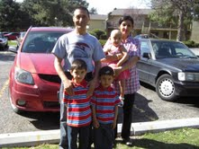
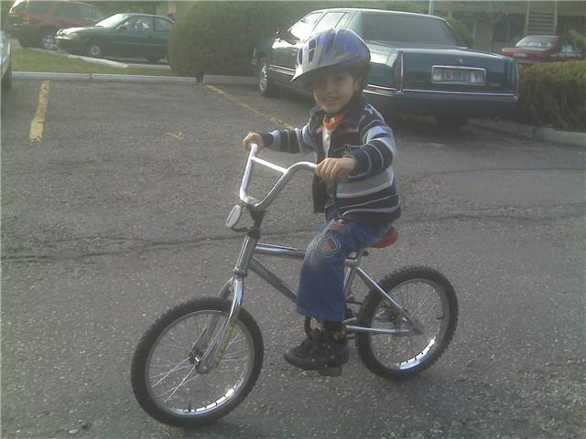
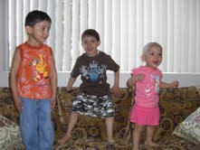
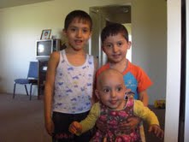
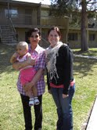
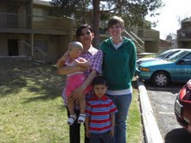
Civic Engagement in Action: Career Counseling From Theory to Application Gretchen Finley, Laura Mundy, Jeana Phillips
“I am more aware of the need to advocate for the refugee population, and will continue to do so through my counseling career.”
“I have learned how difficult it is for someone who is non-English speaking to navigate the current career development system in the U.S.”
Agency for New Americans:
Promoting Self-Sufficiency for Refugees
Purpose:
Aid newly settled refugees in the development of skills associated with finding and keeping a job.
Aid family in a culturally appropriate way, with sensitivity towards
life roles
social values
vocational goals
immediate needs
Activities:
Worked with a newly arrived refugee family from a career and multicultural counseling perspective.
Practiced and supported family with filling out job applications, interviewing skills, and identification of potential jobs
Practiced speaking and writing English
Assisted in creating connections in the community
Helped Family obtain knowledge of community resources
Researched cultural background of family to gain insight into potentially different worldviews
Provided support and encouragement to the family through the difficult process of adapting to a different life; one that may not have met previously held expectations or desires
Acknowledged own experiences and feelings through the process of assisting and supporting others.
“I have been touched by the resiliency exhibited by this family, and will remember them as my example when I encounter my own life difficulties.”
“When we were finally able to meet with our family, in their entirety, and begin our relationship, all previous expectations dissolved.”
“Currently, I am feeling very moved by our family and the relationships we have formed. I have been continuously humbled throughout this process as I witness the resiliency and openness of our family. Together, we have embarked on a journey and have learned much from each other. This family has been critical in assisting me on my own personal quest to understand myself and my place in the world.”
Learning Goals
To help a refugee family find work
To help a refugee family integrate into a new surrounding
To place career counseling theories into practice
To be involved in an active multicultural experience
Coun 507: Career Development and Vocational Counseling, Spring 2010
Instructor: Dr. Aida Hutz

