Slide 1
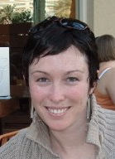
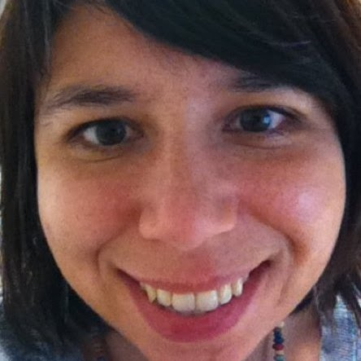
Exploring Mobile Reference
Amy Vecchione
Albertsons Library
Boise State University
@librarythinking
amyvecchione@boisestate.edu
Tobie Garrick
Boise Public Library
tgarrick@cityofboise.org
Notes:
Introduction
Amy
Tobie
What we do and where we work & passion for meeting mobile users needs
Insert poll here:
Which mobile technologies are you using for reference?

Slide 2
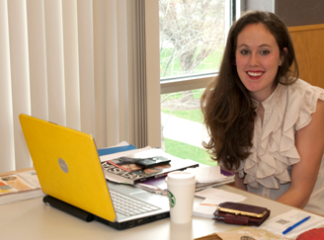
Users have mobile devices
They use them to get information
SMS Reference
Roving mobile reference
Mobile catalog and databases
Mobile games
Notes:
The spectrum of mobile users
Amy will talk about the user in the center – laptop, cell phone, ipod, etc.
Pew internet studies, and Garnet polls show that there is an increasing number of smartphone and mobile users in the US.
There are some ways that you can provide mobile reference at this time.
Our projects that we implemented at our library were born out of playing with the devices.
What happened with devices at Boise State.
What happened with devices – gadget garage – at BPL.
Learned how to use the devices, and came up with ways to interject into the mobile conversation.
Poll: Does your library provide mobile devices for your librarians and library staff to use?
---- talk about how playing with these devices led to the projects that we are presenting here
---- these were born out of the library purchasing equipment for librarians to use and start playing with

Slide 3
Albertsons Library
SMS Reference
Mobile
Device-Assisted Roving Reference
Reference Race: Mobile Game
Boise Public Library
Notes:
What we are going to talk about today.. Are the projects we implemented, and their pitfalls, barriers and successes.
Overview of all of the projects
Overview of projects we completed
Projects we have worked on: Roving Reference http://crln.acrl.org/content/72/4/217.full
SMS Reference
Mobile Game: Research Race
Boise State mobile reference
Game to acquaint users with reference stuff – Research Race
SMS reference
Mobile reference site – QR codes in the library that bring users to the mobile site, and e resources
- Mobile instruction
BPL mobile reference
- roving reference
Mobile site

Slide 4
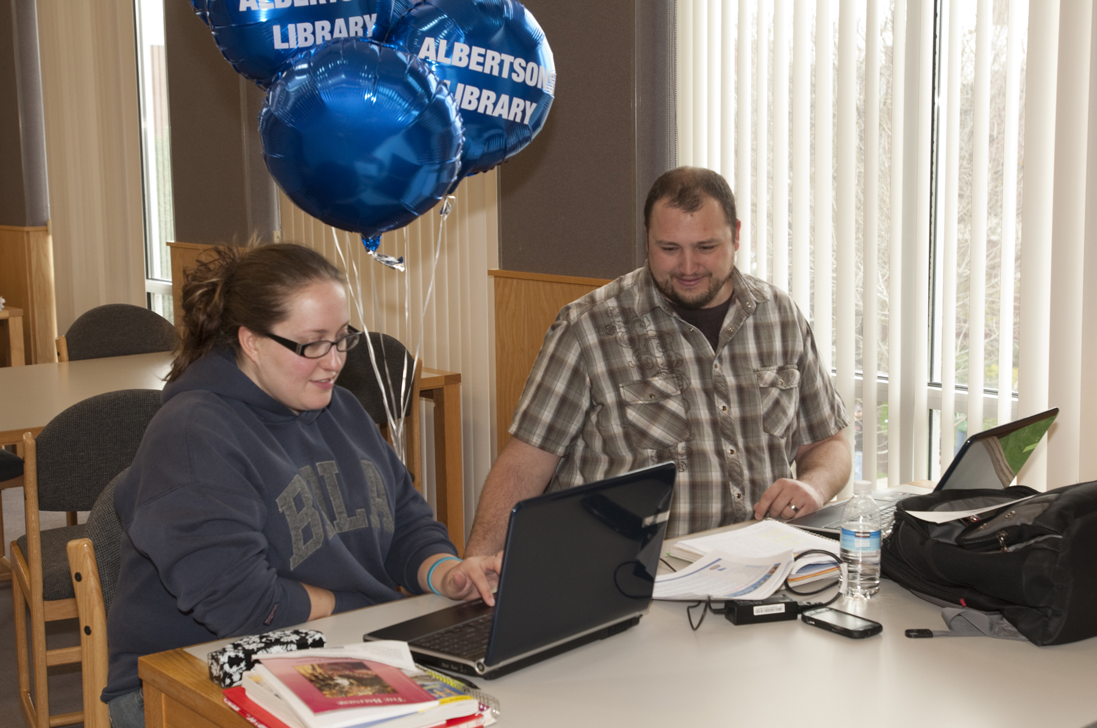
Notes:
Mobile Learning has been gaining a great deal of traction on the Boise State University campus.
Recently polled using Educause ECAR survey (add a little bit about that)
I’d like to start with some statistics:
93% of Boise State University students do not own a dedicated eReader
53.7% of students do own a mobile device
77.7% of those students use their mobile device to check information --- this is on top of the checking email, voice mail, making calls, and checking social networks.
80.9% of the students have a laptop computer

Slide 5
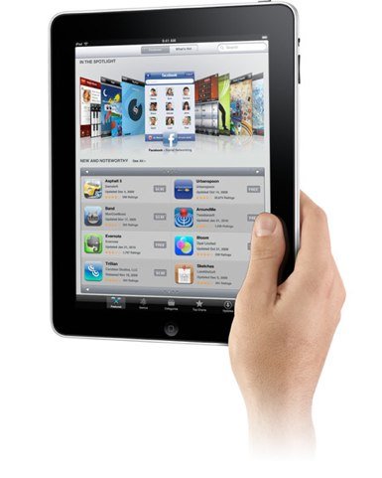
Roving Reference So much more than getting out of your seat So much more than technology
Image credits: Apple
http://www.technewsdaily.com/ipad-news-archive-0375/
Notes:
Catalog --- citrix
“Floor time” not “desk time”

Slide 6
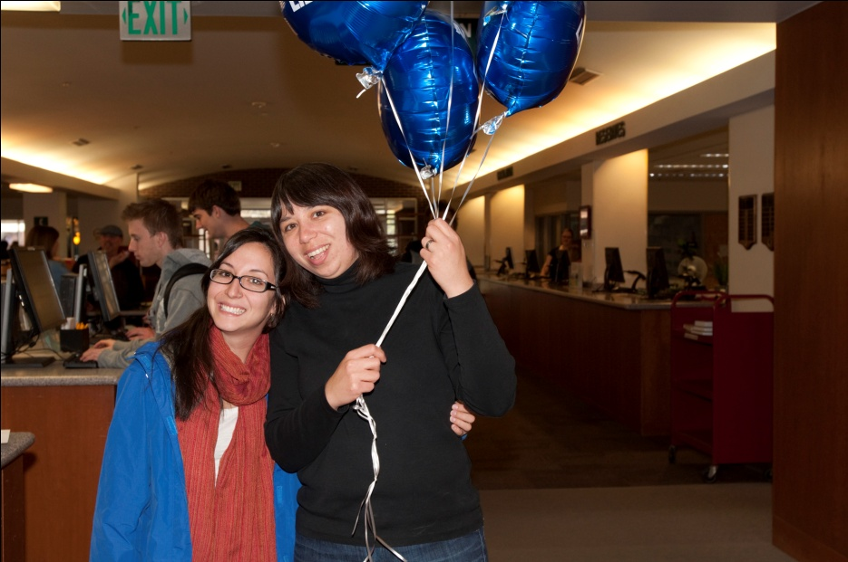
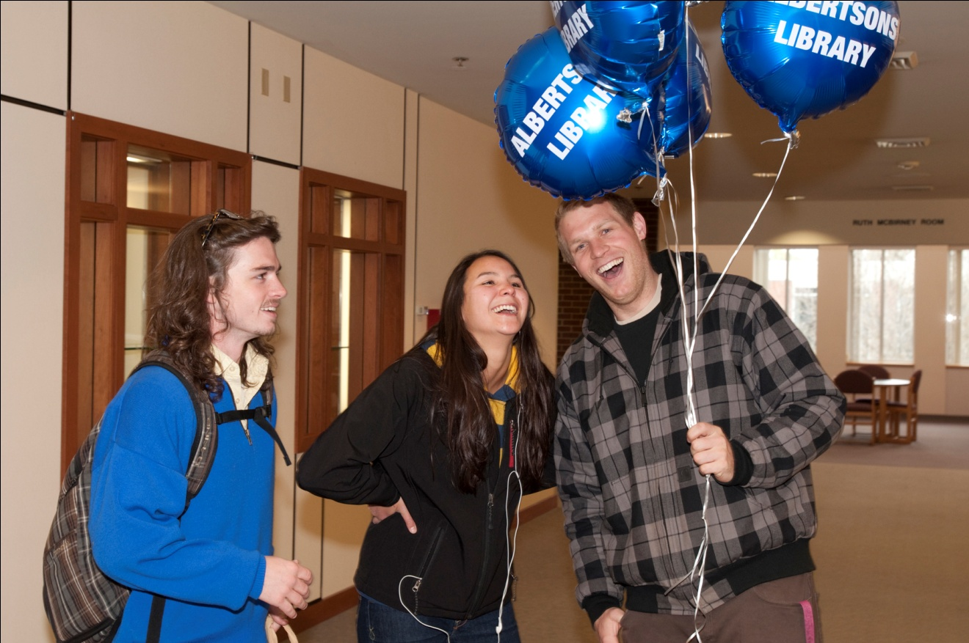
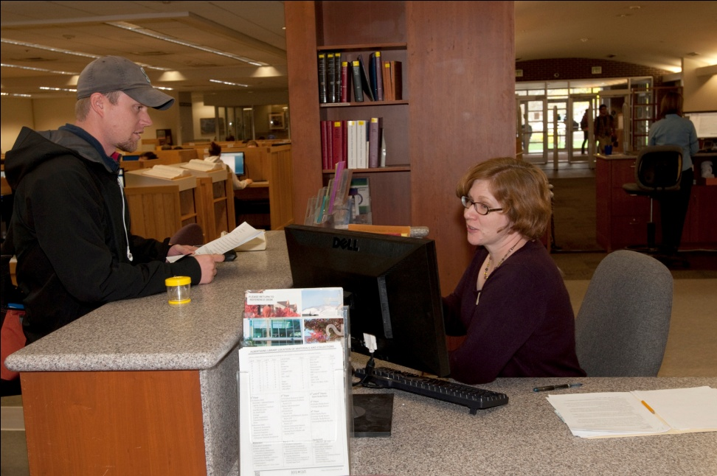
Notes:
Boise State experience with Roving:
Hard to type, need better equipment
Not all librarians want to rove because of philosophy of reference, that students expect someone to be at the desk at all times.
Experiments have involved keeping one librarian at the desk, while one roves. Since our desk is so busy, the roving librarian needs to keep the other librarian at the desk informed about where they are in case they need them to come back.
Students love the help
They appreciate the iPad
What we have done with the iPad:
Using the iPad in student orientations to answer questions – new student orientations
Answer questions on the fly
Use it to show them an image of their liaison librarian, depending on their major – ask the students about who they are, and where they are from, and what their major is, and connect them to a specific librarian
Using the iPad for roving reference in departments on campus for our liaison areas
Answer questions in hallways, on campus, while walking from building to building
Offering remote office hours at specific departments

Slide 7
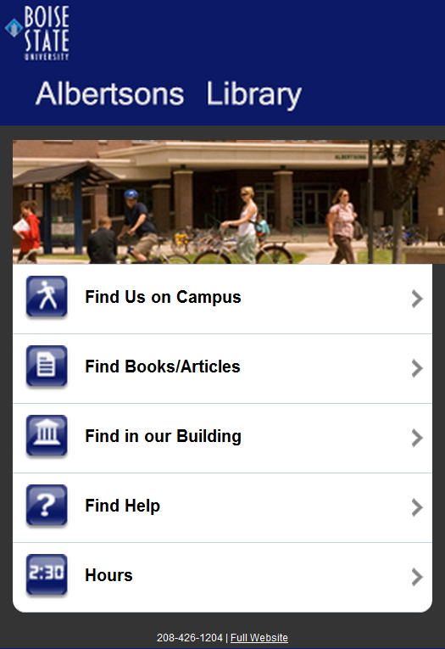
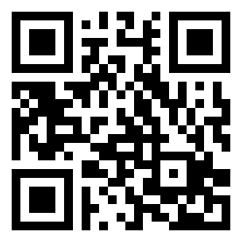
http://bit.ly/ptDja5
Notes:
The mobile site we have developed is simple and easy to use for providing reference services.
Qr codes in the reference area and outside the library when we are closed that direct users to the mobile site.

Slide 8
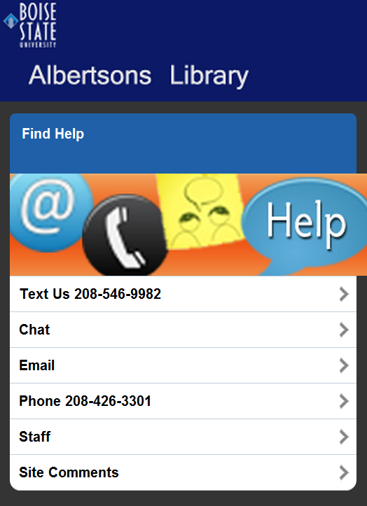
Notes:
Features ways to get help, including text. Offering SMS is key. At Ball State University 94% of the students there send and receive texts. At Boise State, % of students with mobile devices… of those % of them send and receive texts daily.

Slide 9
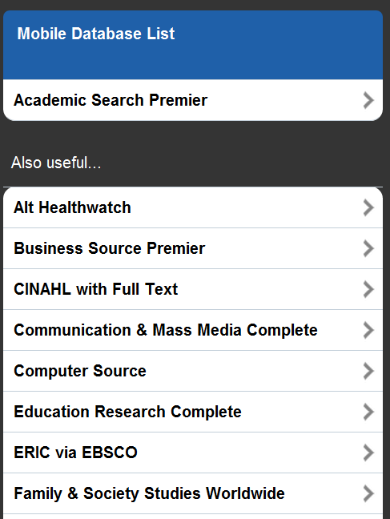
Notes:
The mobile database use is easier for reference instruction, it provides students with fewer options. Sun and wind analogy.

Slide 10
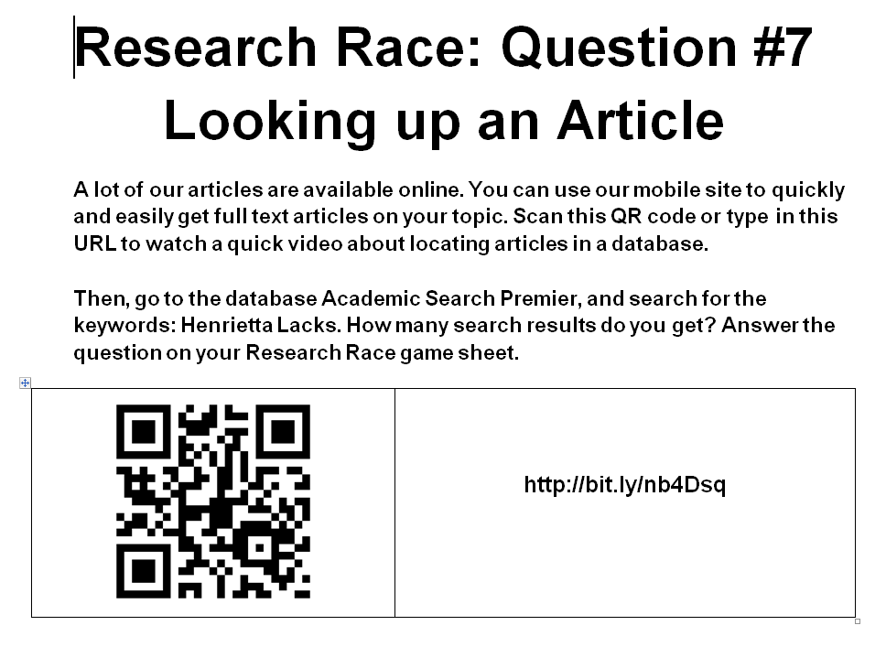
Mobile Games: To Become More Familiar with Reference
Notes:
Research race
Students check out iPads
Learn about what reference is at the library
Also, the tutorial that this links to features the mobile site

Slide 11
Technology Roadblocks
Chat Service Providers
Notes:
Barriers equipment - wifi hotspots, carriers/cases furniture mindset/philosophy of reference money - how to get it, need for each staff member to have own device staffing
vendors - chat/catalogue
other? -

Slide 12
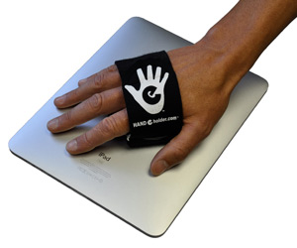
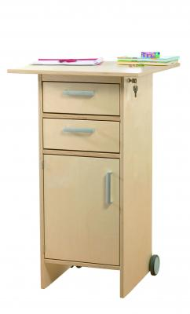
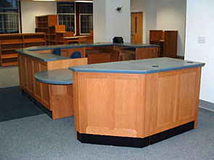
The Devil's in the Details
Reference Desk
Reference Desk
Or
Ipad image c/o http://www.maclife.com/dadsgrads

Slide 13
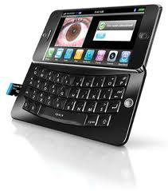
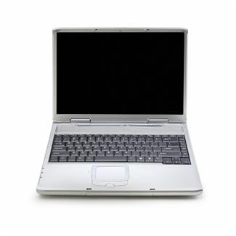
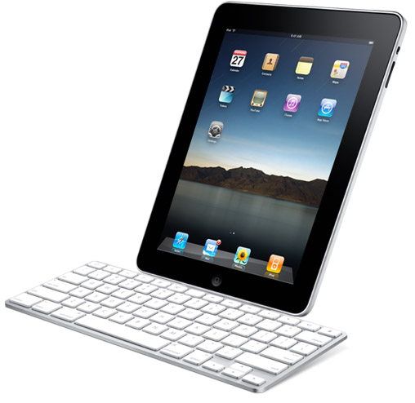
Or is it in our minds?
≠
Ipad image c/o http://www.crunchbase.com/product/ipad
Smart Phone Image c/o http://www.jpmstyle.com/gadget/perfect-smartphone-design-by-pcworld/
Notes:
Barriers and Improvements
Think about it in these terms, it is not the same thing
iPad is a mobile device, not a computer, so there are more things you can do and the barriers will disappear

Slide 14
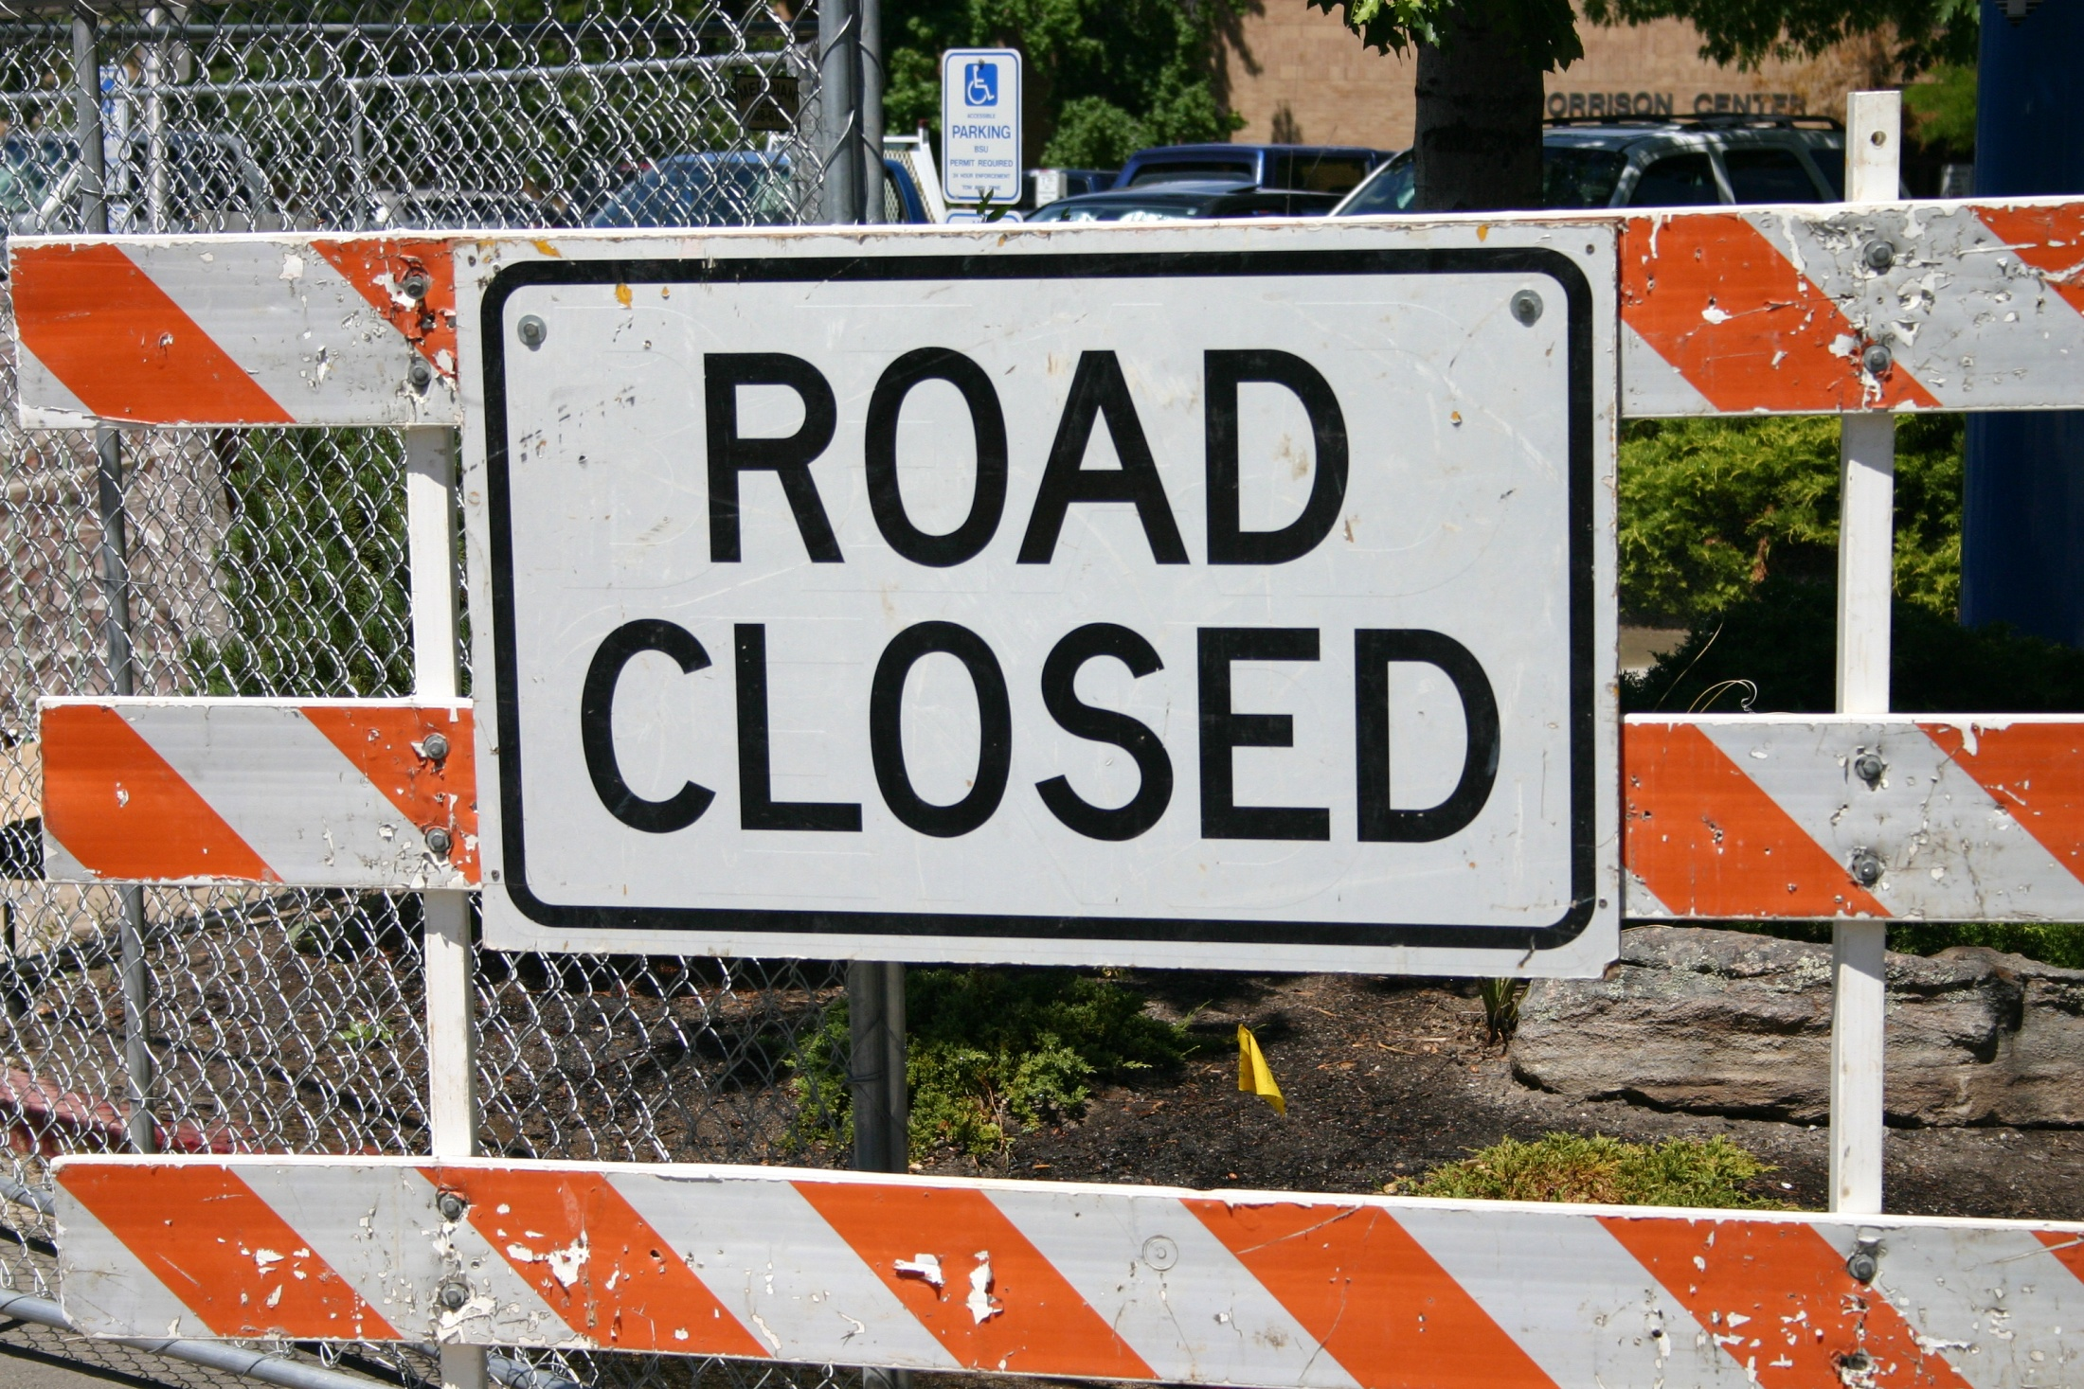
Notes:
Barriers slide
We want the poll here
After summarizing barriers, insert poll
poll attendees “ What barriers do you have to providing mobile reference services?” - Tobie will ask, Amy will monitor chat responses
how each library overcame them keyboard case pocket projector conversations about social intelligence/best practices grants, administrative buy-in and support WorldCat Local Embracing iPads for what they are - Examples of using the technology in ways that it’s perfect for - tammy uses opac instead of horizon. Jen uses ipads for readers advisory. some people cannot use the ipad in a way that is faster than they would use the computer, and that means the ipad is not a service improvement.

Slide 15
Notes:
Dreamworld:
[photo of image of clouds on iPad with clouds behind]
What we would like
Improved -what we would like - dream world -no errors -change expectation (tobie - ipad is not a computer) (computer visual w/line through it --> ipad) -how we can work with this framework --- need to use it in ways that it is functional
how mobile reference can be improved vendors are all mobile friendly
no errors
change expectation (tobie - ipad is not a computer)
how we can work with this framework --- need to use it in ways that it is functional
poll: what would you like to enhance mobile reference services in the future?
Amy will ask, Tobie will monitor chat responses
- floating reference desk with adjustable table top
- monetary accessibility for mobile devices and service
- everyone knows how to use mobile technology
- 24 hour reference service
- technology always works
- equipment always works
- unlimited money and time for mobile initatives
- every vendor has a mobile interface with full functionality
- your ideas?

Slide 16
Questions?
Amy Vecchione
Boise State University
amyvecchione@boisestate.edu
Tobie Garrick
Boise Public Library!
tgarrick@cityofboise.org

